Slide 1

122 From Recipe to Shopping List
Peter H. Chen

Slide 2
122 From Recipe to Shopping List
https://www.udemy.com/course/the-complete-guide-to-angular-2/learn/lecture/6656244#overview
Pass Ingredient from Recipe to Shopping List
Root
Header
Shopping List
Recipe Book
Shopping List Service
Recipe
Service
Shopping List
Recipe List
Shopping List Item
Recipe Item
Ingredient
Recipe Details
Recipe
Model
Component
Feature

Slide 3
122.1 Code

Slide 4
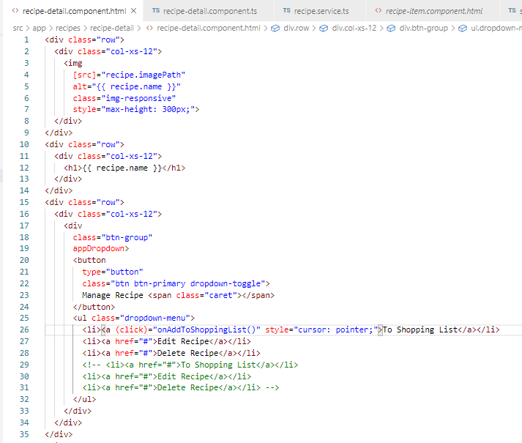
122.1 Code
https://www.udemy.com/course/the-complete-guide-to-angular-2/learn/lecture/6656244#overview
Code
Recipe-detail.component.html.

Slide 5
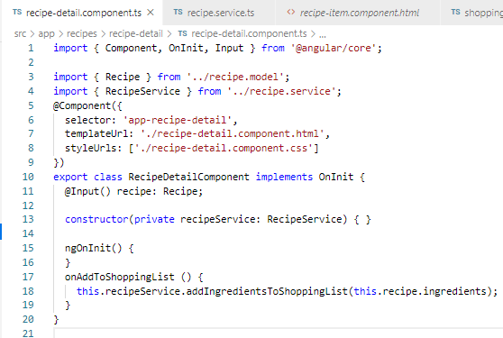
122.1 Code
https://www.udemy.com/course/the-complete-guide-to-angular-2/learn/lecture/6656244#overview
Code
Recipe-detail.component.ts.

Slide 6
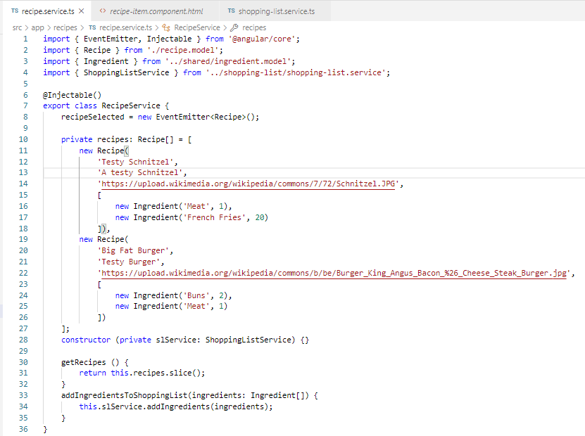
122.1 Code
https://www.udemy.com/course/the-complete-guide-to-angular-2/learn/lecture/6656244#overview
Code
Recipe.service.ts.

Slide 7
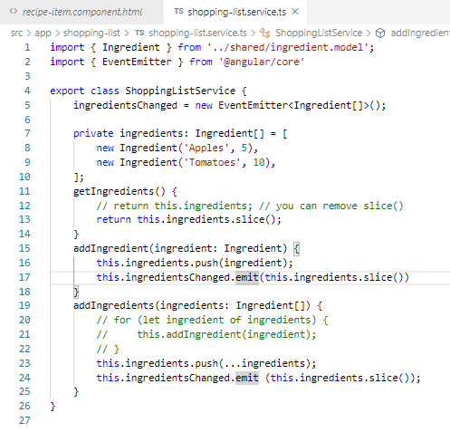
122.1 Code
https://www.udemy.com/course/the-complete-guide-to-angular-2/learn/lecture/6656244#overview
Code
Shopping-list.service.ts.

Slide 8
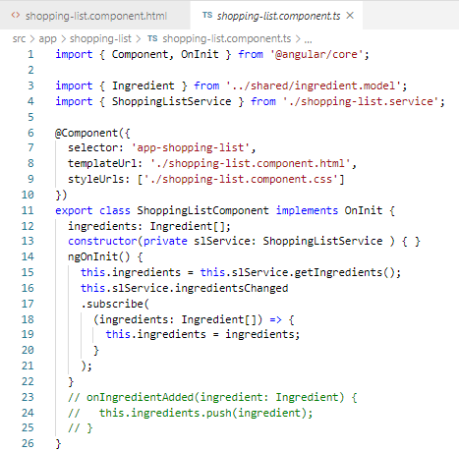
122.1 Code
https://www.udemy.com/course/the-complete-guide-to-angular-2/learn/lecture/6656244#overview
Code
Shopping-list.component.ts.

Slide 9
122.2 Verify

Slide 10
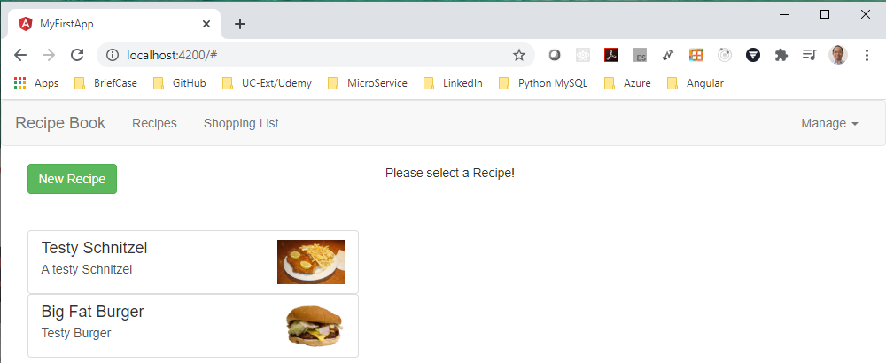
122.2 Verify
https://www.udemy.com/course/the-complete-guide-to-angular-2/learn/lecture/6656244#overview
Verify:

Slide 11
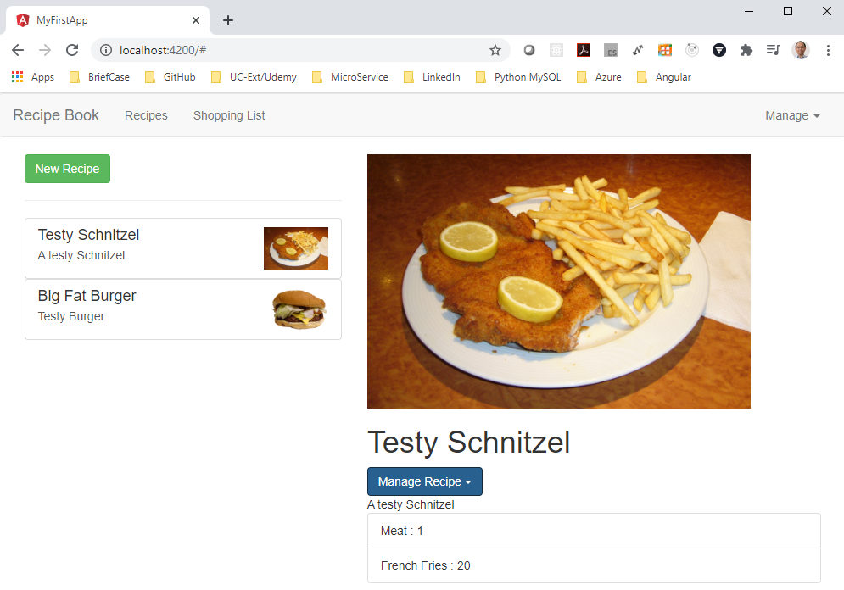
122.2 Verify
https://www.udemy.com/course/the-complete-guide-to-angular-2/learn/lecture/6656244#overview
Verify:

Slide 12
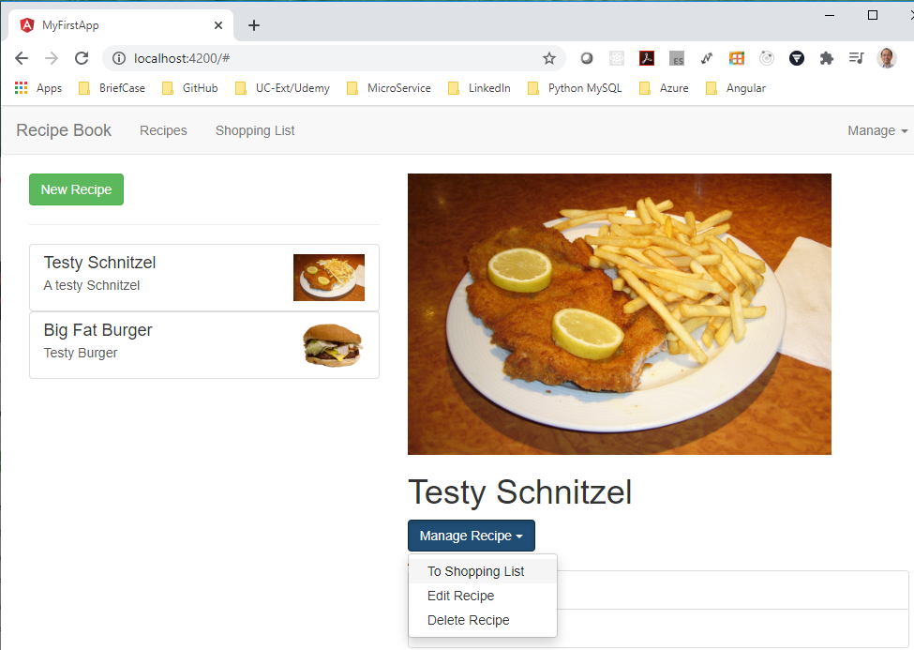
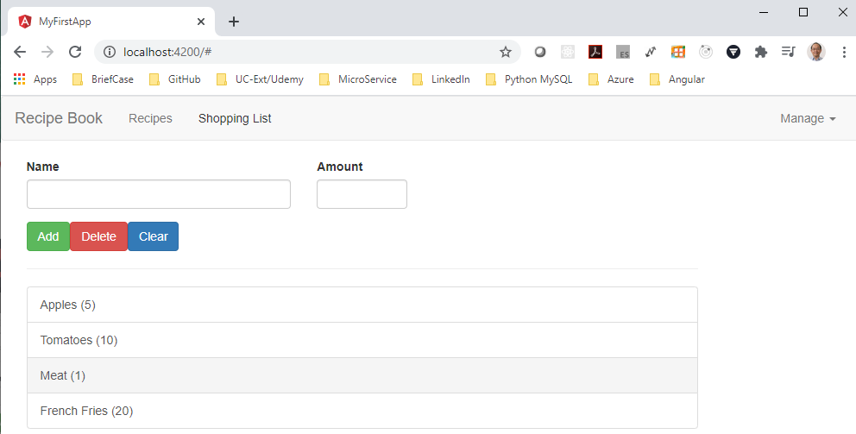
122.2 Verify
https://www.udemy.com/course/the-complete-guide-to-angular-2/learn/lecture/6656244#overview
Verify:

Slide 13
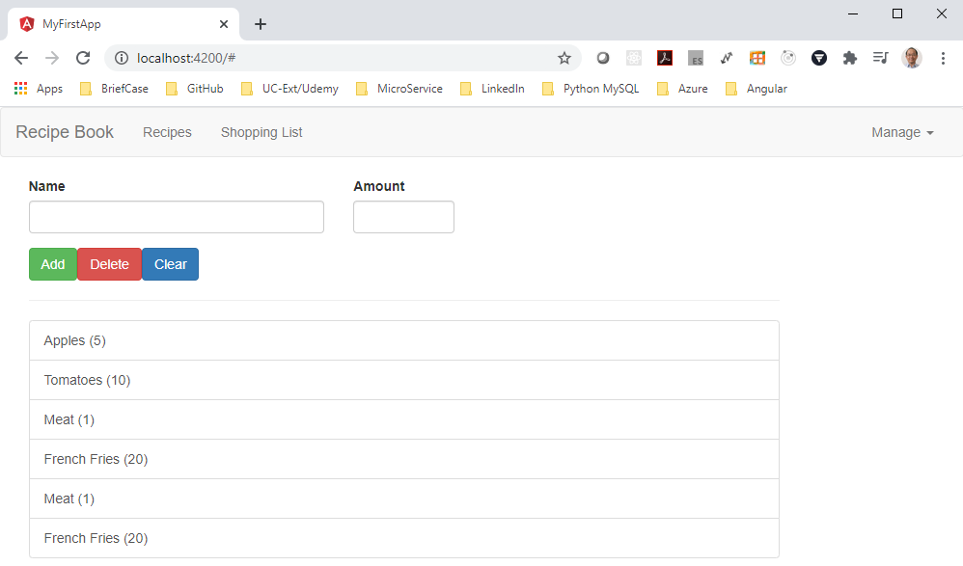
122.2 Verify
https://www.udemy.com/course/the-complete-guide-to-angular-2/learn/lecture/6656244#overview
Verify:

Slide 14
End of Chapter

