Slide 1

2 Basic
Peter H. Chen

Slide 2
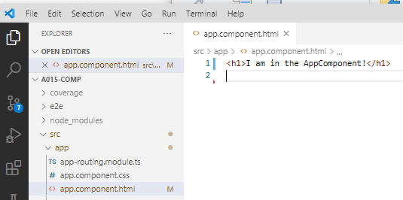
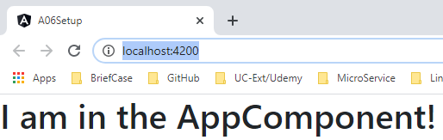
2 Basic
https://www.udemy.com/course/the-complete-guide-to-angular-2/learn/lecture/6655700#overview
Angular App Reload and Restart
In app.component.html:
> <h1> I am in the AppComponent!</h1>
> ng serve --open

Slide 3
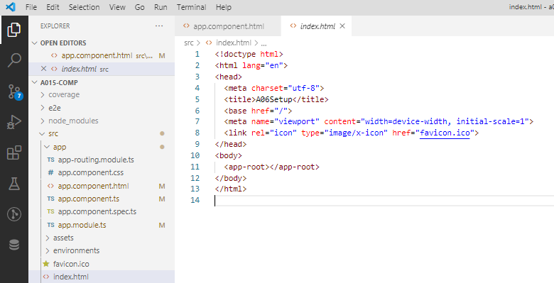
2 Basic
https://www.udemy.com/course/the-complete-guide-to-angular-2/learn/lecture/6655700#overview
Single Page Application
Angular is a SPA (Single Page Application).
The index.html is the Single Page Application.

Slide 4
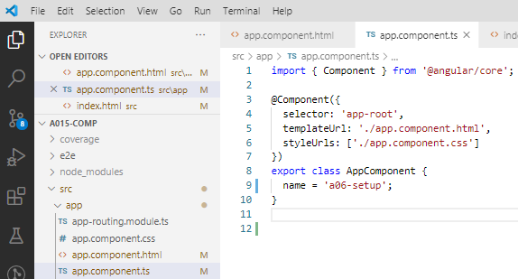
2 Basic
https://www.udemy.com/course/the-complete-guide-to-angular-2/learn/lecture/6655700#overview
App.component.ts
Now, look at the applcompoent.ts file.
Here, we can see @Component decorator. We have the selector property which assign a string ‘app-root’.
This app-root is same text as <app-root> in the index.html.
The component is display in the app.component.html.

Slide 5
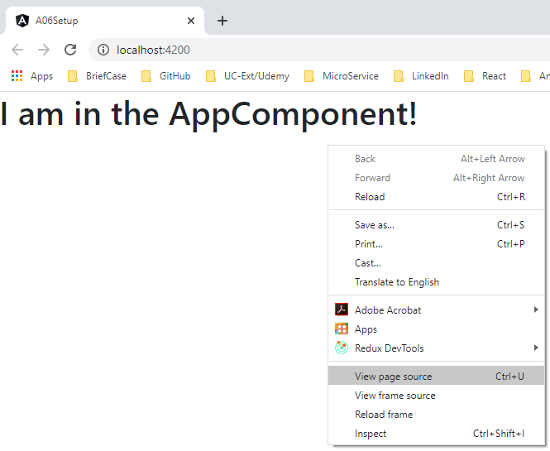
2 Basic
https://www.udemy.com/course/the-complete-guide-to-angular-2/learn/lecture/6655700#overview
index,.html, app.component.ts, and app.component.html
Who inject the relation between the index.html, app.component.ts, and app.component.html?
> RMB: View page source

Slide 6
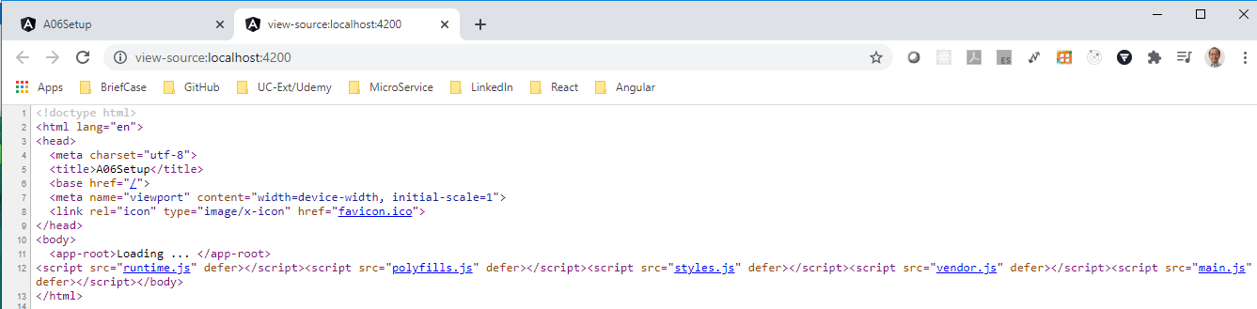
2 Basic
https://www.udemy.com/course/the-complete-guide-to-angular-2/learn/lecture/6655700#overview
index,.html, app.component.ts, and app.component.html
This is the place that Angular load information from index.html, app.component.ts, app.component.html, and make the display.
This file will create a bundle of JavaScript, a little bit confusion but very convenient functionality for us.
So, this script file is very useful and helpful for us. It is the first code executed.
Keep in mind, this code is written in main.js file. That is why we called it “main.js”.

Slide 7
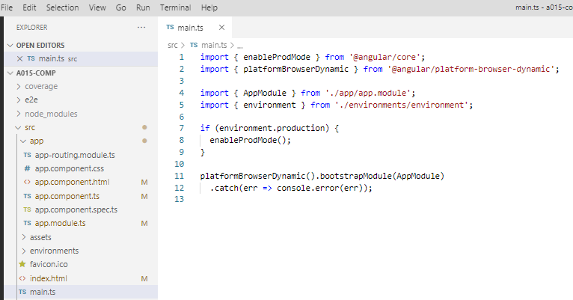
2 Basic
https://www.udemy.com/course/the-complete-guide-to-angular-2/learn/lecture/6655700#overview
main.js
Let’s take a closer look at main.js. Here we see a couple of imports.
Here, we check we are in production mode or not. We can turn off some warining messages.
Most importantly here is the last lines (see lines 11-12). These lines bootstraps the Angular application by passing an application appModel to this method and appModule refers to the app.module.ts file.

Slide 8
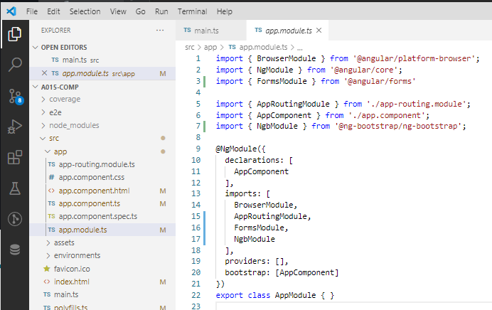
2 Basic
https://www.udemy.com/course/the-complete-guide-to-angular-2/learn/lecture/6655700#overview
app.module.js
Now, let’s look at the app.module.js file.
We see the bootstrap array which include all the components. Those components are known to Angular to analyze the index.html and associated components.

Slide 9
2 Basic
https://www.udemy.com/course/the-complete-guide-to-angular-2/learn/lecture/6655700#overview
Angular main and Associated Components
So Angular get started, the main.js file gets started, then bootstrap the an Angular application, and we pass the AppModule as argument.
In this module, we tell Angular, there is the AppComponent which you know when you try to start and Angular.

Slide 10
2.1 Angular Start Sequence

Slide 11
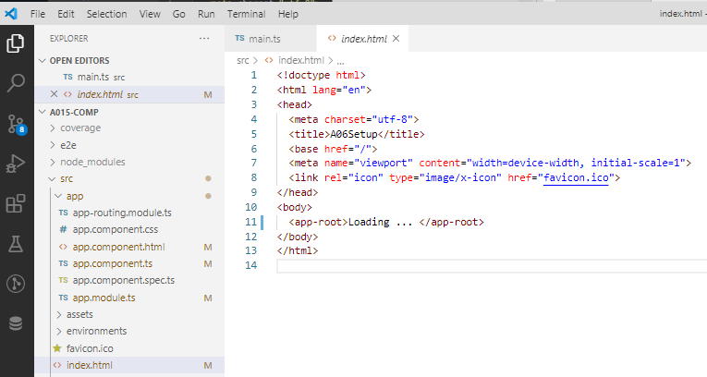
2.1 Angular Start Sequence
https://www.udemy.com/course/the-complete-guide-to-angular-2/learn/lecture/6655700#overview
Angular start sequence: index.html
Angular will start to analyze with the start of <app-root> in index.html.

Slide 12
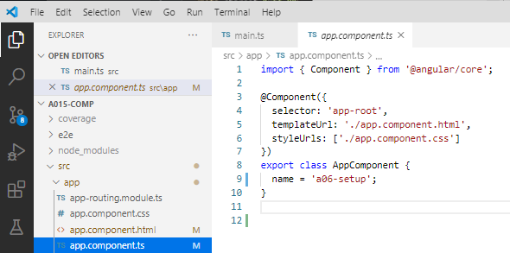
2.1 Angular Start Sequence
https://www.udemy.com/course/the-complete-guide-to-angular-2/learn/lecture/6655700#overview
Angular start sequence: app.module.ts
Then, find the selector app-root in app.module.ts.

Slide 13
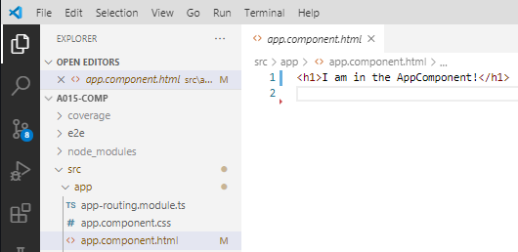
2.1 Angular Start Sequence
https://www.udemy.com/course/the-complete-guide-to-angular-2/learn/lecture/6655700#overview
Angular start sequence: app.module.html
Then, the app.module.html is what we see.

Slide 14
End of Chapter

