Slide 1

16 New Component
Peter H. Chen

Slide 2
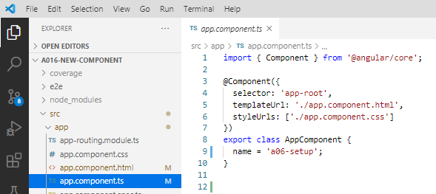
16 New Component
https://www.udemy.com/course/the-complete-guide-to-angular-2/learn/lecture/6655710#overview
New Component
Let’s start at AppComponent defined in app.component.ts.

Slide 3
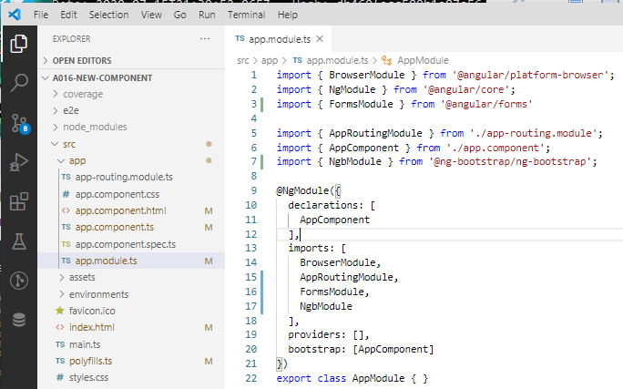
16 New Component
https://www.udemy.com/course/the-complete-guide-to-angular-2/learn/lecture/6655710#overview
New Component
In the other hand, we have the bootstrap array with AppComponent defined in app.module.ts.
The bootstrap arrays tell Angular to bootstrap these components as the root components.

Slide 4
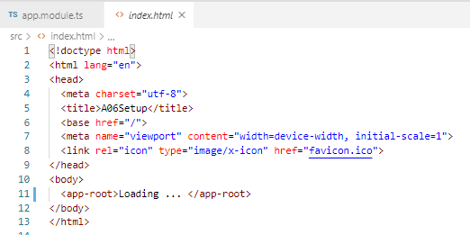
16 New Component
https://www.udemy.com/course/the-complete-guide-to-angular-2/learn/lecture/6655710#overview
New Component
For other components, we are not add to index.html.
The selector will not added here.
We now, want to add the server component.

Slide 5
16.1 Add Server Component

Slide 6
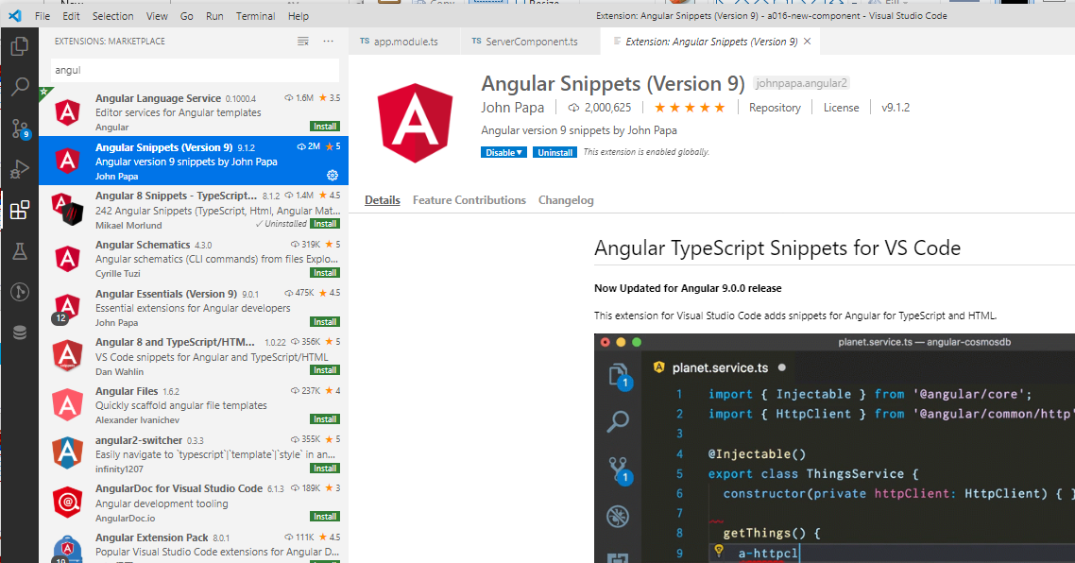
16.1 Add Server Component
https://www.udemy.com/course/the-complete-guide-to-angular-2/learn/lecture/6655710#overview
Add Server Component
Install the Angular-9 snippet for VS code.
This will help you to generate the template for Angular component template.

Slide 7
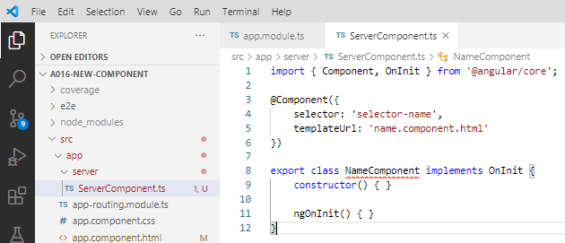
16.1 Add Server Component
https://www.udemy.com/course/the-complete-guide-to-angular-2/learn/lecture/6655710#overview
Add Server Component
We now want to add the server component.
New folder and file: app\server\ServerComponent.ts
Type “a-c” (for Angular Component) by Angular-9 snippet to generate Angular Component.

Slide 8
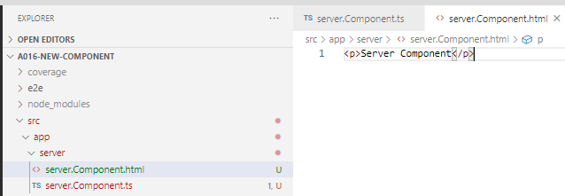
16.1 Add Server Component
https://www.udemy.com/course/the-complete-guide-to-angular-2/learn/lecture/6655710#overview
Add Server Component
Generate “server/server.Component.html”
Type “<p>Server Component</p>”.

Slide 9
16.1 Add Server Component
https://www.udemy.com/course/the-complete-guide-to-angular-2/learn/lecture/6655710#overview
Add Server Component
Inside the @Component is the meta data.
We have to fill out the selector and templateUrl.
The selector is a unique name, normally started with app-, “app-server” in the HTML file.
The templateUrl is “app-server.html”.

Slide 10
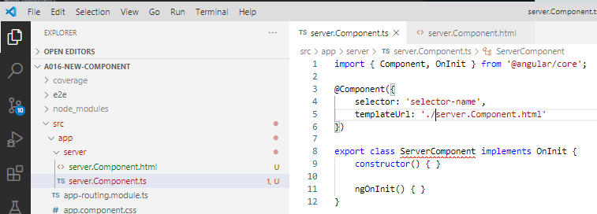
16.1 Add Server Component
https://www.udemy.com/course/the-complete-guide-to-angular-2/learn/lecture/6655710#overview
Add Server Component
Rename “export class ServerComponent”
We add the tmeplate.Url: “server.Component.html”

Slide 11
End of Chapter

