Slide 1

17 Component Module
Peter H. Chen

Slide 2
17 Component Module
https://www.udemy.com/course/the-complete-guide-to-angular-2/learn/lecture/6655710#overview
Component Module
Angular uses components to build web pages and use modules to bundle different pieces, for example, for different components of your app into packages.
We will use one app module for multiple components. Later, we add more modules.

Slide 3
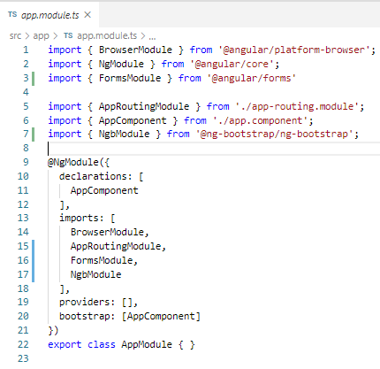
17 Component Module
https://www.udemy.com/course/the-complete-guide-to-angular-2/learn/lecture/6655710#overview
Component Module
Here, we have AppModule with empty {}. https://stackoverflow.com/questions/44316561/why-angular-export-empty-class-in-app-modules-ts
The decorator @NgModule is passed into AppModule {}.

Slide 4
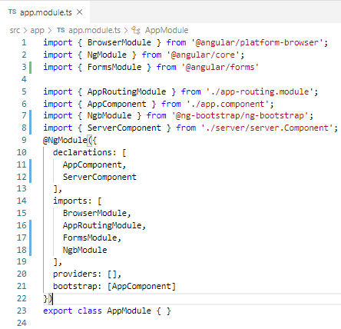
17 Component Module
https://www.udemy.com/course/the-complete-guide-to-angular-2/learn/lecture/6655710#overview
Component Module
We still need to add the component to declaration of @NgModule.

Slide 5
17 Component Module
https://www.udemy.com/course/the-complete-guide-to-angular-2/learn/lecture/6655710#overview
Component Module
We see four properties passed to @NgModule: declaration,imports, providers, and bootstrap.
We already look at bootstrap. This tells Angular which components can be shared. Which component can be recognized by the index.html.
We will not touch the bootstrap in app.module.ts.

Slide 6
17.1 Add Server Component

Slide 7
17.1 Add Server Component
https://www.udemy.com/course/the-complete-guide-to-angular-2/learn/lecture/6655710#overview
Add Server Component
Install the Angular-9 snippet for VS code.
This will help you to generate the template for Angular component template.

Slide 8
End of Chapter

