Slide 1

18 Custom Component
Peter H. Chen

Slide 2
18 Component Module
https://www.udemy.com/course/the-complete-guide-to-angular-2/learn/lecture/6655710#overview
Custom Component
Here, we add @Component of server component by selector <app-server> and templateUrl.

Slide 3
18.1 Add Server Component

Slide 4
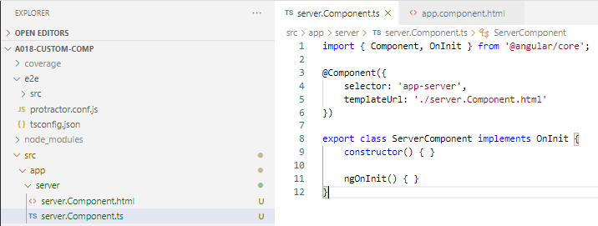
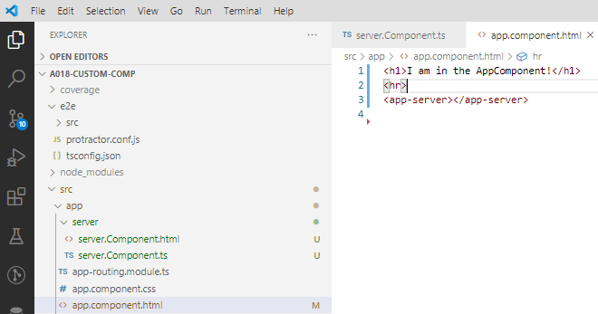
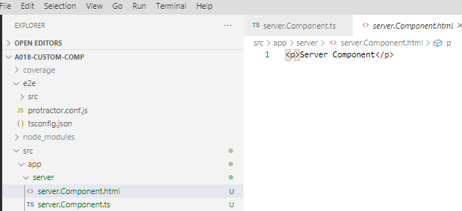
18 Component Module
https://www.udemy.com/course/the-complete-guide-to-angular-2/learn/lecture/6655710#overview
Custom Component
In server.Component.ts, we add selector: ‘app-server’ and templateUrl: ‘./server.Component.html’.
In the app.Componeent.html, we add <app-server>

Slide 5
18.2 Verify

Slide 6
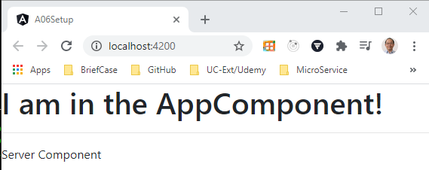
18.2 Verify
https://www.udemy.com/course/the-complete-guide-to-angular-2/learn/lecture/6655732#overview
Verify

Slide 7
End of Chapter

