Slide 1

19 CLI Component
Peter H. Chen

Slide 2
19 CLI Component
https://www.udemy.com/course/the-complete-guide-to-angular-2/learn/lecture/6655742#overview
CLI Component
We created custom component manually.
We create the component by CLI. We can create the component by the CLI command window.

Slide 3
19.1 CLI Generate Component

Slide 4
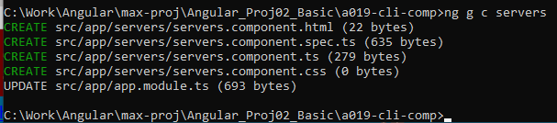
19.1 CLI Generate Component
https://www.udemy.com/course/the-complete-guide-to-angular-2/learn/lecture/6655742#overview
CLI Generate Component
> ng generate component servers
Or
> ng g c servers

Slide 5
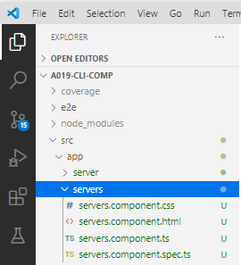
19.1 CLI Generate Component
https://www.udemy.com/course/the-complete-guide-to-angular-2/learn/lecture/6655742#overview
CLI Generate Component
Servers:
> servers.Compoment.html, css, ts, and spec.ts.

Slide 6
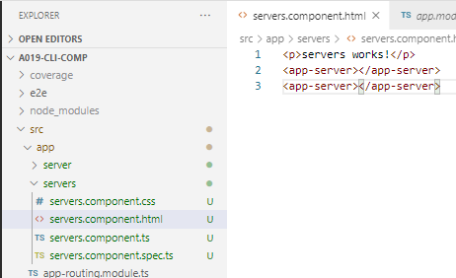
19.1 CLI Generate Component
https://www.udemy.com/course/the-complete-guide-to-angular-2/learn/lecture/6655742#overview
CLI Generate Component
In Servers.compoment.html, add two <app-server>.

Slide 7
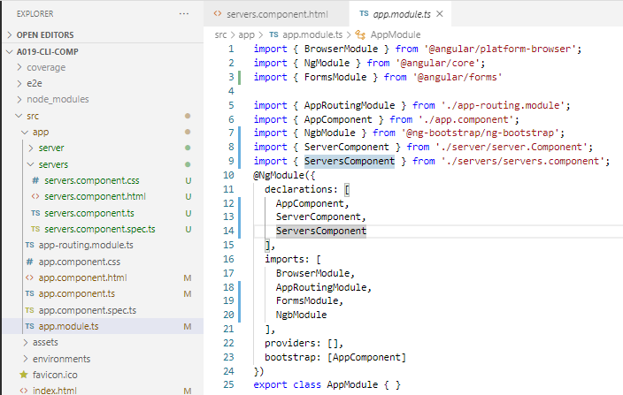
19.1 CLI Generate Component
https://www.udemy.com/course/the-complete-guide-to-angular-2/learn/lecture/6655742#overview
CLI Generate Component
In app.module.ts, add module “ServersComponent”.

Slide 8
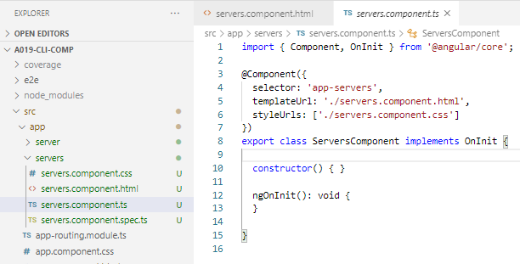
19.1 CLI Generate Component
https://www.udemy.com/course/the-complete-guide-to-angular-2/learn/lecture/6655742#overview
CLI Generate Component
In servers.component.ts, add selector: ‘app-servers’

Slide 9
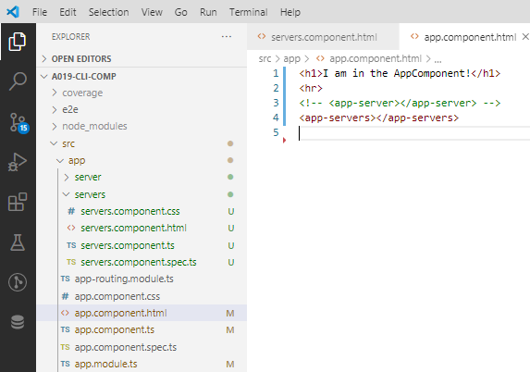
19.1 CLI Generate Component
https://www.udemy.com/course/the-complete-guide-to-angular-2/learn/lecture/6655742#overview
CLI Generate Component
In app.component.html, add ‘<app-servers>’

Slide 10
19.2 Verify

Slide 11
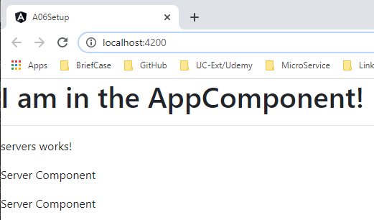
19.2 Verify
https://www.udemy.com/course/the-complete-guide-to-angular-2/learn/lecture/6655732#overview
Verify
> ng serve --open
app.component.html <app-servers>
servers.component.html
<app-server>
<app-server>
server.component.html
<p>Server Component</p>

Slide 12
End of Chapter

