Slide 1

20 Component Template
Peter H. Chen

Slide 2
20 Component Template
https://www.udemy.com/course/the-complete-guide-to-angular-2/learn/lecture/6655748#overview
Component Template
Instead of use templateUrl, we use Template instead.

Slide 3
20.1 Template Code

Slide 4
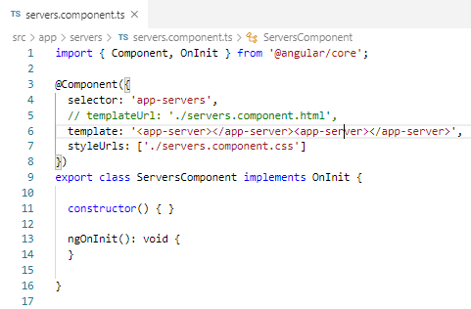
20.1 Template Code
https://www.udemy.com/course/the-complete-guide-to-angular-2/learn/lecture/6655732#overview
Template Code
Change templateUrl into template.

Slide 5
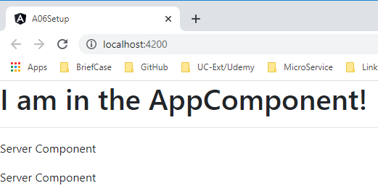
20.1 Verify
https://www.udemy.com/course/the-complete-guide-to-angular-2/learn/lecture/6655732#overview
Verify
> ng serve --open

Slide 6
20.2 Multiple Lines

Slide 7
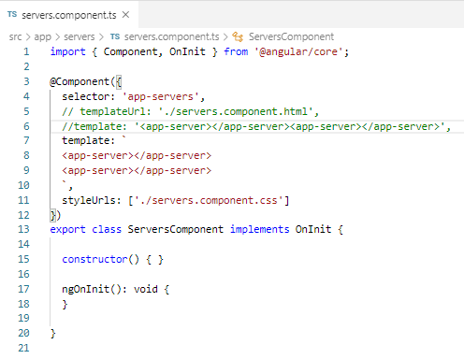
20.2 Multiple Lines
https://www.udemy.com/course/the-complete-guide-to-angular-2/learn/lecture/6655732#overview
Template Code
Change to multiple lines with backstroke (`). `… `

Slide 8
20.2 Verify
https://www.udemy.com/course/the-complete-guide-to-angular-2/learn/lecture/6655732#overview
Verify
> ng serve --open

Slide 9
End of Chapter

