Slide 1

21 Component Style
Peter H. Chen

Slide 2
21 Component Style
https://www.udemy.com/course/the-complete-guide-to-angular-2/learn/lecture/6655760#overview
Component Style

Slide 3
21.1 Component Style

Slide 4
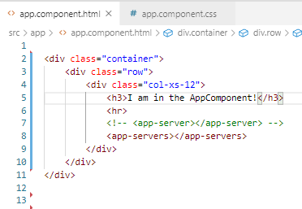
21.1 Component Style
https://www.udemy.com/course/the-complete-guide-to-angular-2/learn/lecture/6655732#overview
Template Code
Define div

Slide 5
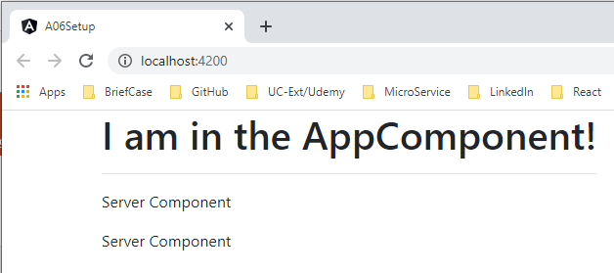
21.1 Verify
https://www.udemy.com/course/the-complete-guide-to-angular-2/learn/lecture/6655732#overview
Verify
> ng serve --open

Slide 6
21.2 Define CSS

Slide 7
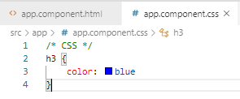
21.2 Define CSS
https://www.udemy.com/course/the-complete-guide-to-angular-2/learn/lecture/6655732#overview
Define CSS

Slide 8
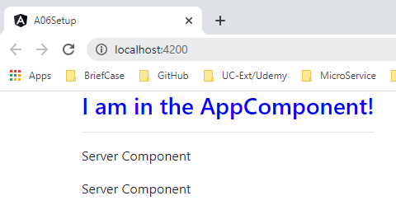
21.2 Verify
https://www.udemy.com/course/the-complete-guide-to-angular-2/learn/lecture/6655732#overview
Verify
> ng serve --open

Slide 9
21.3 Style CSS

Slide 10
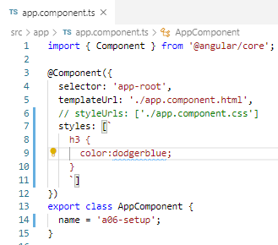
21.3 Style CSS
https://www.udemy.com/course/the-complete-guide-to-angular-2/learn/lecture/6655732#overview
Style CSS

Slide 11
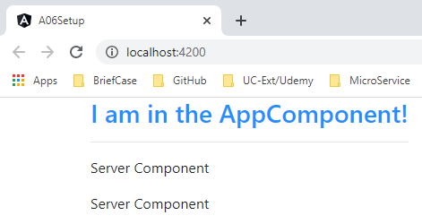
21.3 Verify
https://www.udemy.com/course/the-complete-guide-to-angular-2/learn/lecture/6655732#overview
Verify
> ng serve --open

Slide 12
End of Chapter

