Slide 1

22 Selector
Peter H. Chen

Slide 2
22 Selector
https://www.udemy.com/course/the-complete-guide-to-angular-2/learn/lecture/6655772#overview
Selector
The selector is a property inside the angular component which identifies the directive in a template and triggers instantiation of the directive.
The selector has to be unique so that it doesn't override already existing element or component available by a number of third-party packages.

Slide 3
22.1 Selector

Slide 4
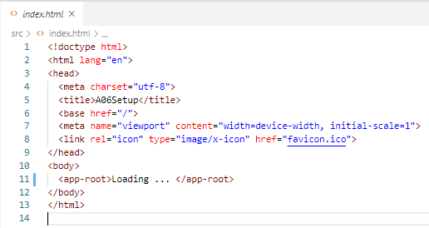
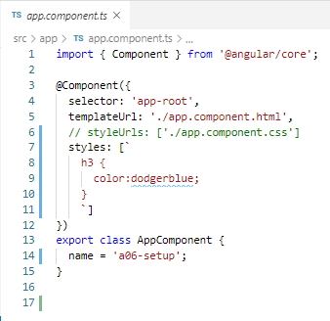
22.1 Selector
https://www.udemy.com/course/the-complete-guide-to-angular-2/learn/lecture/6655732#overview
Angular selector
HTML element

Slide 5
End of Chapter

