Slide 1

23 Assignment 01
Peter H. Chen

Slide 2
23 Assignment 01
https://www.udemy.com/course/the-complete-guide-to-angular-2/learn/lecture/6655772#overview
Assignment
Create two new Components (manually or with CLI): WarningAlert and SuccessAlert
Output them beneath each other in the AppComponent
Output a warning or success message in the Components
Style the Components appropriately (maybe some red/ green text?)
Note:
Use external or internal templates and styles!
Feel free to create more components, nest them into each other or play around withe different types of selectors!

Slide 3
23 Assignment 01
https://www.udemy.com/course/the-complete-guide-to-angular-2/learn/lecture/6655772#overview
Assignment
Older version of CLI in local directory.
https://stackoverflow.com/questions/59447679/an-unhandled-exception-occurred-job-name-getprojectmetadata-does-not-exist
> npm i @angular-devkit/build-angular
> npm i @angular-devkit/build-angular@0.803.25

Slide 4
23.1 Code

Slide 5
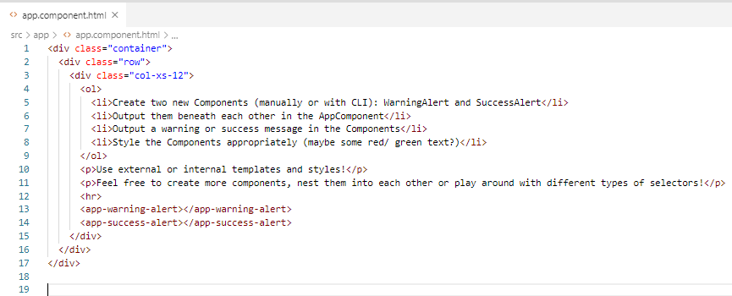
23.1 Code
https://www.udemy.com/course/the-complete-guide-to-angular-2/learn/lecture/12982432#overview
Code: app.component.html

Slide 6
23.2 Create Two Components

Slide 7
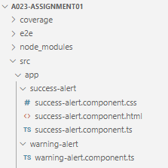
23.2 Create Two Folders
https://www.udemy.com/course/the-complete-guide-to-angular-2/learn/lecture/12982432#overview
Under the app folder, creates success-alert and warning-alert folders.

Slide 8
23.3 Create Warning Component

Slide 9
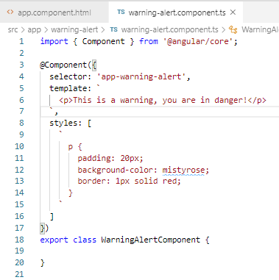
23.3 Create Warning Component
https://www.udemy.com/course/the-complete-guide-to-angular-2/learn/lecture/12982432#overview
In the warning-alert folder, create warning-alert.component.ts.

Slide 10
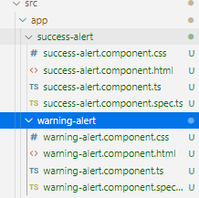
23.3 Create Warning Component
https://www.udemy.com/course/the-complete-guide-to-angular-2/learn/lecture/12982432#overview
In the project folder, create the successful component
> ng g c success-alert

Slide 11
23.5 Add Elements to HTML

Slide 12
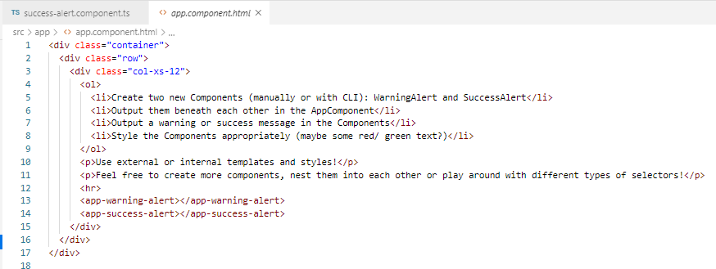
23.5 Add Elements to HTML
https://www.udemy.com/course/the-complete-guide-to-angular-2/learn/lecture/12982432#overview
In the app.component.html,
Add elements <app-warning-alter> and <app-success-alert> for selector.

Slide 13
23.6 Add Component in Module

Slide 14
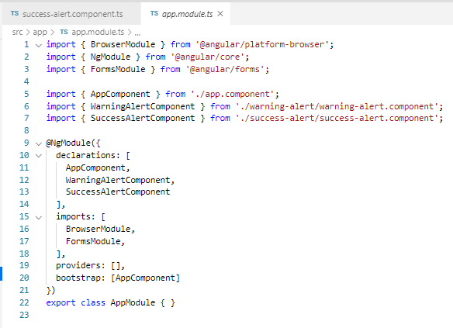
23.6 Add Component in Module
https://www.udemy.com/course/the-complete-guide-to-angular-2/learn/lecture/12982432#overview
It still not working.
Look at the error message. We have to add the Components in the app.modules.ts.

Slide 15
23.7 Verify

Slide 16
23.7 Verify
https://www.udemy.com/course/the-complete-guide-to-angular-2/learn/lecture/12982432#overview
> npm install
> npm audit fix
Older version of CLI in local directory.
https://stackoverflow.com/questions/59447679/an-unhandled-exception-occurred-job-name-getprojectmetadata-does-not-exist
> npm i @angular-devkit/build-angular
> npm i @angular-devkit/build-angular@0.803.25

Slide 17
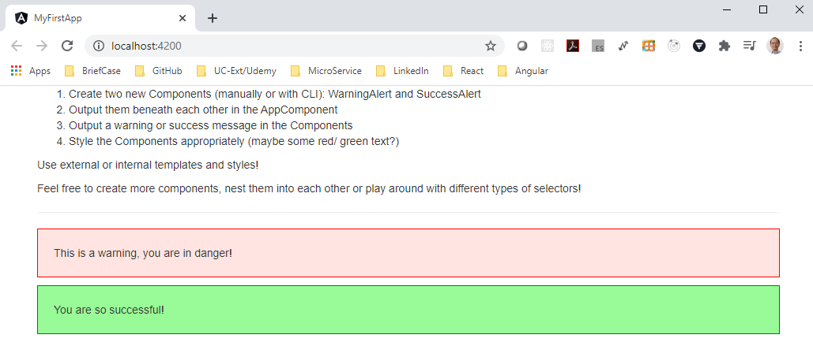
23.7 Verify
https://www.udemy.com/course/the-complete-guide-to-angular-2/learn/lecture/12982432#overview
> ng serve --open

Slide 18
End of Chapter

