Slide 1

24 Data Binding
Peter H. Chen

Slide 2
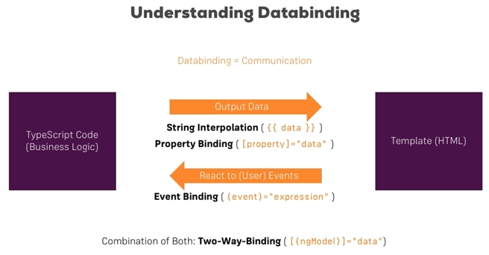
24 Data Binding
https://www.udemy.com/course/the-complete-guide-to-angular-2/learn/lecture/6655784#overview
Data Binding

Slide 3
End of Chapter

