Slide 1

25 String Interpolation
Peter H. Chen

Slide 2
25 String Interpolation
https://www.udemy.com/course/the-complete-guide-to-angular-2/learn/lecture/6655804#overview
String Interpolation

Slide 3
25.1 String Interpolation

Slide 4

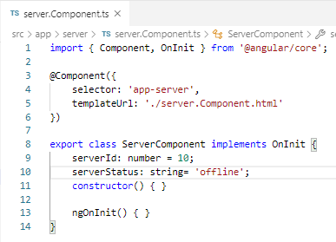
25.1 String Interpolation
https://www.udemy.com/course/the-complete-guide-to-angular-2/learn/lecture/6655804#overview
String Interpolation
> server.Component.html
> server.Component.ts

Slide 5
25.2 Verify

Slide 6
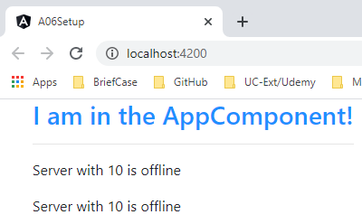
25.2 Verify
https://www.udemy.com/course/the-complete-guide-to-angular-2/learn/lecture/6655804#overview
Verify

Slide 7
End of Chapter

