Slide 1

26 Property Binding
Peter H. Chen

Slide 2
26 Property Binding
https://www.udemy.com/course/the-complete-guide-to-angular-2/learn/lecture/6655806#overview
String Interpolation
There are a lot of times where you can use property binding and string interpolation.

Slide 3
26.1 Property Binding

Slide 4
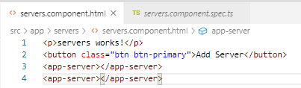
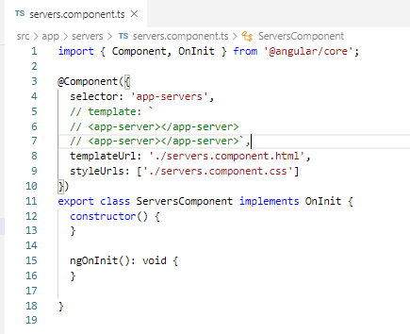
26.1 Property Binding
https://www.udemy.com/course/the-complete-guide-to-angular-2/learn/lecture/6655806#overview
String Interpolation
> servers.Component.html
> servers.Component.ts

Slide 5
26.2 Verify

Slide 6
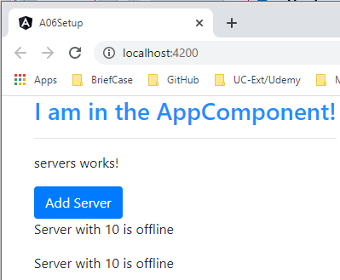
26.3 Property Binding
https://www.udemy.com/course/the-complete-guide-to-angular-2/learn/lecture/6655806#overview
Verify

Slide 7
26.3 Add Event Handler

Slide 8
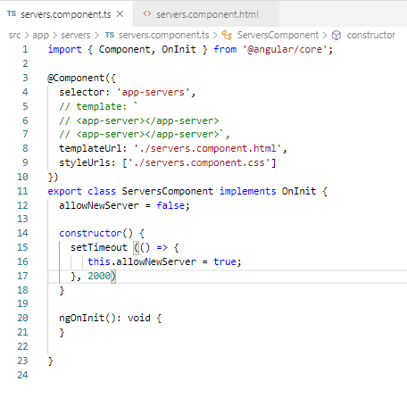
26.3 Add Event Handler
https://www.udemy.com/course/the-complete-guide-to-angular-2/learn/lecture/6655806#overview
Event = false, after two second, set to true,

Slide 9
26.4 Bind Event Property

Slide 10
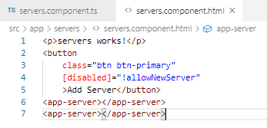
26.4 Bind Event Property
https://www.udemy.com/course/the-complete-guide-to-angular-2/learn/lecture/6655806#overview
In HTML, set the disabled from true (not false) to false (not true).

Slide 11
26.5 Verify Event Property

Slide 12
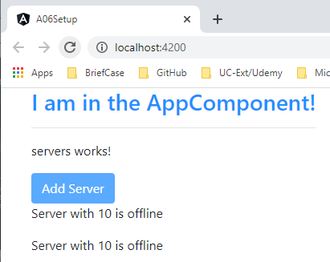
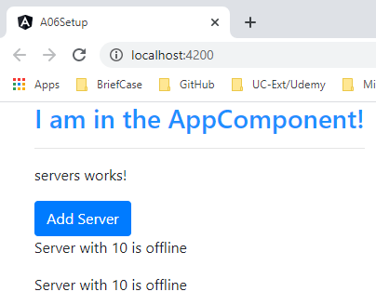
26.5 Verify Event Property
https://www.udemy.com/course/the-complete-guide-to-angular-2/learn/lecture/6655806#overview
Verify
Button Disabled = true (!false)
After two second
Button Disabled = false (!true)

Slide 13
End of Chapter

