Slide 1

27 Property Bind vs. String Interpolate
Peter H. Chen

Slide 2
27 Property Bind vs. String Interpolate
https://www.udemy.com/course/the-complete-guide-to-angular-2/learn/lecture/6655814#overview
Property Binding vs. String Interpolation
Property binding and interpolation are the data binding types in Angular.
They are used from moving data from the component to template.
https://www.telerik.com/blogs/understanding-angular-property-binding-and-interpolation#:~:text=Property%20binding%20and%20interpolation%20are,the%20component%20to%20the%20template.&text=Angular%20finds%20the%20variable%20matching,Numbers%2C%20strings%2C%20etc.
1. Event Binding:
This data binding type is when information flows from the view to the component when an event is triggered.
The view sends the data from an event like the click of a button to be used to update the component. It is the exact opposite of property binding, where the data goes from the component to the view.

Slide 3
27 Property Bind vs. String Interpolate
https://www.udemy.com/course/the-complete-guide-to-angular-2/learn/lecture/6655814#overview
// component.html
<p>My name is {{name}}</p>
<button (click)="updateName()">Update button</button>
// component.ts
@Component({
templateUrl: 'component.html’,
selector: 'app-component’,
})
export class Component {
name = 'Peter’;
updateName() {
this.name = 'John’;
}
}

Slide 4
27 Property Bind vs. String Interpolate
https://www.udemy.com/course/the-complete-guide-to-angular-2/learn/lecture/6655814#overview
2. Two-way data binding: Two-way binding is a mechanism where data flows both ways from the component to the view and back. The component and view are always in sync, and changes made on either end are immediately updated both ways. Two-way binding is commonly used when dealing with forms where the user input is used to update the component’s state and vice versa.
3. Interpolation: This data binding mechanism will be spoken about in detail in this article. In the technique, text representing variables in components are placed in between double curly braces in the template.
Angular finds the variable matching the text in the component and replaces the text with the value assigned to the variable. Numbers, strings, etc. can be used directly between the curly braces.

Slide 5
27 Property Bind vs. String Interpolate
https://www.udemy.com/course/the-complete-guide-to-angular-2/learn/lecture/6655814#overview
//component.html
<p>{{ name }}</p>
// component.ts @Component({
templateUrl: 'component.html’,
selector: 'app-component’,
})
export class Component {
name = 'Peter’;
}

Slide 6
27 Property Bind vs. String Interpolate
https://www.udemy.com/course/the-complete-guide-to-angular-2/learn/lecture/6655814#overview
4. Property binding: Property binding is a one-way mechanism that lets you set the property of a view element. It involves updating the value of a property in the component and binding it to an element in the view template.
Property binding uses the [] syntax for data binding.
An example is setting the disabled state of a button.

Slide 7
27 Property Bind vs. String Interpolate
https://www.udemy.com/course/the-complete-guide-to-angular-2/learn/lecture/6655814#overview
// component.html
<button [disabled]="buttonDisabled"></button>
// component.ts @Component({
templateUrl: 'component.html’,
selector: 'app-component’,
})
export class Component {
buttonDisabled = true;
}

Slide 8
27.1 Property Binding vs. String Interpolation

Slide 9
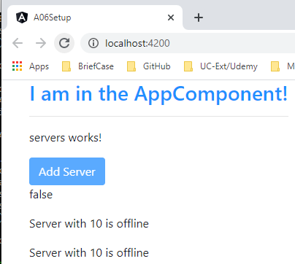
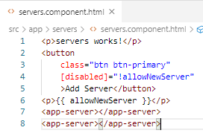
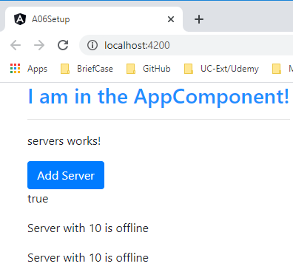
27.1 Property Binding vs. String Interpolation
https://www.udemy.com/course/the-complete-guide-to-angular-2/learn/lecture/6655814#overview
Property Biding vs. String Interpolation
[disabled]: property binding.
{{ allowNewServe }}: string interpolation

Slide 10
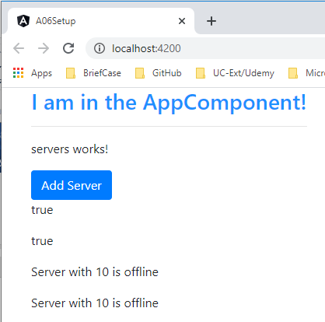
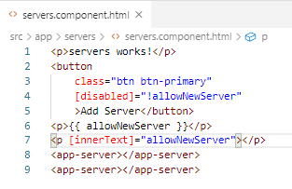
27.1 Property Binding vs. String Interpolation
https://www.udemy.com/course/the-complete-guide-to-angular-2/learn/lecture/6655814#overview
Property Biding vs. String Interpolation
[]: property binding.
“”: String Interpolation
[innerText]=“allowNewServer”

Slide 11
End of Chapter

