Slide 1

28 Event Binding
Peter H. Chen

Slide 2
28 Event Binding
https://www.udemy.com/course/the-complete-guide-to-angular-2/learn/lecture/6655820#overview
Event Binding
We have property binding and string interpolation.
Now, we want to have event bind to button.

Slide 3
28.1 Event Binding

Slide 4
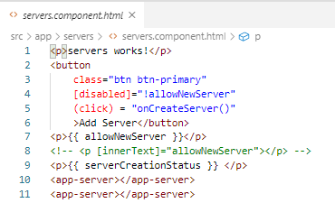
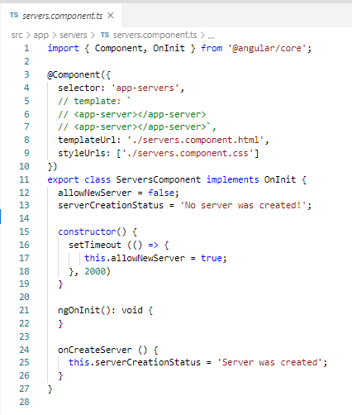
28.1 Event Binding
https://www.udemy.com/course/the-complete-guide-to-angular-2/learn/lecture/6655820#overview
Event Binding

Slide 5
28.2 Verify

Slide 6
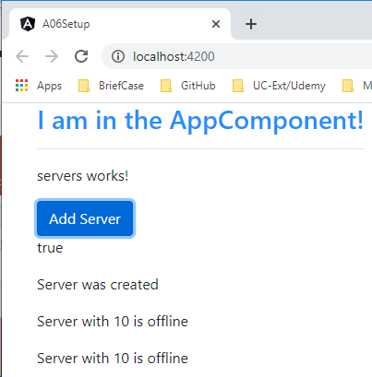
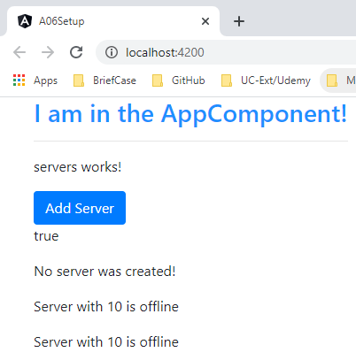
28.2 Verify
https://www.udemy.com/course/the-complete-guide-to-angular-2/learn/lecture/6655820#overview
Verify

Slide 7
End of Chapter

