Slide 1

30 Event Binding Passing Data
Peter H. Chen

Slide 2
30 Event Binding Passing Data
https://www.udemy.com/course/the-complete-guide-to-angular-2/learn/lecture/6655832#overview
Event Binding Passing Data
Now, we discuss two-way binding for event binding.

Slide 3
30.1 Event Binding

Slide 4
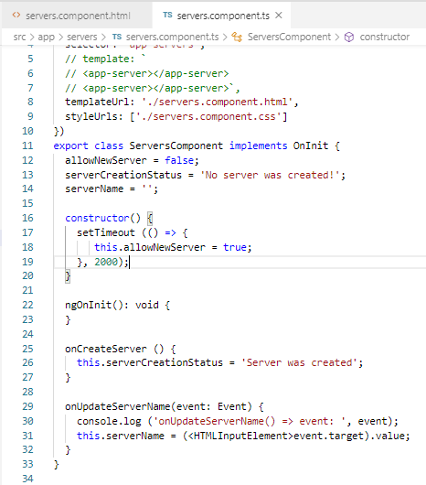
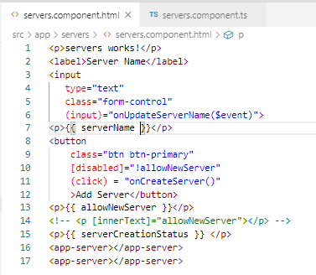
30.1 Event Binding
https://www.udemy.com/course/the-complete-guide-to-angular-2/learn/lecture/6655832#overview
Event Binding
https://www.w3schools.com/bootstrap/bootstrap_forms.asp
> class =‘form-control’ is defined by bootstrap.

Slide 5
30.2 Verify

Slide 6
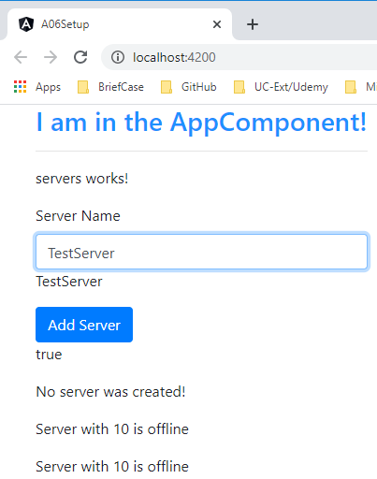
30.2 Verify
https://www.udemy.com/course/the-complete-guide-to-angular-2/learn/lecture/6655832#overview
Verify

Slide 7
End of Chapter

