Slide 1

32 Two Way Databind
Peter H. Chen

Slide 2
32 Two Way Databind
https://www.udemy.com/course/the-complete-guide-to-angular-2/learn/lecture/6655868#overview
Last discussion, we have event binding and property binding.
Now, we combine them together to the two-way binding.

Slide 3
32.1 Code

Slide 4
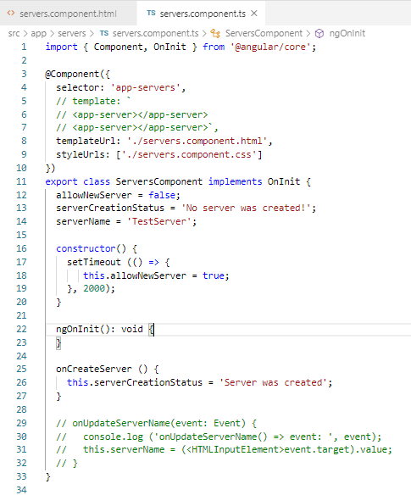
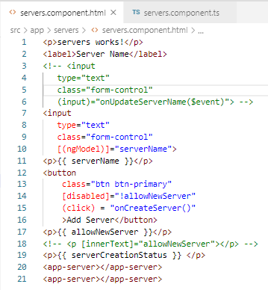
32.1 Code
https://www.udemy.com/course/the-complete-guide-to-angular-2/learn/lecture/6655868#overview
Code:
[(ngModel)] = “serverName”
<p>{{ serverName }}

Slide 5
32.2 Verify

Slide 6
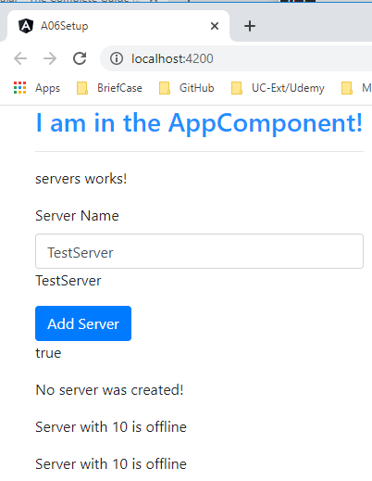
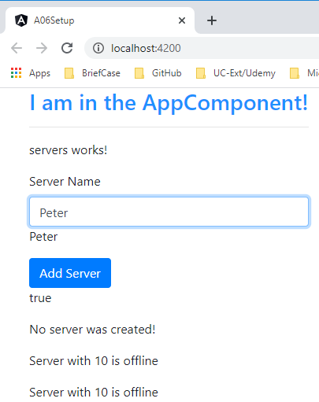
32.2 Verify
https://www.udemy.com/course/the-complete-guide-to-angular-2/learn/lecture/6655868#overview
Verify

Slide 7
End of Chapter

