Slide 1

33 Two Way Databind
Peter H. Chen

Slide 2
33 Two Way Databind
https://www.udemy.com/course/the-complete-guide-to-angular-2/learn/lecture/6655868#overview
Last discussion, we have event binding and property binding.
Now, we combine them together to the two-way binding.

Slide 3
33.1 Code

Slide 4
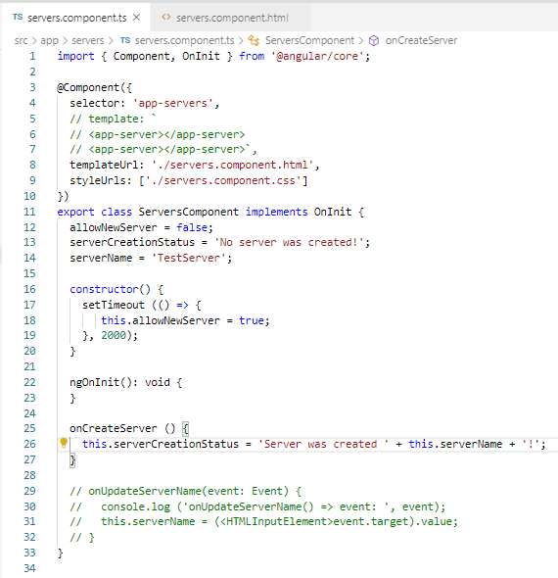
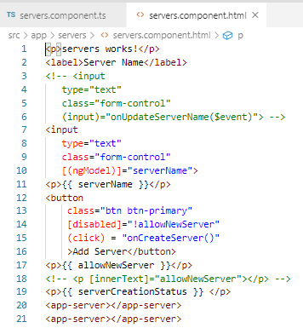
33.1 Code
https://www.udemy.com/course/the-complete-guide-to-angular-2/learn/lecture/6655868#overview
Code:
This.serverCreatedStatus = ‘…’;

Slide 5
33.2 Verify

Slide 6
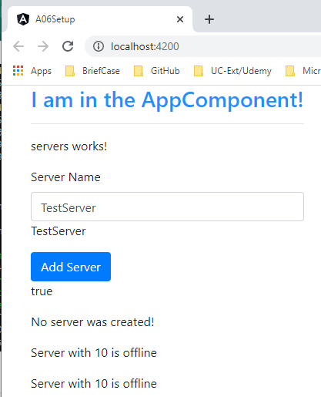

33.2 Verify
https://www.udemy.com/course/the-complete-guide-to-angular-2/learn/lecture/6655868#overview
Verify

Slide 7
End of Chapter

