Slide 1

34 Assignment 02 Databind
Peter H. Chen

Slide 2
34 Assignment 02 Databind
https://www.udemy.com/course/the-complete-guide-to-angular-2/learn/lecture/12982436#overview
Assignment 02 Databinding
Add a Input field which updates a property ('username') via Two-Way-Binding
Output the username property via String Interpolation (in a paragraph below the input)
Add a button which may only be clicked if the username is NOT an empty string
Upon clicking the button, the username should be reset to an empty string

Slide 3
34.1 Code

Slide 4
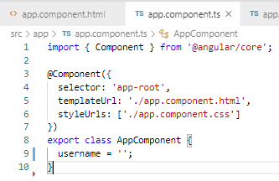
34.1 Code
https://www.udemy.com/course/the-complete-guide-to-angular-2/learn/lecture/12982436#overview
Code:
> username = ‘’;

Slide 5
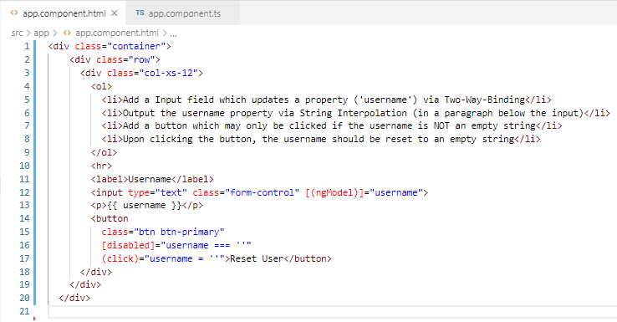
34.1 Code
https://www.udemy.com/course/the-complete-guide-to-angular-2/learn/lecture/12982436#overview
Code:
This.serverCreatedStatus = ‘…’;

Slide 6
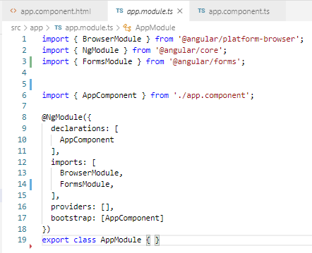
34.1 Code
https://www.udemy.com/course/the-complete-guide-to-angular-2/learn/lecture/12982436#overview
Code:
Module.ts

Slide 7
34.2 Verify

Slide 8
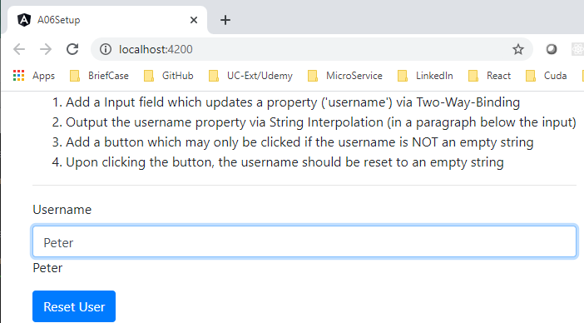
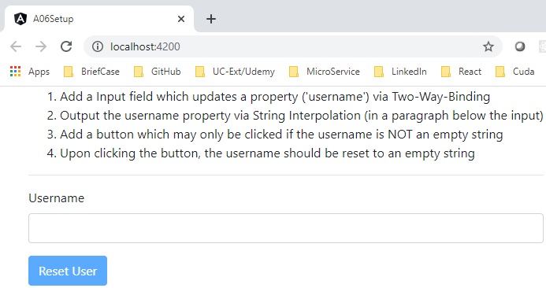
34.2 Verify
https://www.udemy.com/course/the-complete-guide-to-angular-2/learn/lecture/12982436#overview
Verify

Slide 9
End of Chapter

