Slide 1

35 Directive
Peter H. Chen

Slide 2
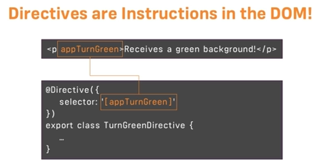
35 Directive
https://www.udemy.com/course/the-complete-guide-to-angular-2/learn/lecture/6655898#overview
What are Directives?
Directives are instructions in the DOM.
We already use directive in the component.
Selector, templateUrl, style, and etc. are directives.
There area others directives. We will discuss next.

Slide 3
End of Chapter

