Slide 1

36 ngIf
Peter H. Chen

Slide 2
36 ngIf
https://www.udemy.com/course/the-complete-guide-to-angular-2/learn/lecture/6655898#overview
ngIf

Slide 3
36.1 Code

Slide 4
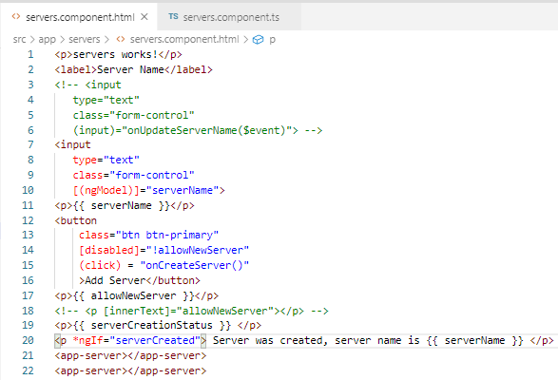
36.1 Code
https://www.udemy.com/course/the-complete-guide-to-angular-2/learn/lecture/6655898#overview
ngIf

Slide 5
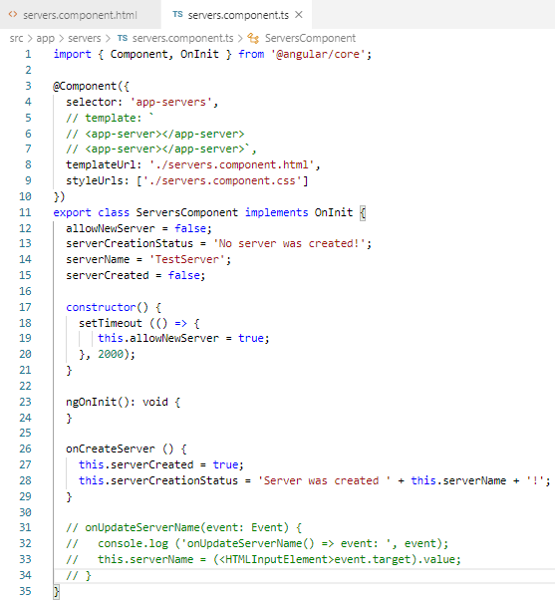
36.1 Code
https://www.udemy.com/course/the-complete-guide-to-angular-2/learn/lecture/6655898#overview
ngIf

Slide 6
36.2 Verify

Slide 7
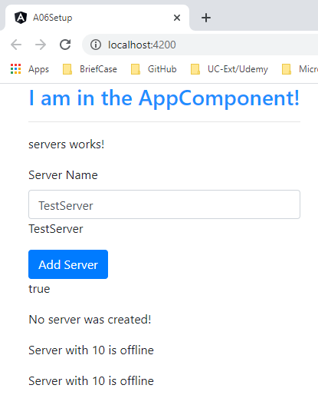
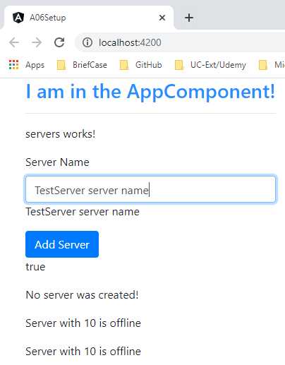
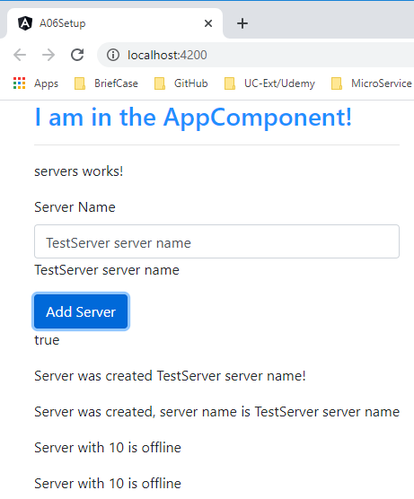
36.2 Verify
https://www.udemy.com/course/the-complete-guide-to-angular-2/learn/lecture/6655898#overview
Verify

Slide 8
End of Chapter

