Slide 1

37 ngIf .. else
Peter H. Chen

Slide 2
37 ngIf .. else
https://www.udemy.com/course/the-complete-guide-to-angular-2/learn/lecture/6655898#overview
ngIf .. else

Slide 3
37.1 Code

Slide 4
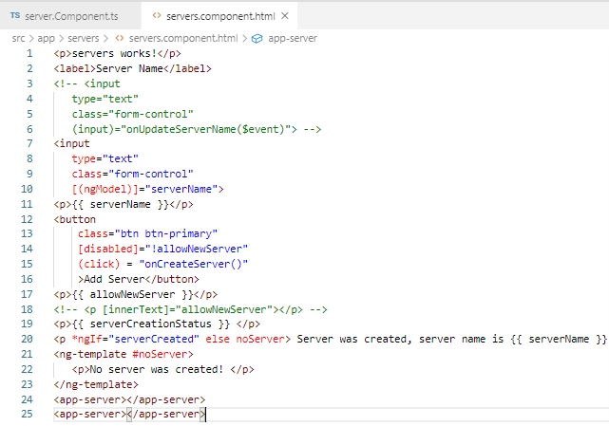
37.1 Code
https://www.udemy.com/course/the-complete-guide-to-angular-2/learn/lecture/6655898#overview
ngIf else

Slide 5
37.2 Verify

Slide 6
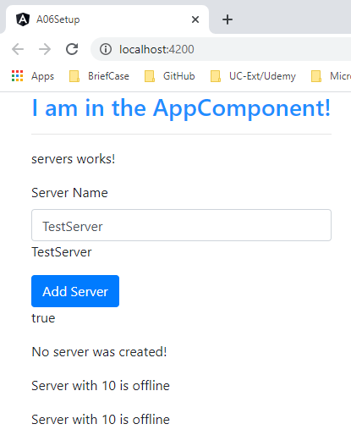
37.2 Verify
https://www.udemy.com/course/the-complete-guide-to-angular-2/learn/lecture/6655898#overview
Verify

Slide 7
End of Chapter

