Slide 1

38 ngStyle
Peter H. Chen

Slide 2
38 ngStyle
https://www.udemy.com/course/the-complete-guide-to-angular-2/learn/lecture/6655914#overview
ngStyle

Slide 3
38.1 Code

Slide 4
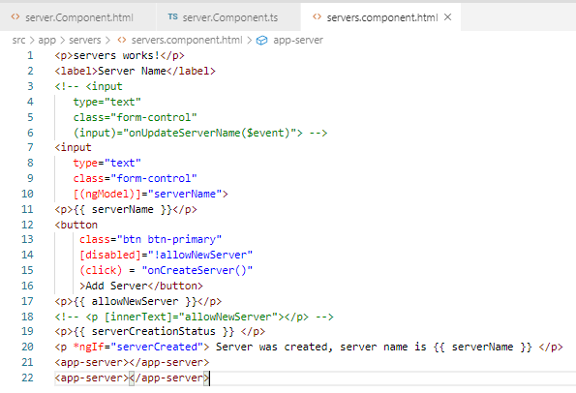
38.1 Code
https://www.udemy.com/course/the-complete-guide-to-angular-2/learn/lecture/6655914#overview
Code

Slide 5
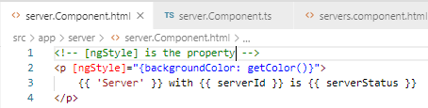
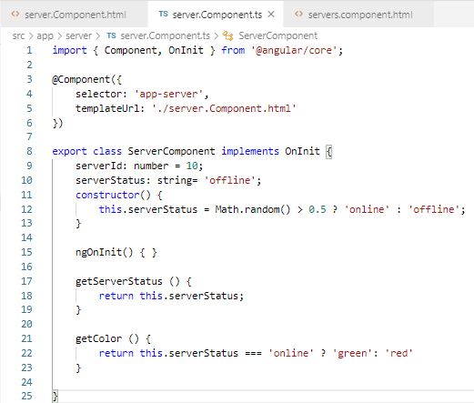
38.1 Code
https://www.udemy.com/course/the-complete-guide-to-angular-2/learn/lecture/6655914#overview
Code

Slide 6
38.2 Verify

Slide 7
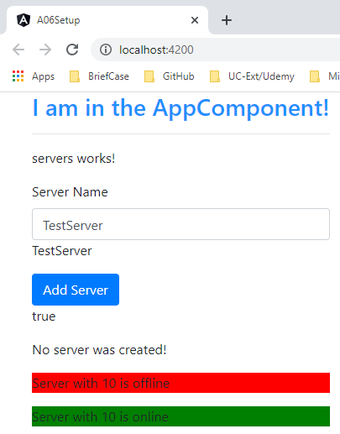
38.2 Verify
https://www.udemy.com/course/the-complete-guide-to-angular-2/learn/lecture/6655914#overview
Verify

Slide 8
End of Chapter

