Slide 1

39 ngClass
Peter H. Chen

Slide 2
39 ngClass
https://www.udemy.com/course/the-complete-guide-to-angular-2/learn/lecture/6655924#overview
ngClass: Set html element color to ‘white’.

Slide 3
39.1 Code

Slide 4
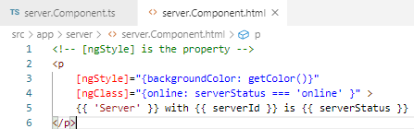
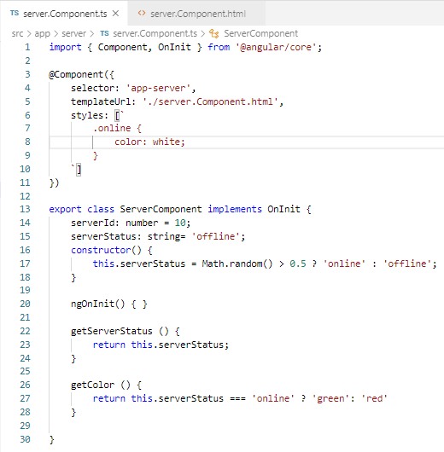
39.1 Code
https://www.udemy.com/course/the-complete-guide-to-angular-2/learn/lecture/6655924#overview
Code: Set property [ngClass] to ‘white’

Slide 5
39.2 Verify

Slide 6
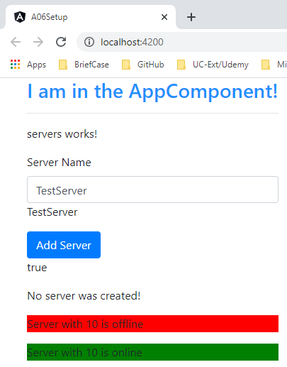
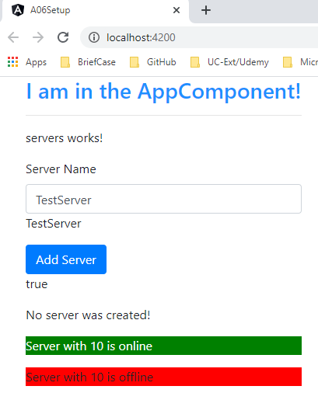
39.2 Verify
https://www.udemy.com/course/the-complete-guide-to-angular-2/learn/lecture/6655924#overview
Verify: Before text color is ‘black’. Now, online text become ‘white’

Slide 7
End of Chapter

