Slide 1

40 ngFor
Peter H. Chen

Slide 2
40 ngFor
https://www.udemy.com/course/the-complete-guide-to-angular-2/learn/lecture/6655924#overview
ngFor

Slide 3
40.1 Code

Slide 4
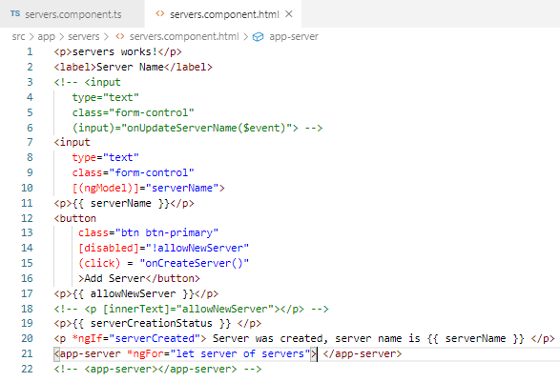
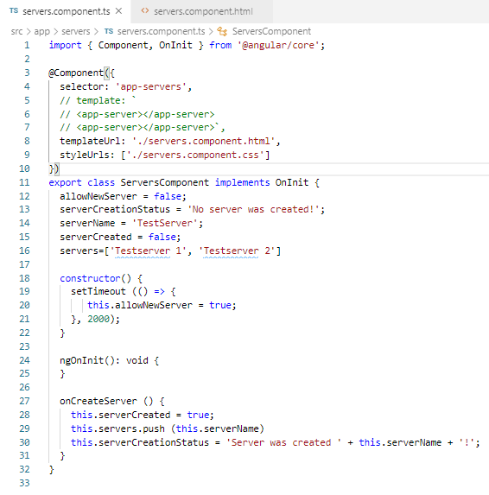
40.1 Code
https://www.udemy.com/course/the-complete-guide-to-angular-2/learn/lecture/6655924#overview
Code:

Slide 5
40.2 Verify

Slide 6
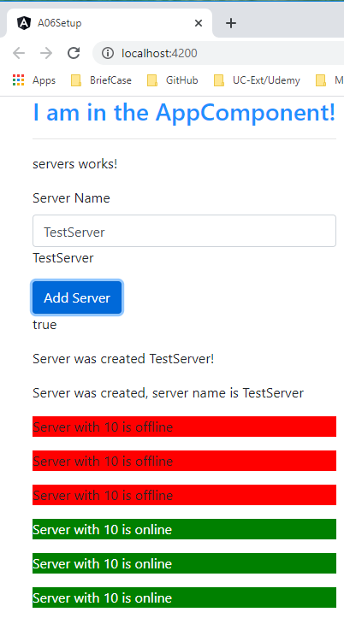
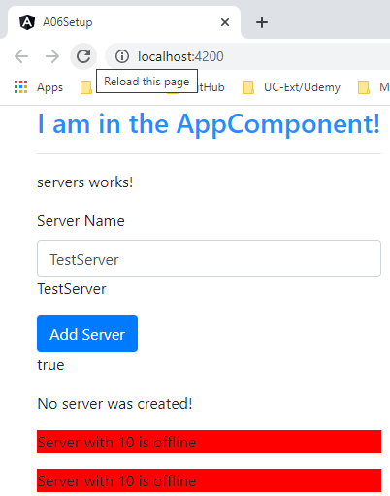
40.2 Verify
https://www.udemy.com/course/the-complete-guide-to-angular-2/learn/lecture/6655924#overview
Verify:

Slide 7
End of Chapter

