Slide 1

41 Assignment 03: Directive
Peter H. Chen

Slide 2
41 Assignment 03: Directive
https://www.udemy.com/course/the-complete-guide-to-angular-2/learn/lecture/6655924#overview
Assignment 03: Directive
Add A button which says 'Display Details’
Add a paragraph with any content of your choice (e.g., 'Secret Password = tuna’)
Toggle the displaying of that paragraph with the button created in the first step
Log all button clicks in an array and output that array below the secret paragraph (simply an incrementing number)
Starting at the 5th log item, give all future log items a blue background (via ngStyle) and white color (ngClass)

Slide 3
41.1 Code

Slide 4
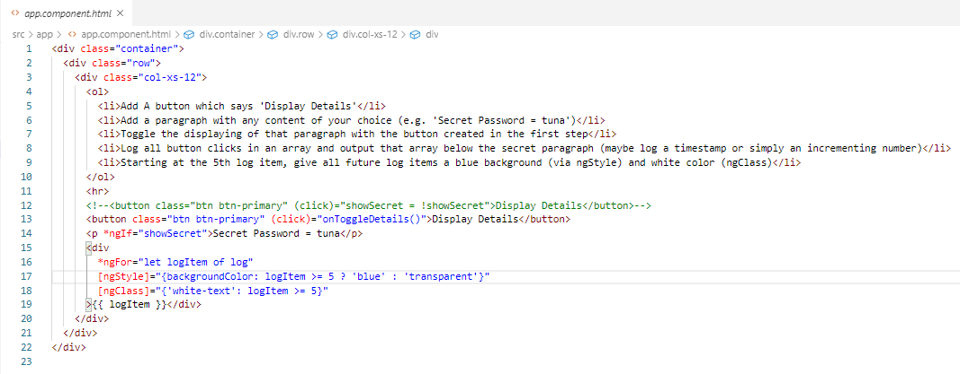
41.1 Code
https://www.udemy.com/course/the-complete-guide-to-angular-2/learn/lecture/6655924#overview
Code:

Slide 5
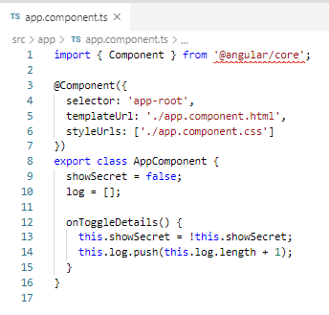
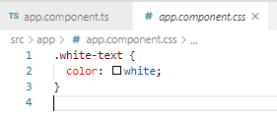
41.1 Code
https://www.udemy.com/course/the-complete-guide-to-angular-2/learn/lecture/6655924#overview
Code:

Slide 6
41.2 Verify

Slide 7
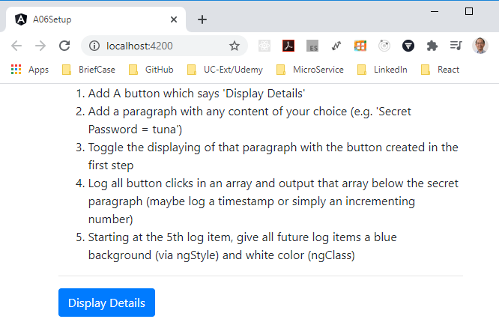
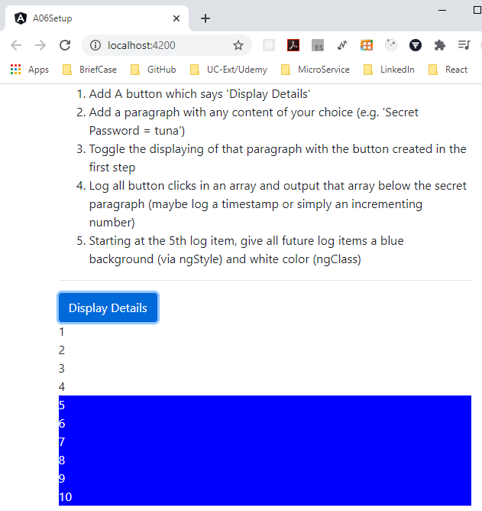
41.2 Verify
https://www.udemy.com/course/the-complete-guide-to-angular-2/learn/lecture/6655924#overview
Verify:

Slide 8
End of Chapter

