Slide 1

42 Assignment 03: Index
Peter H. Chen

Slide 2
42 Assignment 03: Index
https://www.udemy.com/course/the-complete-guide-to-angular-2/learn/lecture/6655944#overview
Assignment 03: Add Time stamp and Index
Add A button which says 'Display Details’
Add a paragraph with any content of your choice (e.g., 'Secret Password = tuna’)
Toggle the displaying of that paragraph with the button created in the first step
Log all button clicks in an array and output that array below the secret paragraph (log a timestamp)
Starting at the 5th log item, give all future log items a blue background (via ngStyle) and white color (ngClass)

Slide 3
42.1 Code

Slide 4
42.1 Code
https://www.udemy.com/course/the-complete-guide-to-angular-2/learn/lecture/6655944#overview
Code:

Slide 5
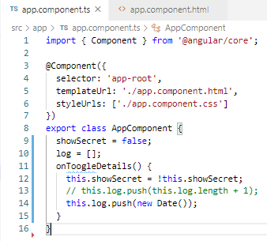
42.1 Code
https://www.udemy.com/course/the-complete-guide-to-angular-2/learn/lecture/6655944#overview
Code:

Slide 6
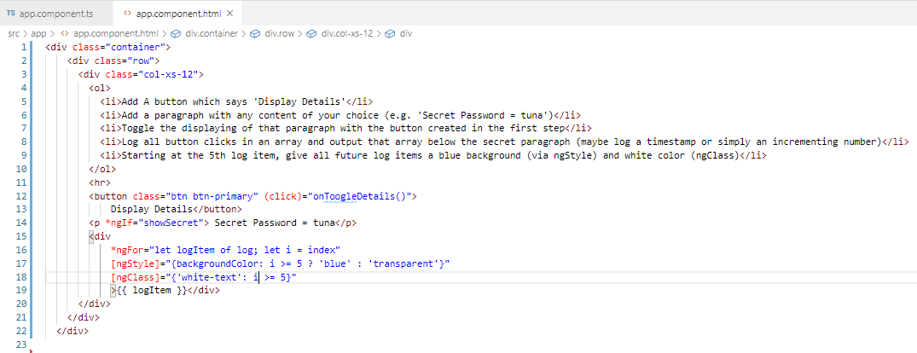
42.1 Code
https://www.udemy.com/course/the-complete-guide-to-angular-2/learn/lecture/6655944#overview
Code:

Slide 7
42.2 Verify

Slide 8
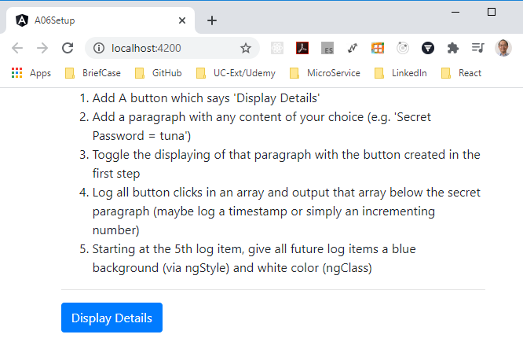
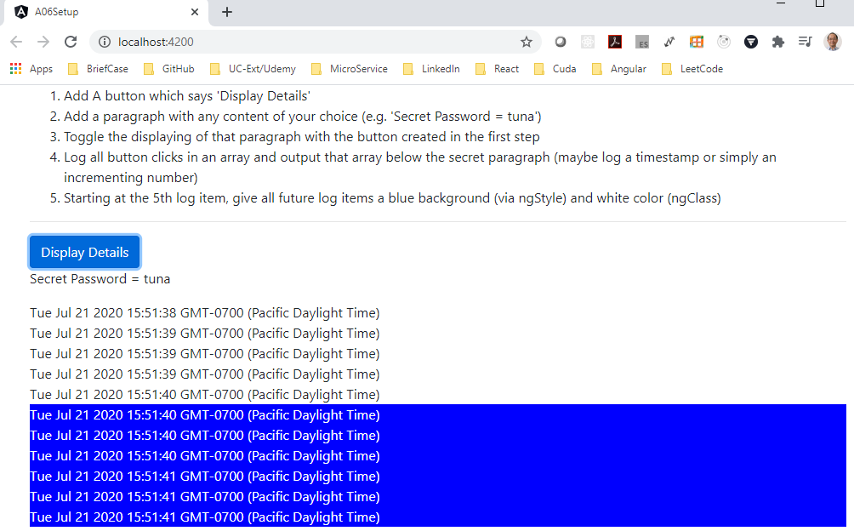
42.2 Verify
https://www.udemy.com/course/the-complete-guide-to-angular-2/learn/lecture/6655944#overview
Verify:

Slide 9
End of Chapter

