Slide 1

84 Databinding between Components
Peter H. Chen

Slide 2
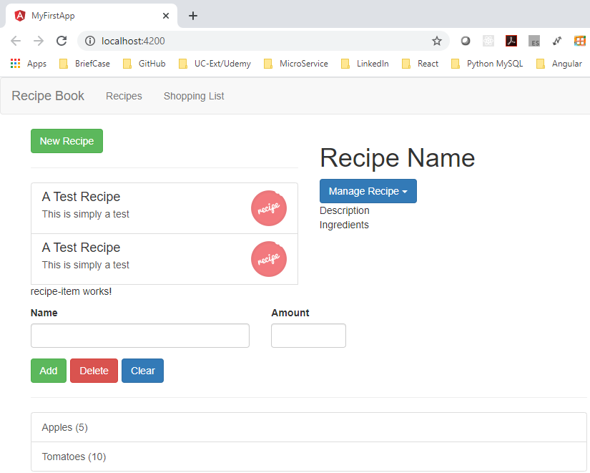
84 Databinding between Components
https://www.udemy.com/course/the-complete-guide-to-angular-2/learn/lecture/6656132#overview
Databinding between Components
We discuss the databinding between components and lifecycle hook work.
We fine tune the knowledge for navigate between recipes and shopping list.
We will have the working communications between the components.

Slide 3
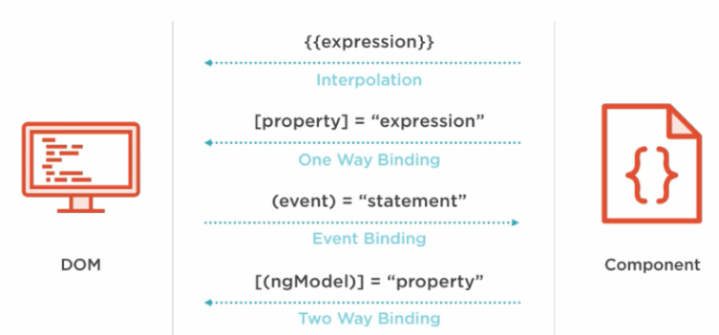
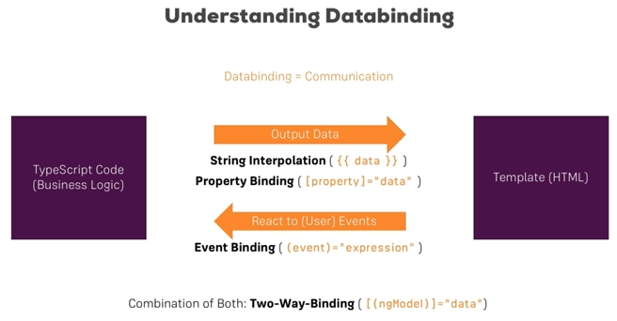
84 Databinding between Components
https://www.udemy.com/course/the-complete-guide-to-angular-2/learn/lecture/6656132#overview
Databinding between Components

Slide 4
End of Chapter

