Slide 1

85 Databinding between Components
Peter H. Chen

Slide 2
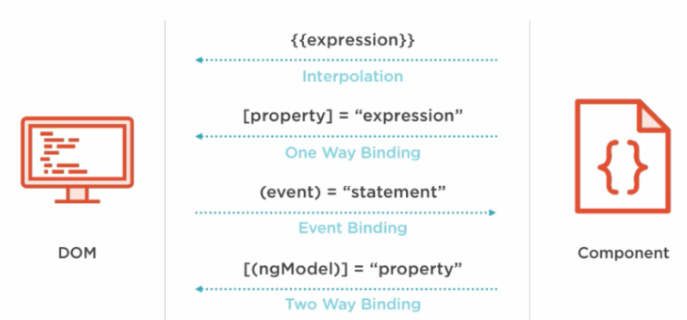
85 Databinding between Components
https://www.udemy.com/course/the-complete-guide-to-angular-2/learn/lecture/6656132#overview
Databinding between Components
We use navigator to switch two pages (page 1: recipe and page 2: shopping- list)
Navigator pass ‘recipe’ or ‘shopping-list’
In the app component, we use *ngIf to display recipe or shopping-list.

Slide 3
85.1 Navigator Component

Slide 4
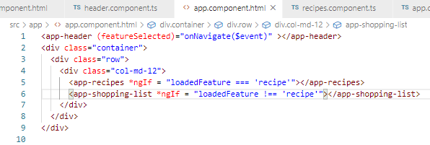
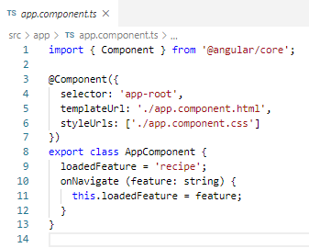
85.1 Navigator Component
https://www.udemy.com/course/the-complete-guide-to-angular-2/learn/lecture/6656132#overview
Navigator Component:
Toggle recipes component and shopping list component

Slide 5
85.2 Header Component

Slide 6
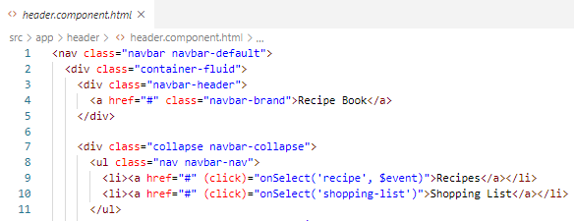
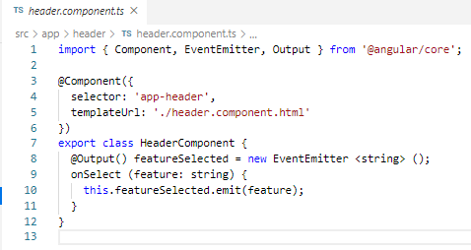
85.2 Header Component
https://www.udemy.com/course/the-complete-guide-to-angular-2/learn/lecture/6656132#overview
Header Component: Select the Feature and Output Selected Feature to parent (Navigate Component). After selected, the feature is emitted to parent.

Slide 7
85.1 Verify

Slide 8
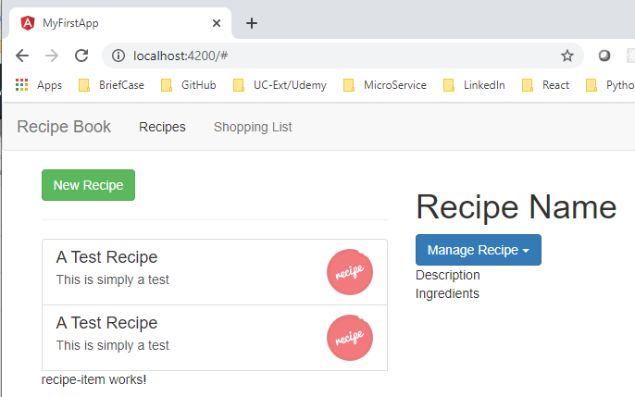
85.1 Verify
https://www.udemy.com/course/the-complete-guide-to-angular-2/learn/lecture/6656132#overview
Verify

Slide 9
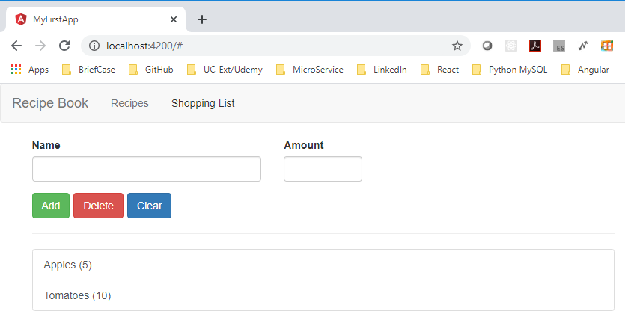
85.1 Verify
https://www.udemy.com/course/the-complete-guide-to-angular-2/learn/lecture/6656132#overview
Verify

Slide 10
End of Chapter

