Slide 1

86 Recipe Data with Property Binding
Peter H. Chen

Slide 2
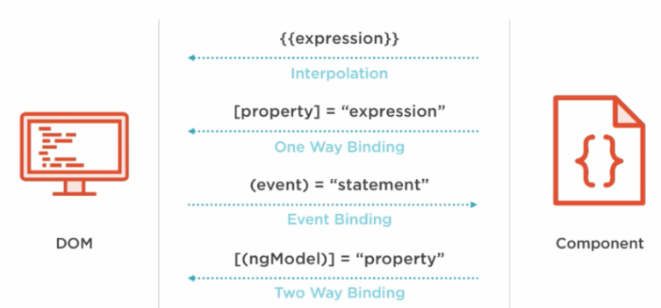
86 Recipe Data with Property Binding
https://www.udemy.com/course/the-complete-guide-to-angular-2/learn/lecture/6656132#overview
Recipe Data with Property Binding
We have navigate the two pages. Now, we discuss the recipe.

Slide 3
86.1 Property Binding

Slide 4
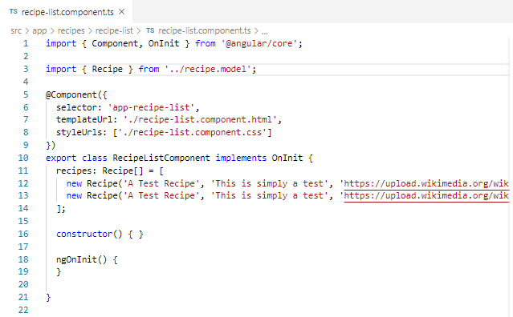
86.1 Property Binding
https://www.udemy.com/course/the-complete-guide-to-angular-2/learn/lecture/6656132#overview
Property Binding:
Initialize Data.

Slide 5
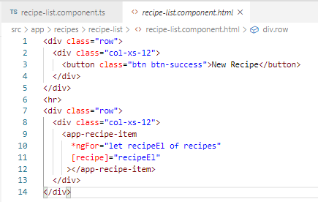
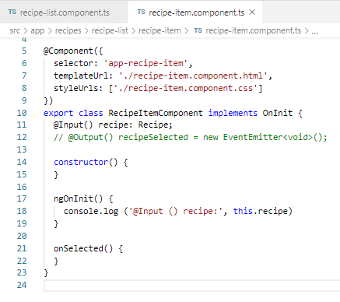
86.1 Property Binding
https://www.udemy.com/course/the-complete-guide-to-angular-2/learn/lecture/6656132#overview
Property Binding:
Make sure the data is passed from parent to child component.

Slide 6
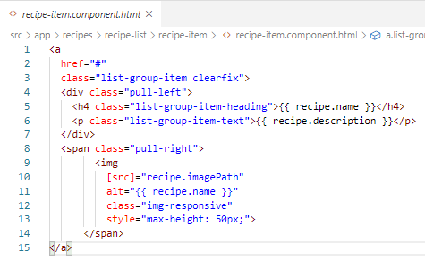
86.1 Property Binding
https://www.udemy.com/course/the-complete-guide-to-angular-2/learn/lecture/6656132#overview
Property Binding:
Display the data attribute.

Slide 7
86.2 Verify

Slide 8
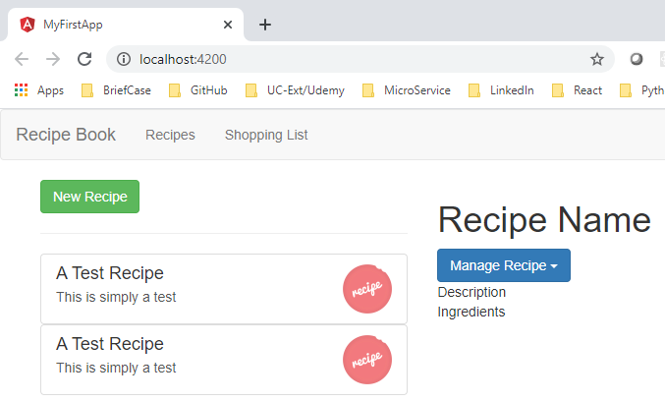
86.2 Verify
https://www.udemy.com/course/the-complete-guide-to-angular-2/learn/lecture/6656132#overview
Verify

Slide 9
End of Chapter

