Slide 1

87 Click Item and Display Detail
Peter H. Chen

Slide 2
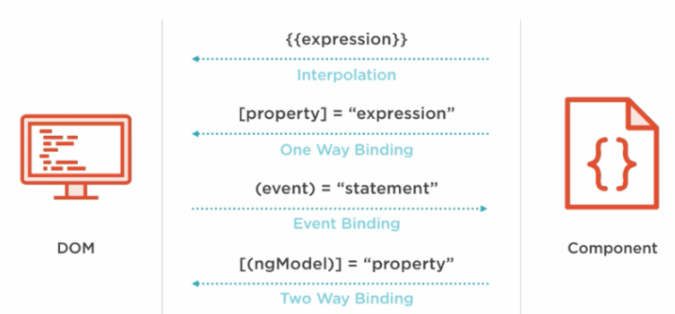
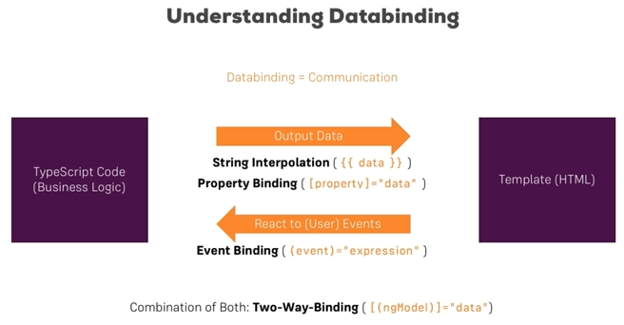
87 Click Item and Display Detail
https://www.udemy.com/course/the-complete-guide-to-angular-2/learn/lecture/6656144#overview
Recipe Event Binding
Component recipes contains the recipe-list and recipe-detail.
Click recipe-list component display the information to recipe-detail component. (): data. []: event

Slide 3
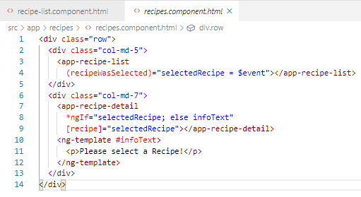
87 Click Item and Display Detail
https://www.udemy.com/course/the-complete-guide-to-angular-2/learn/lecture/6656144#overview
Recipe Event Binding
Component recipes contains the recipe-list and recipe-detail.
Click recipe-list component display the information to recipe-detail component. (): data. []: event

Slide 4
87.1 Pass Recipe Item

Slide 5
87.1 Pass Recipe Item
https://www.udemy.com/course/the-complete-guide-to-angular-2/learn/lecture/6656144#overview
Display Recipe Item
recipe-list.html
[recipe]
1
Recipe
@Input recipe
recipe-item.html
recipe-item.ts
{{ recipe }}

Slide 6
87.2 Click Item and Display Detail

Slide 7
87.2 Click Item and Display Detail
https://www.udemy.com/course/the-complete-guide-to-angular-2/learn/lecture/6656144#overview
Item selected
Recipe selected
Recipe Passed
recipes.html
(recipeWasSelected)
[recipe]
2
Selected Recipe
3
Pass Recipe
@Output
recipeWasSelected
@Input recipe
recipe-list.ts
recipe-detail.ts
recipe-detail.html
recipe-list.html
[recipe]
{{ recipe }}
(recipeSelected)
1
Item Selected
@Output recipeSelected
@Input recipe
recipe-item.html
recipe-item.ts
{{ recipe }}

Slide 8
87.3 Code

Slide 9
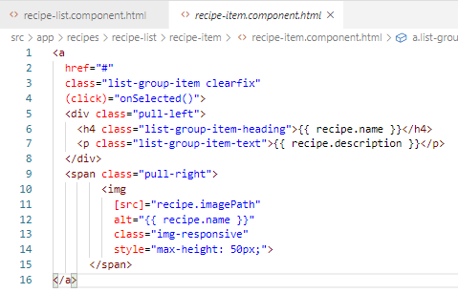
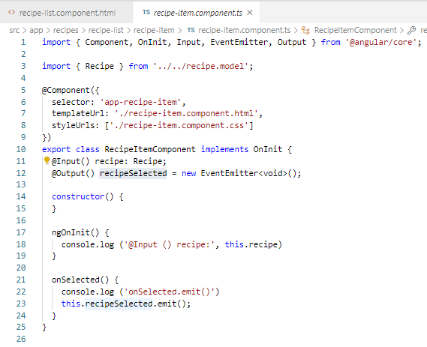
87.3 Code
https://www.udemy.com/course/the-complete-guide-to-angular-2/learn/lecture/6656144#overview
Code
Child component recipe-item: We bind the event of selection to display the data.
Emit the recipe data.

Slide 10
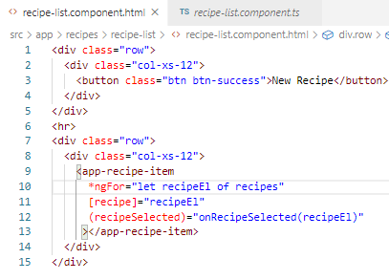
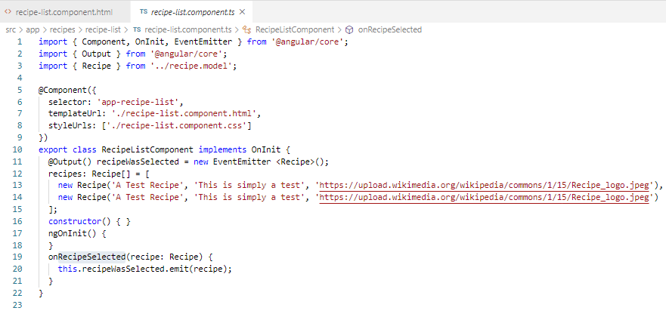
87.1 Event Binding
https://www.udemy.com/course/the-complete-guide-to-angular-2/learn/lecture/6656144#overview
Property Binding:
recipe-list is the parent of recipe-item.
Recipe-list emit the recipe to its parent recipes.

Slide 11
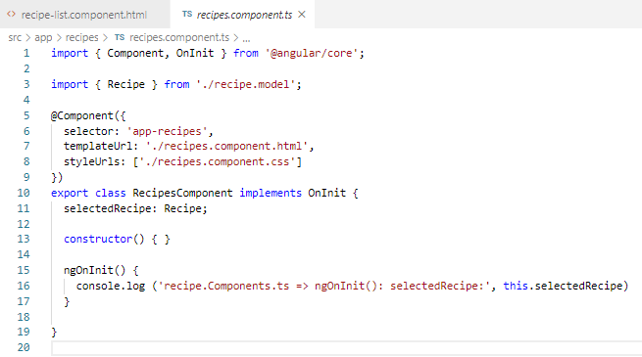
87.1 Event Binding
https://www.udemy.com/course/the-complete-guide-to-angular-2/learn/lecture/6656144#overview
Property Binding:
recipe-list is the parent of recipe-item.
Recipe-list emit the recipe to its parent recipes.

Slide 12
87.4 Verify Display Recipe Item

Slide 13
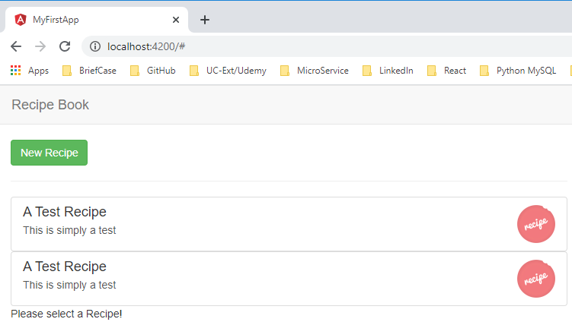
87.4 Verify Display Recipe Item
https://www.udemy.com/course/the-complete-guide-to-angular-2/learn/lecture/6656144#overview
Verify Display Recipe Item

Slide 14
87.5 Click Item and Display Detail

Slide 15
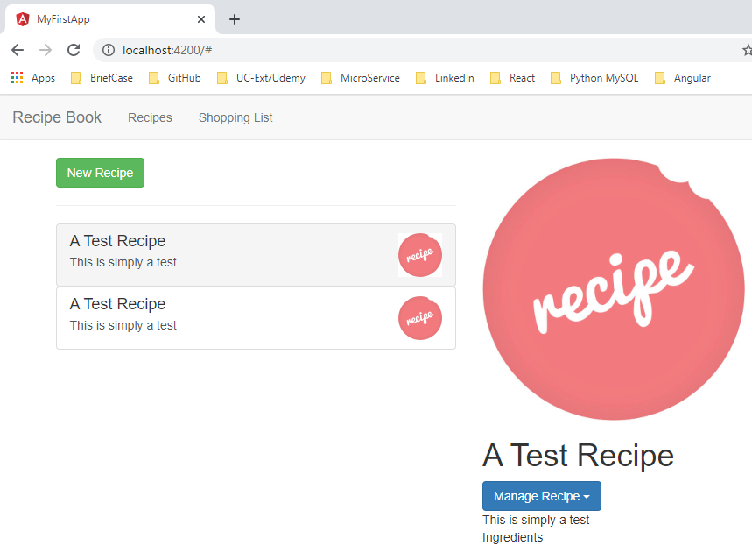
87.5 Click Item and Display Detail
https://www.udemy.com/course/the-complete-guide-to-angular-2/learn/lecture/6656144#overview
Verify Click Item and Display Detail

Slide 16
End of Chapter

