Slide 1

89 Ingredient of Shopping List
Peter H. Chen

Slide 2
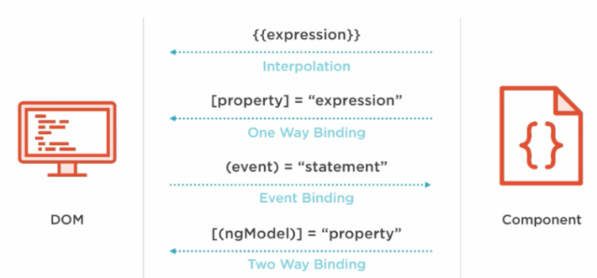
89 Ingredient of Shopping List
https://www.udemy.com/course/the-complete-guide-to-angular-2/learn/lecture/6656144#overview
Add Ingredients of Shopping List

Slide 3
89.1 Ingredient of Shopping List

Slide 4
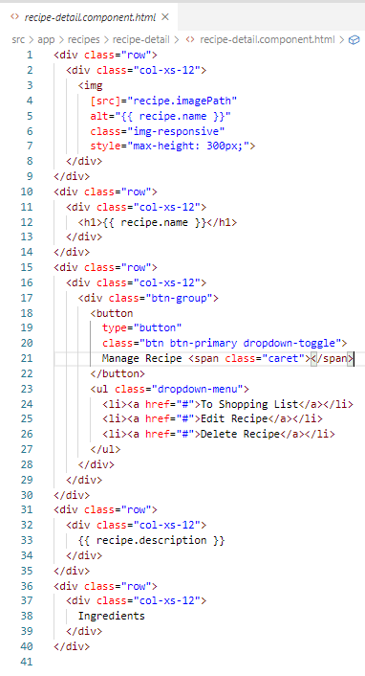
89.1 Ingredient of Shopping List
https://www.udemy.com/course/the-complete-guide-to-angular-2/learn/lecture/6656144#overview
Ingredient of Shopping List

Slide 5
89.2 Verify

Slide 6
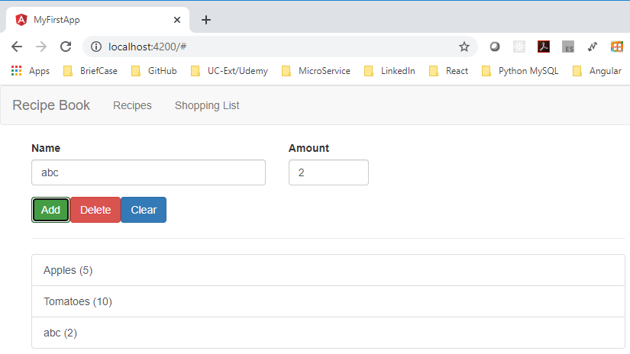
89.2 Verify
https://www.udemy.com/course/the-complete-guide-to-angular-2/learn/lecture/6656144#overview
Verify

Slide 7
End of Chapter

