Slide 1

8 Programming Assignment 1
Peter H. Chen

Slide 2
8 Programming Assignment 1
https://www.udemy.com/course/cuda-programming-masterclass/learn/lecture/12554944#overview
Programming Assignment 1
Print value of threadIdx, blockDim, gridDim variables for 3D grid which has 4 threads in all X, Y, and Z dimension. The thread block size is 2 threads in each dimension.

Slide 3
8.1 Code

Slide 4
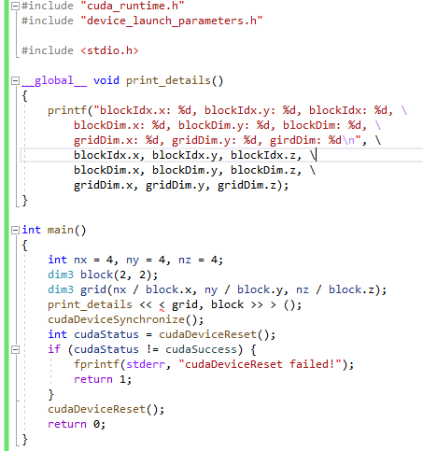
8.1 Code
https://www.udemy.com/course/cuda-programming-masterclass/learn/lecture/12554944#overview
Code:

Slide 5
8.2 Verify

Slide 6
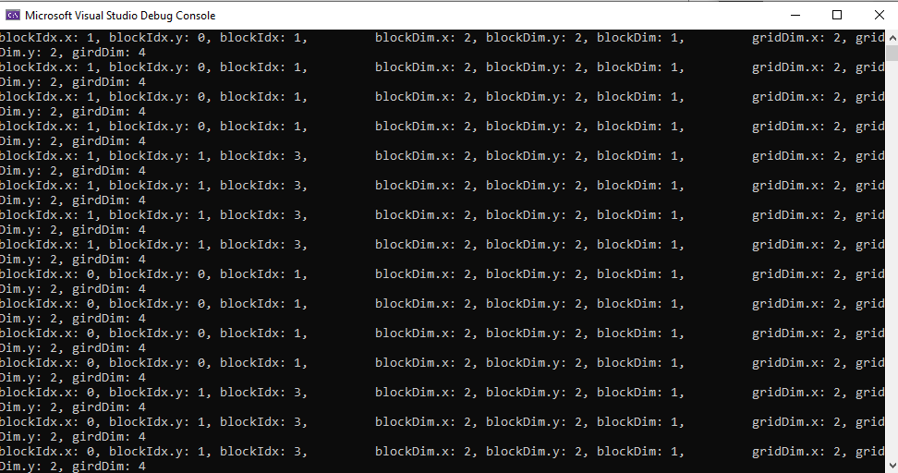
8.2 Verify
https://www.udemy.com/course/cuda-programming-masterclass/learn/lecture/12554944#overview
Verify

Slide 7
End of Chapter

