Slide 1

3 Super, Heterogeneous, and GPU
Peter H. Chen

Slide 2
3 Super, Heterogeneous, and GPU
https://www.udemy.com/course/cuda-programming-masterclass/learn/lecture/11833342#overview
Super Computing, Heterogeneous Computing, and GPU
We discuss the major fields in parallel computing: Super computing, Heterogeneous Computing, and GPU (Graphics Processing Units).

Slide 3
3.1 Super Computing

Slide 4
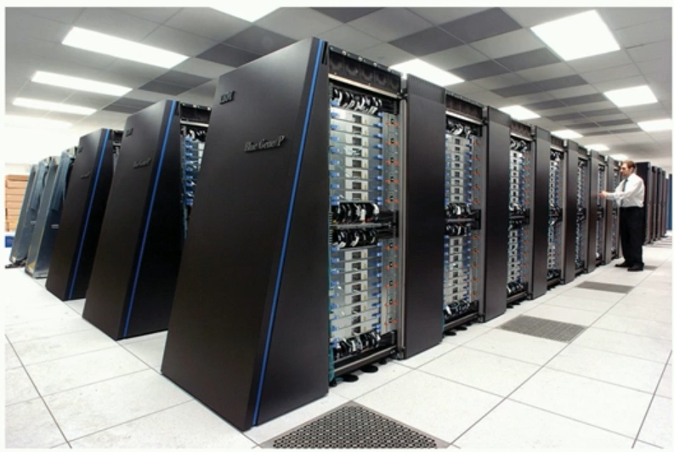
3.1 Super Computing
https://www.udemy.com/course/cuda-programming-masterclass/learn/lecture/11833342#overview
Super Computing
A Super computing is a computer with a high level of performance compared to a general-purpose computer.
Performance of a supercomputer is measured in floating-point operations per second.
Below is IBM Blue gene supercomputer.

Slide 5
3.1 Super Computing
https://www.udemy.com/course/cuda-programming-masterclass/learn/lecture/11833342#overview
Super Computing
Commonly, CPU, Memory, and processing cores are connected in a way that those can perform part of a heavy intense task to achieve collective results.
Performance of a supercomputer is measured using FPS (Floating Point Operations Per Second).

Slide 6
3.1 Super Computing
https://www.udemy.com/course/cuda-programming-masterclass/learn/lecture/11833342#overview
Usage of Super Computers
Supercomputers are used in many fields, such as,
Biomedical Research
Aerospace Simulation
Genetic Research
Earth Resource Explorations
Physics Simulations
These field are required accuracy and faster with solving equations with thousands of variables to achieve the precision.
For example, if you take aerospace simulation of a rocket launch, which relies on extra accurate results.
As they travel thousands of miles and one prevision point might have effect of a couple of miles.
Even physics simulation of a fluid, may involving in solving equation with multiple variables for each particles in the fluid to actually calculate the location of each particle.

Slide 7
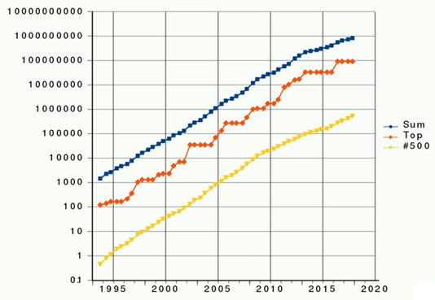
3.1 Super Computing
https://www.udemy.com/course/cuda-programming-masterclass/learn/lecture/11833342#overview
Computation power od a supercomputer grew in the past 20 years.
Vertical axis is logarithmic scale of billion floating point operations per second.
1 = 1 billion floating point operations per second. 10 = 10 billions floating point operations per second.

Slide 8
3.1 Super Computing
https://www.udemy.com/course/cuda-programming-masterclass/learn/lecture/11833342#overview
Computation power od a supercomputer grew in the past 20 years.
Currently, fastest supercomputer can perform hundred peta (10**15) flops per second.
Even the graph look like straight line in log scale, it is an exponential growth in real scale.

Slide 9
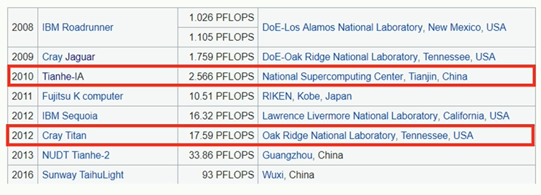
3.1 Super Computing
https://www.udemy.com/course/cuda-programming-masterclass/learn/lecture/11833342#overview
China’s Sunway TaihuLight has been the fastest supercomputer in 2016.
Tianhe-1A is a landmark achievement in supercomputing world around 2010, as scientist achieve the higher computing capability for much less power consumption using NVIDIA GPUs.
It was a vital landmark in Cuda computing time line as well.
Note: PFLOPS = Peta (10**15) Floating Point Operations per second.

Slide 10
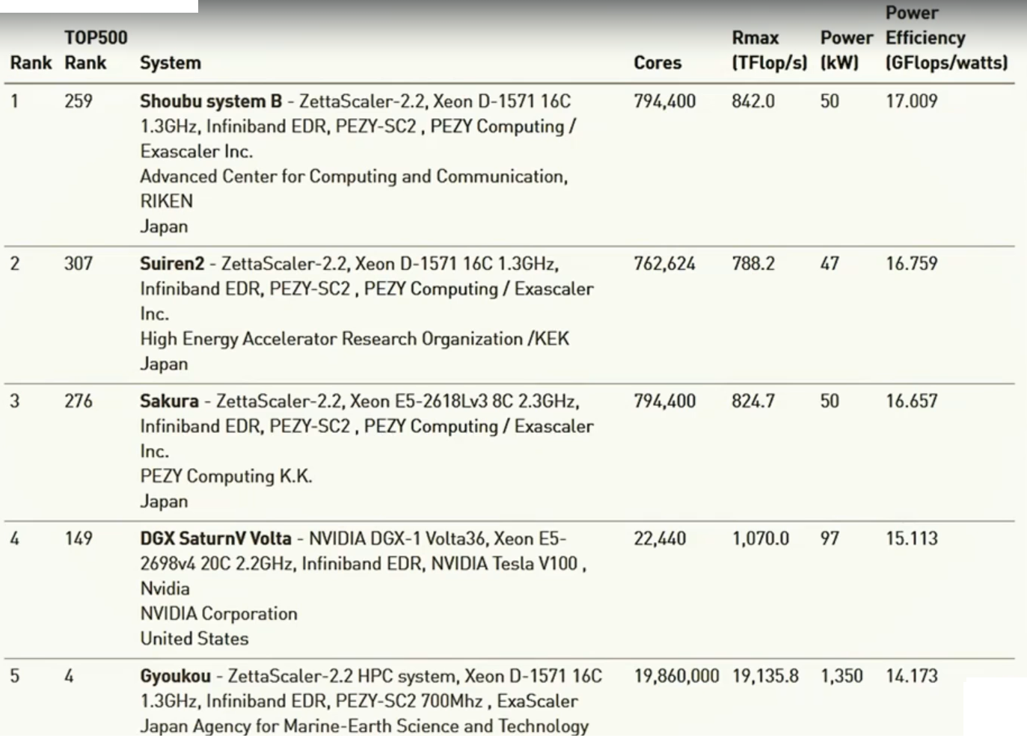
3.1 Super Computing
https://www.udemy.com/course/cuda-programming-masterclass/learn/lecture/11833342#overview
This table shows part of rank supercomputer based on the efficiency.
The power efficiency measured by how many floating point operations performed for single watt.

Slide 11
3.1 Super Computing
https://www.udemy.com/course/cuda-programming-masterclass/learn/lecture/11833342#overview
All the super computer implemented by PhysX multicore processors or NVIDIA Tesla GPUs.

Slide 12
3.2 GPUs

Slide 13
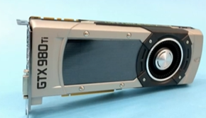
3.2 GPUs
https://www.udemy.com/course/cuda-programming-masterclass/learn/lecture/11833342#overview
GPUs
The GPU (Graphics Processing Unit), as a specialized computer processor, addresses the demands of real-time high-resolution 3D graphics compute-intensive tasks.
To address this demand, GPUs are designed in a efficient way than traditional GPUs.

Slide 14
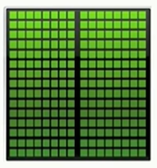

3.2 GPUs
https://www.udemy.com/course/cuda-programming-masterclass/learn/lecture/11833342#overview
Summary of CPU and GPU
On the other hand, CPUs are design with light but thousands of cores as shown in the left images to render thousands of pixels at once.
These core do not include mechanisms like branch predictors and have relatively low clock speed than CPUs.
GPUs have thousand of cores. GPUs have massively parallel architecture. GPUs can execute thousands of thread parallelly.
We call this type of devices as throughput devices.
Does not have optimization hardware like branch predictors
CPU are enhanced to process instruction quickly
CPU is a latency Device with high clock speed
Smaller number of cores. The Diagram show 2 cores or two computing units.
The cores have optimization hardware, like branch predictors and multi-level caches. The main focus of CPU is to run the instruction faster.

Slide 15
3.2 GPUs
https://www.udemy.com/course/cuda-programming-masterclass/learn/lecture/11833342#overview
Summary of CPU and GPU
Other than the differences, there are few other differences which are summarized in this table.
GPU | CPU
Context switching done by hardware. In GPUs, thousand of cores more than available in computing devices will enable more efficient execution. | Context switching done by software. CPU consumes hundreds of clock cycles. If you have much more threads running in CPU than available cores, performance will be degraded due to context switching
Can switch between threads if one thread stalls (loses) | For memory instruction, latencies with L1 and L2 cache misses, threads are going to stall
Thread schedulers and dispatch units are implemented in hardware | Work item creation done in software

Slide 16
3.3 Heterogeneous Computing

Slide 17
3.3 Heterogeneous Computing
https://www.udemy.com/course/cuda-programming-masterclass/learn/lecture/11833342#overview
Heterogeneous Computing
Heterogenous computing refers to systems that use more than one kind of processor or cores.
These systems gives us efficient way of performing highly parallel computation.
These systems gain performance or energy efficiency not just by adding the same type of processors, but by adding dissimilar coprocessors, usually incorporating specialized processing capabilities to handle particular tasks.

Slide 18
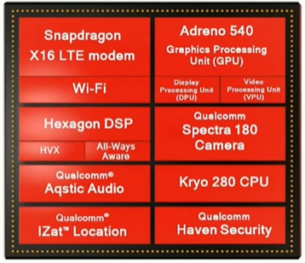
3.3 Heterogeneous Computing
https://www.udemy.com/course/cuda-programming-masterclass/learn/lecture/11833342#overview
Heterogeneous Computing
The following diagram shows the components heterogeneous computing.
They are very cheap smartphone available in current market.
If you look at here, there are multiple computer processors in this diagram.
We have Hexagon DSP, Adreno 540 GPU, and Kryo 280 CPU.
For example, we can perform some computation which are intend to execute in CPU on DSP or GPU unit when they are free.

Slide 19
3.3 Heterogeneous Computing
https://www.udemy.com/course/cuda-programming-masterclass/learn/lecture/11833342#overview
Heterogeneous Computing
This allows us to drive the total computing power of our overall device.
This kind of multiprocessor environment enables us to perform task using many types of processors.
As you can see, we do not have to go further than your pocket to find a heterogeneous computing environment.

Slide 20
3.4 Assignment

Slide 21
3.4 Assignment
https://www.udemy.com/course/cuda-programming-masterclass/learn/lecture/11833342#overview
Assignment
1. List 2 more field which benefited from Super Computing
Ans:
1) Autonomous driving especially in computer vision and machine perception 2) High-performance gaming platforms
2. Explain the term heterogeneous commuting in your word (Express your ide about that term) and list a place you can find heterogenous computing environment.
Ans:
Heterogeneous computing is a collaborative computing environment that makes use of the processing possibilities of collection of CPUs, GPUs, DSPs, and FPGAs. Examples of a heterogeneous computing platform are laptops and autonomous driving cars.

Slide 22
3.4 Assignment
https://www.udemy.com/course/cuda-programming-masterclass/learn/lecture/11833342#overview
Assignment
3. Name the 3 fastest super computers in the world at the moment.
Ans:
1) IBM Summit 2) IBM/Nvidia/Mellanox Sierra 3) Sunway TaihuLight

Slide 23
End of Chapter

