Slide 1

4 Install Cuda
Peter H. Chen

Slide 2
4 Install Cuda
https://www.udemy.com/course/cuda-programming-masterclass/learn/lecture/11833356#overview
Install Cuda
We have go through some terminology of parallel computing.
We will dive into the Cuda Programming.
We will install Cuda and run Cuda program.

Slide 3
4.1 Cuda

Slide 4
4.1 Cuda
https://www.udemy.com/course/cuda-programming-masterclass/learn/lecture/11833356#overview
Cuda
Cuda (Compute Unified Device Architecture) is a parallel computing platform and Application Programming Interface (API) model created by NVIDA.
The specialty of Cuda is that it enables us to use NVIDIA massively parallel GPUs as general purpose computing device paradigm.
GPGPU Programming: We refer to as GPGPU (General Purpose Computing in Graphic Processing Units) programming.
We use Windows 10 to access NVIDIA GPU.

Slide 5
4.2 Install Cuda Toolkit

Slide 6
4.2 Install Cuda Toolkit
https://www.udemy.com/course/cuda-programming-masterclass/learn/lecture/11833356#overview
Install Cuda Toolkit
Cuda requirement:
Windows 10
Visual Studio 2019 community edition as your IDE
If you are on Linux or MacOS: Eclipse Insight edition as your IDE

Slide 7
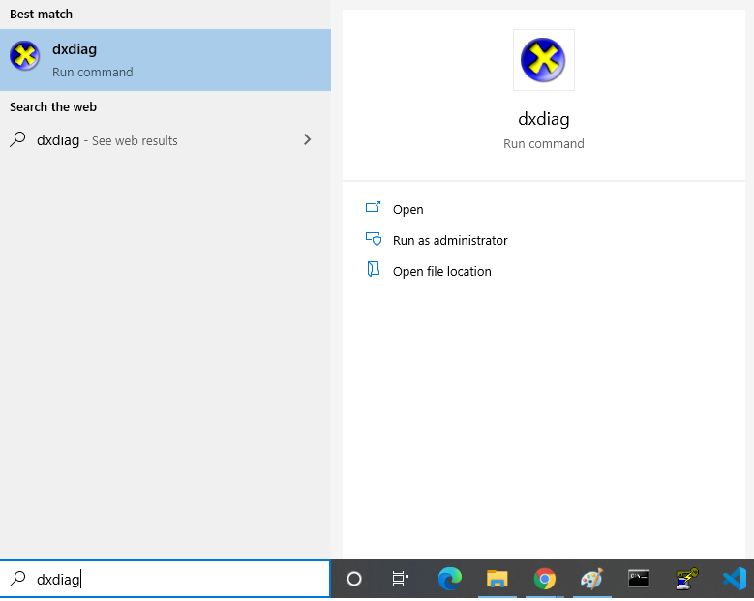
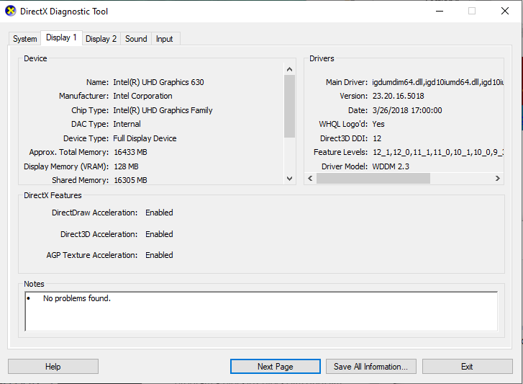
4.2 Install Cuda Toolkit
https://www.udemy.com/course/cuda-programming-masterclass/learn/lecture/11833356#overview
Install Cuda Toolkit
On windows 10, command search
> dxdiag (DirectX Diagnostic Tool)
For “display 1”, I have Intel graphic card on my PC.

Slide 8
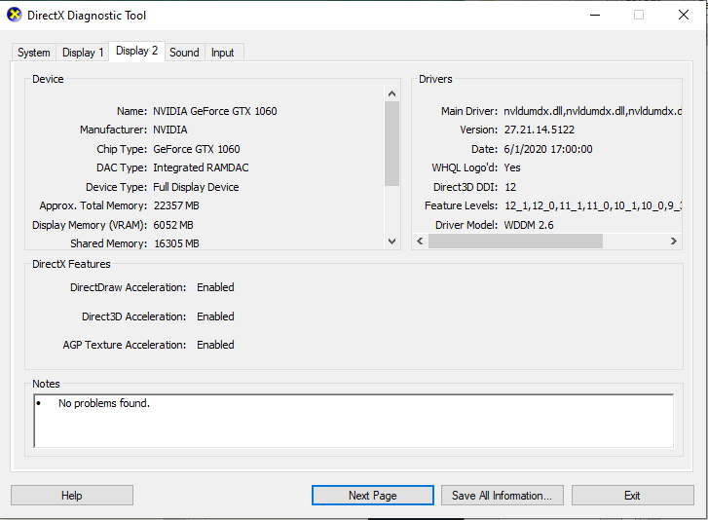
4.2 Install Cuda Toolkit
https://www.udemy.com/course/cuda-programming-masterclass/learn/lecture/11833356#overview
Install Cuda Toolkit
Click “Display 2” about the graphic card. I have the “NIVIDIA GeForce GTX1060” on my PC.
We have to check what microarchitecture belongs to and compute capability of that device.

Slide 9
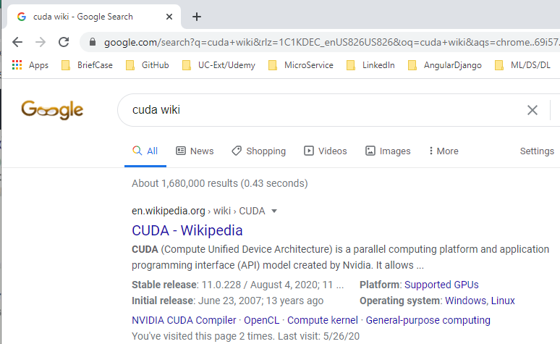
4.2 Install Cuda Toolkit
https://www.udemy.com/course/cuda-programming-masterclass/learn/lecture/11833356#overview
Install Cuda Toolkit
Microarchitecture and compute capability are basically way of categorizing GPUs based on their chip set.
Search for Cuda Wikipedia.

Slide 10
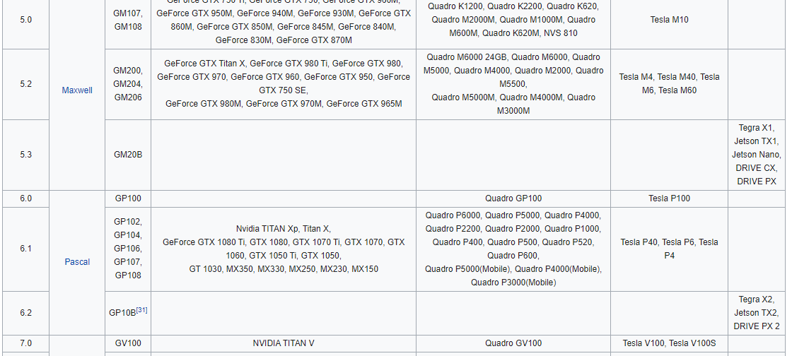
4.2 Install Cuda Toolkit
https://www.udemy.com/course/cuda-programming-masterclass/learn/lecture/11833356#overview
Install Cuda Toolkit
Scroll down for GTX 1060-1080 to see which category of NIVIDIA GPUs.
Find out which compute capability and microarchitecture which your PC belongs to. My is GeForce GTX 1060 between to Maxwell (5.2) and Pascal (6.1).

Slide 11
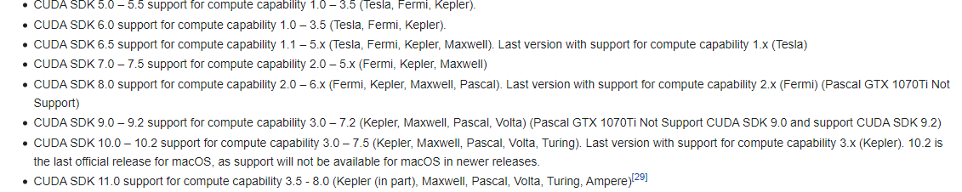
4.2 Install Cuda Toolkit
https://www.udemy.com/course/cuda-programming-masterclass/learn/lecture/11833356#overview
Install Cuda Toolkit
My microarchitecture is Maxwell and Pascal.
We can use Cuda SDK 11.

Slide 12
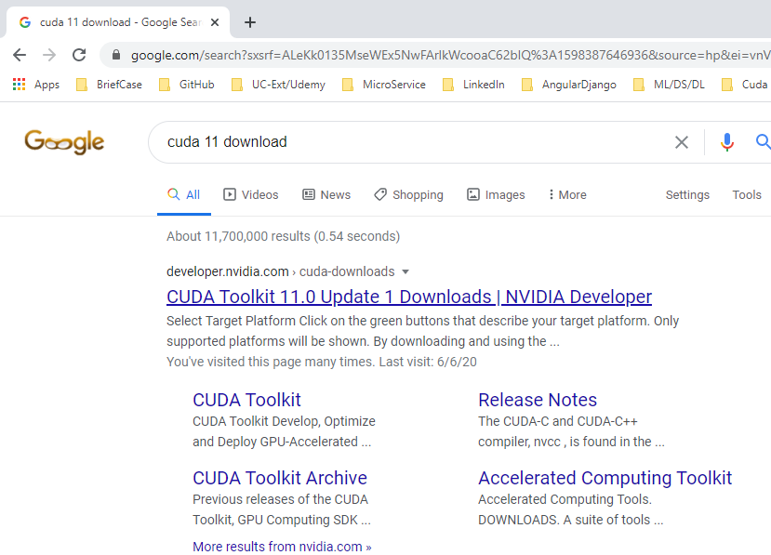
4.2 Install Cuda Toolkit
https://www.udemy.com/course/cuda-programming-masterclass/learn/lecture/11833356#overview
Install Cuda Toolkit
Search for Cuda 11 download.

Slide 13
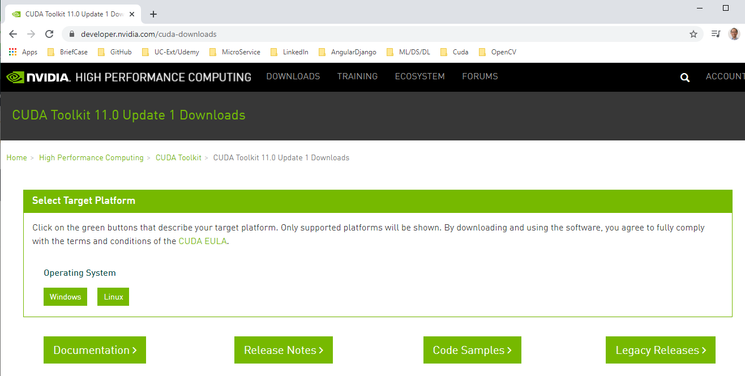
4.2 Install Cuda Toolkit
https://www.udemy.com/course/cuda-programming-masterclass/learn/lecture/11833356#overview
Install Cuda Toolkit
Download Cuda 11 download.

Slide 14
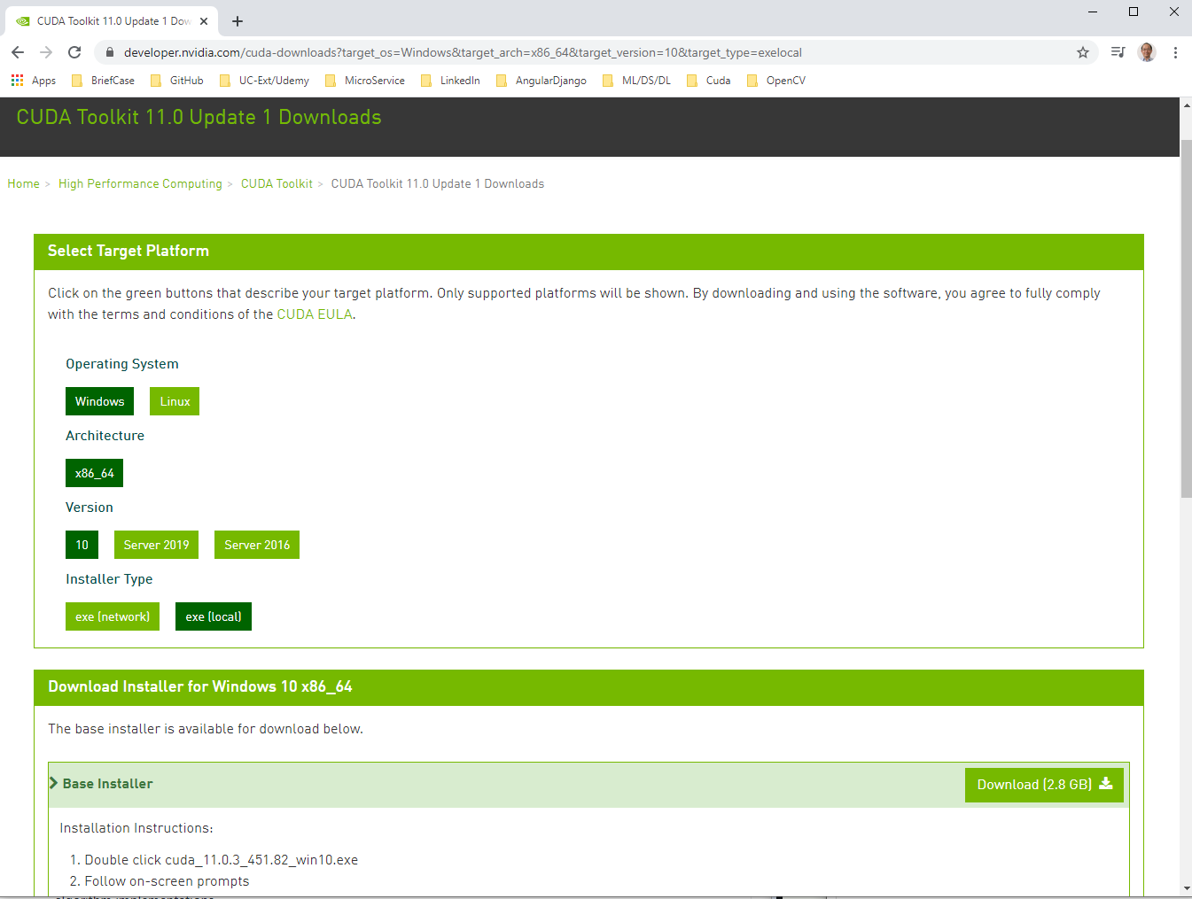
4.2 Install Cuda Toolkit
https://www.udemy.com/course/cuda-programming-masterclass/learn/lecture/11833356#overview
Install Cuda Toolkit
Download Cuda 11 and double click to start Cuda installation.

Slide 15
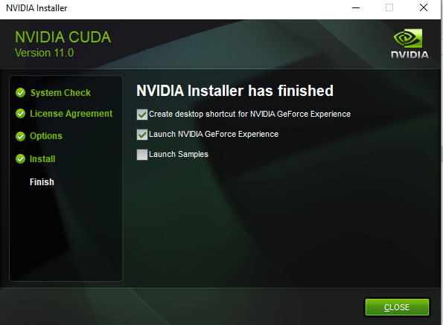
4.2 Install Cuda Toolkit
https://www.udemy.com/course/cuda-programming-masterclass/learn/lecture/11833356#overview
Install Cuda Toolkit
After Cuda installation, we have the following screen.

Slide 16
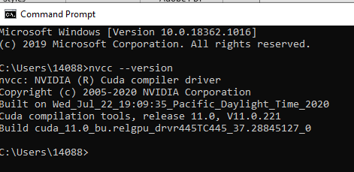
4.2 Install Cuda Toolkit
https://www.udemy.com/course/cuda-programming-masterclass/learn/lecture/11833356#overview
Verify installation
Open Command prompt:
> nvcc --version

Slide 17
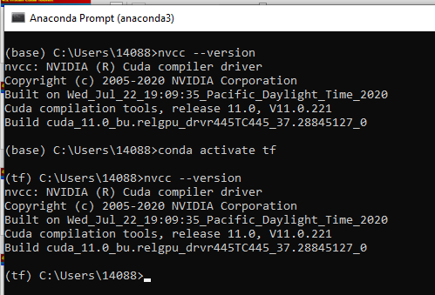
4.2 Install Cuda Toolkit
https://www.udemy.com/course/cuda-programming-masterclass/learn/lecture/11833356#overview
Verify installation
Open Anaconda
> conda activate tf
> nvcc –version
OK. We have successful installed the Cuda toolkit in windows 10 and Anaconda.

Slide 18
4.3 Visual Studio

Slide 19
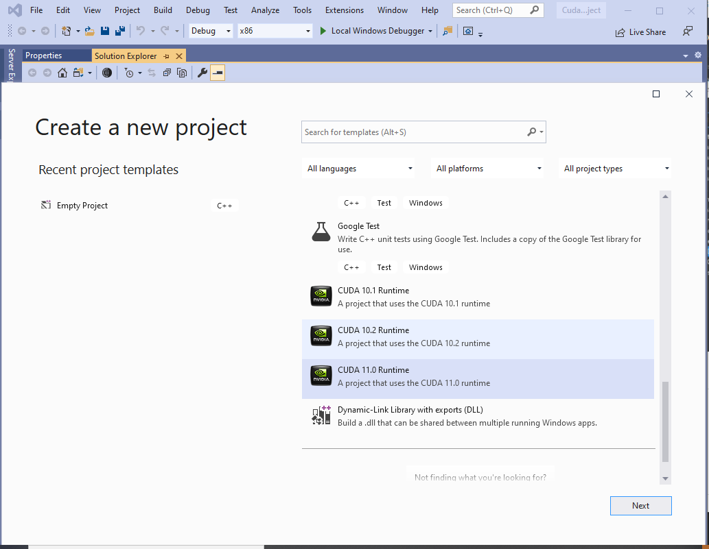
4.3 Visual Studio
https://www.udemy.com/course/cuda-programming-masterclass/learn/lecture/11833356#overview
Visual Studio
Select Project Templates: CUDA 11.0 Runtime.

Slide 20
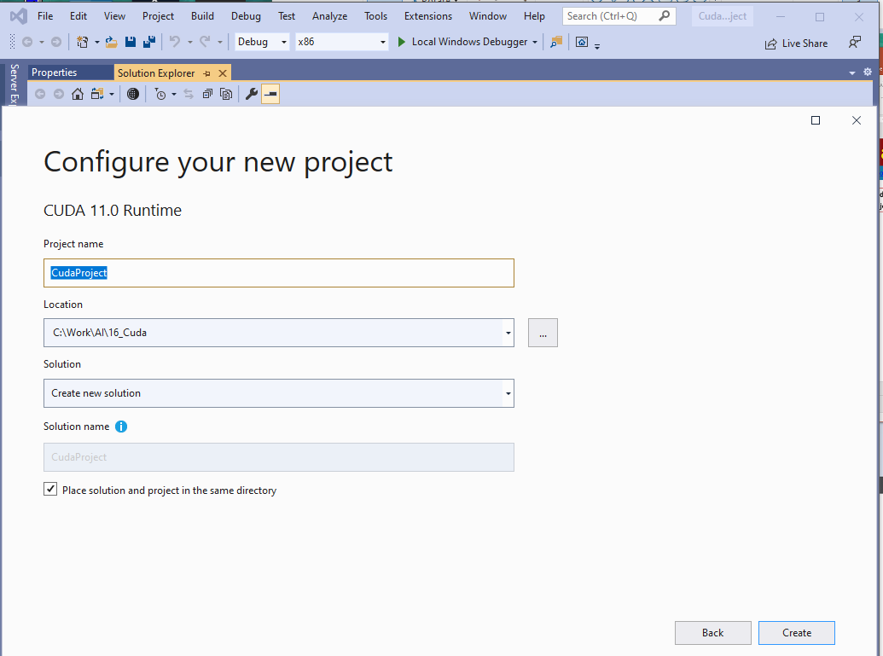
4.3 Visual Studio
https://www.udemy.com/course/cuda-programming-masterclass/learn/lecture/11833356#overview
Visual Studio
Project Name: 04_CudaProject
Location: C:\Work\AI\16_Cuda

Slide 21
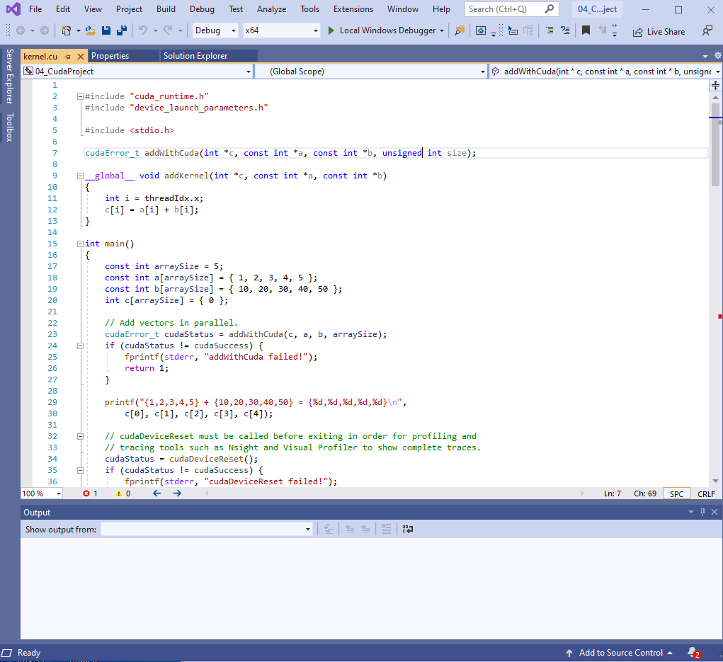
4.3 Visual Studio
https://www.udemy.com/course/cuda-programming-masterclass/learn/lecture/11833356#overview
Visual Studio
Click “Next”, we have:

Slide 22
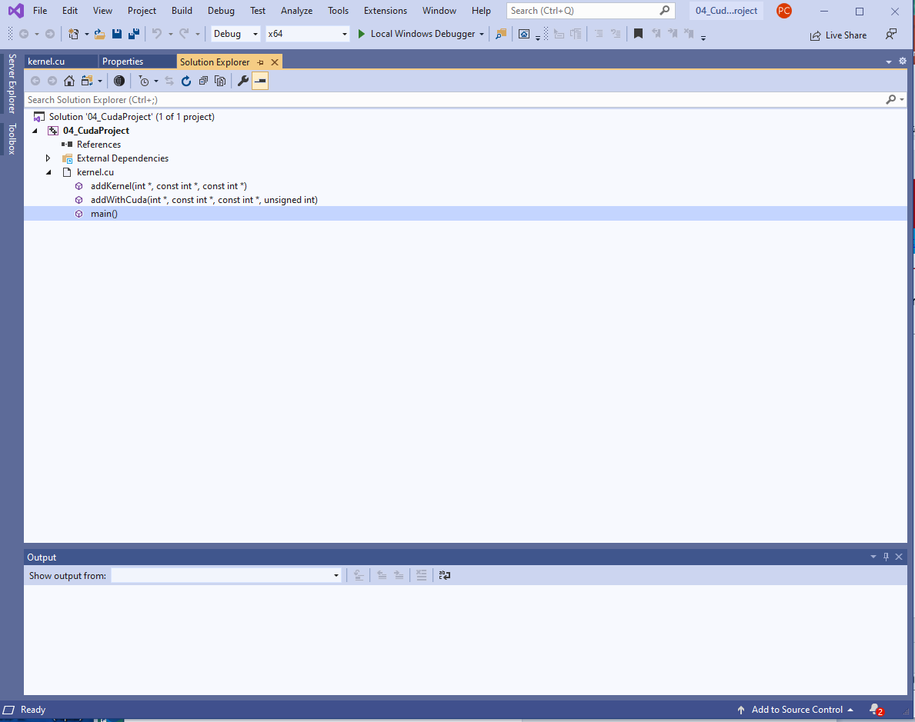
4.3 Visual Studio
https://www.udemy.com/course/cuda-programming-masterclass/learn/lecture/11833356#overview
Visual Studio
Use “Solution Explorer” to explorer the project “04_CudatProject” and “kernel.cu”.
The file extension “.cu” is extension for cuda program.
The code can be compiled into different devices.

Slide 23
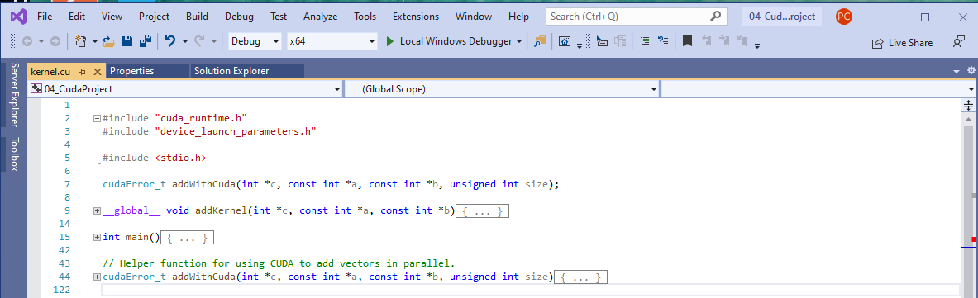
4.3 Visual Studio
https://www.udemy.com/course/cuda-programming-masterclass/learn/lecture/11833356#overview
Visual Studio
Double click “kernel.cu”

Slide 24
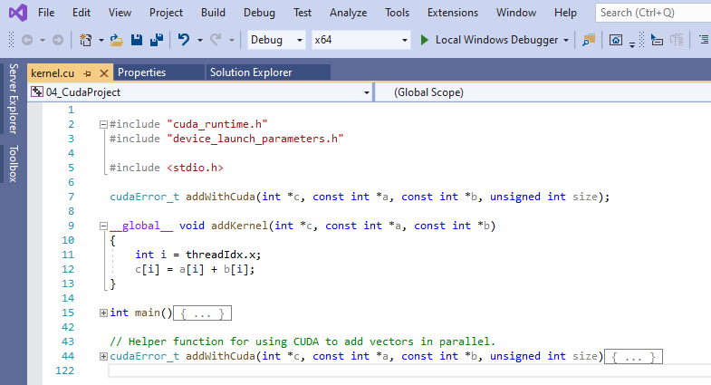
4.3 Visual Studio
https://www.udemy.com/course/cuda-programming-masterclass/learn/lecture/11833356#overview
Visual Studio
The “kernel.cu” file adding two vectors in GPU: a[i] and b[i] into c[i].
We have three kernel functions: addKernerl function which starts with global modifier is the function is going to execute in the GPU and such function we referred to as kernels.
So here we have a kernel called addKernel.

Slide 25
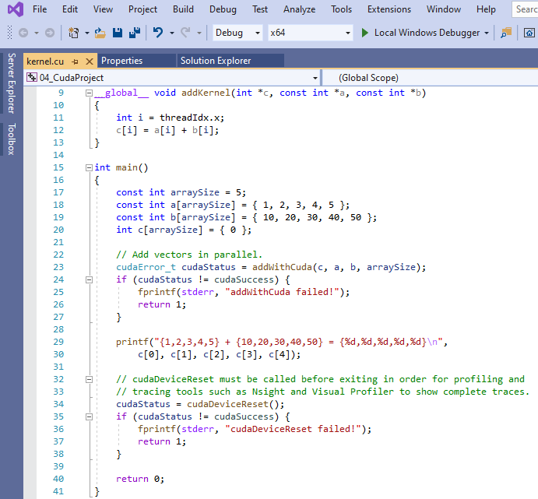
4.3 Visual Studio
https://www.udemy.com/course/cuda-programming-masterclass/learn/lecture/11833356#overview
Visual Studio
1. Main function is going to initialize the data.
3
2. Then call add with Cuda function which responsible for setting up the GPU.
1
2
3. The addKernel will execute in the GPU.

Slide 26
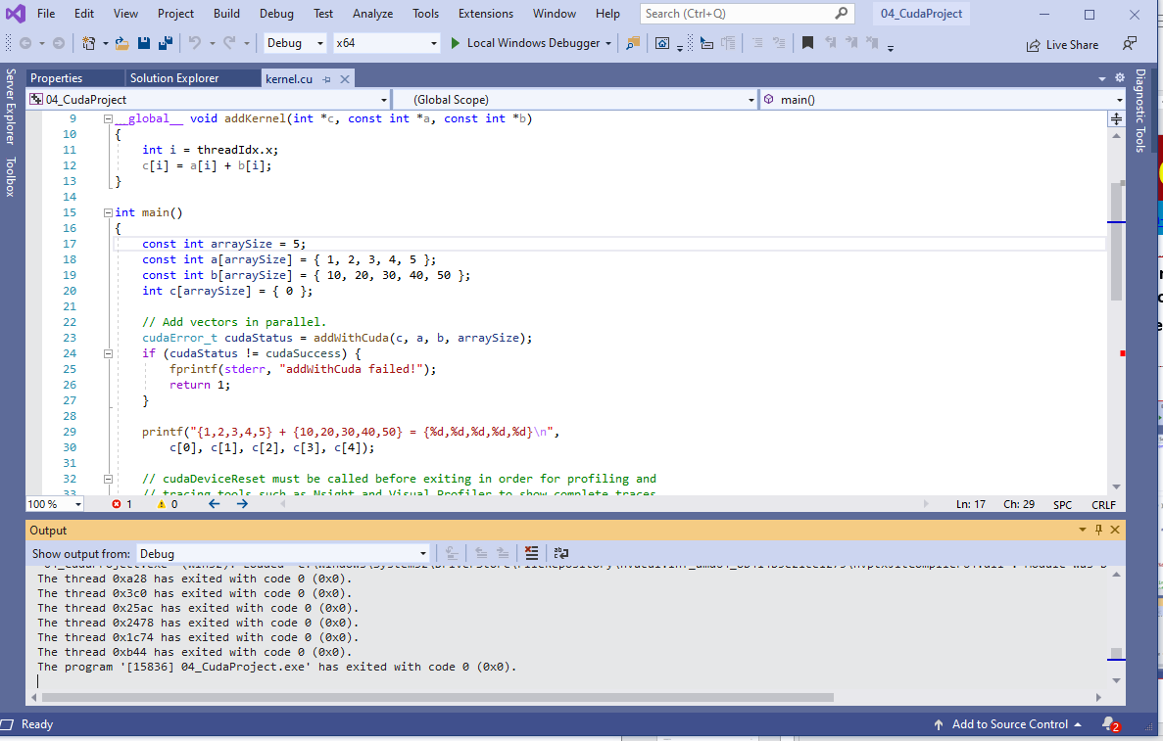
4.3 Visual Studio
https://www.udemy.com/course/cuda-programming-masterclass/learn/lecture/11833356#overview
This may seems like overwhelming for beginners at first but we will explore details of this kind of programming.
Click “>” to run the code.

Slide 27
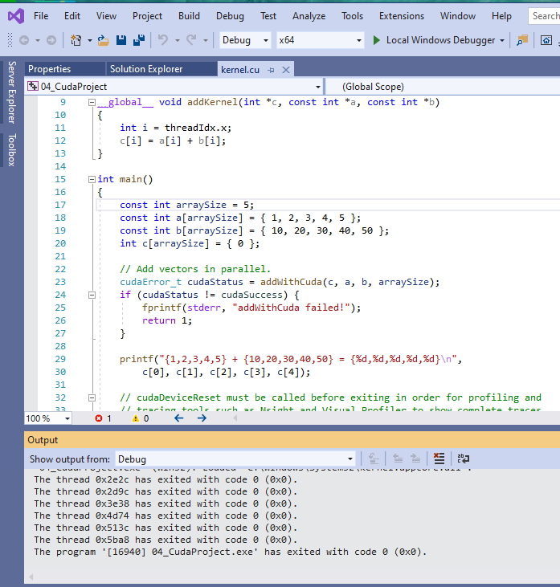
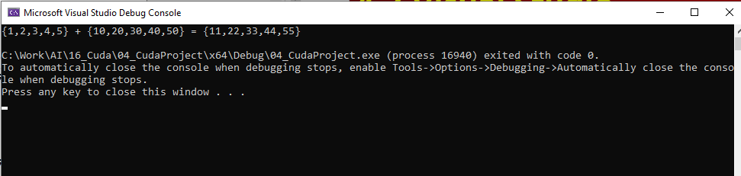
4.3 Visual Studio
https://www.udemy.com/course/cuda-programming-masterclass/learn/lecture/11833356#overview
Verify the result: {1,2,3,4,5} + {10,20,30,40,50} = {11,22,33,44,55}

Slide 28
End of Chapter

