Slide 1

5 Basic Element of Cuda Program
Peter H. Chen

Slide 2
5 Basic Element of Cuda Program
https://www.udemy.com/course/cuda-programming-masterclass/learn/lecture/11833384#overview
Basic Element of Cuda Program
We have installed the Cuda Program.
We will write our own Cuda Program from scratch.

Slide 3
5.1 Basic Steps of a Cuda Program

Slide 4
5.1 Basic Steps of a Cuda Program
https://www.udemy.com/course/cuda-programming-masterclass/learn/lecture/11833384#overview
Basic Steps of a Cuda Program
Almost every Cuda application follows the basic set of steps.
We initialize the data from CPU.
Transfer the initialized data from CPU context to GPU context.
We launch kernel to perform task on these transferred data. (Kernel launch with needed grid/block size)
GPU context transfers result back to CPU context.
Reclaim the allocated memory from both CPU and GPU execution to the system.
Cuda application will perform these set of steps multiple times.
We will look at each of these steps and details related to kernels launch.

Slide 5
5.2 Elements of a Cuda Program

Slide 6
5.2 Elements of a Cuda Program
https://www.udemy.com/course/cuda-programming-masterclass/learn/lecture/11833384#overview
Elements of a Cuda Program
Cuda applications consist of sequential code
Host code (main function): Code that is going to run in CPU.
Device Code: Code that is going to run in GPU.
Apart from sequence your programming logic, the responsibility of calling Cuda kernel with proper device configuration is handed by the host code.
For a most basic Cuda program, “hello Cuda world” program.
This program print out “Hello Cuda World” to the console.
It print the output to the terminal after the result executed by the device or GPU, not CPU.

Slide 7

5.2 Elements of a Cuda Program
https://www.udemy.com/course/cuda-programming-masterclass/learn/lecture/11833384#overview
Elements of a Cuda Program
First thing to notice is that we have
We included necessary header files: cuda_runtime.h and device_launch_parameters.h files which allows us to use the keywords in the Cuda runtime.
We include stdio.h header file to use the printf function, to output the text to the console.

Slide 8
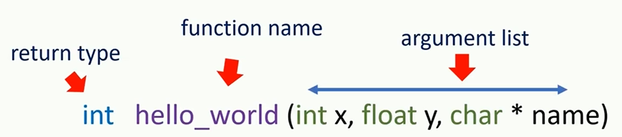
5.2 Elements of a Cuda Program
https://www.udemy.com/course/cuda-programming-masterclass/learn/lecture/11833384#overview
Elements of a Cuda Program
Second, we add host code and device code.
In this example, it is the main () function.
We will fill the main function after we complete the device code. In C function, normally, we have return type, function name, and then argument list.

Slide 9
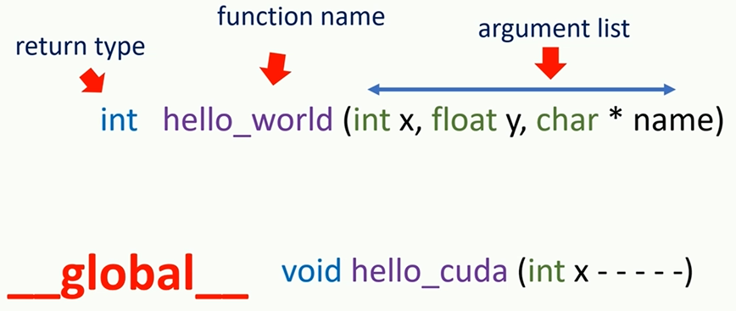
5.2 Elements of a Cuda Program
https://www.udemy.com/course/cuda-programming-masterclass/learn/lecture/11833384#overview
Elements of a Cuda Program
But device function or kernel definitions, we have to add another keyword to specify that this function is going to run in Cuda enable device.
For that purpose, we use either __host__, __device__, or __global__ modifiers.
We will discuss more on modifiers.
For now, we will use __global__ keyword for this purpose.

Slide 10
5.2 Elements of a Cuda Program
https://www.udemy.com/course/cuda-programming-masterclass/learn/lecture/11833384#overview
Elements of a Cuda Program
Also, every kernel should have “void” as return type to indicate nothing is returning from this function call.
If you want to return some variables from the kernel, we have to explicitly transfer those memories using specific Cuda runtime function calls.

Slide 11
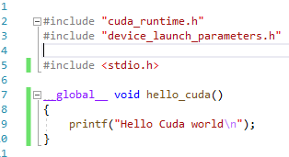
5.2 Elements of a Cuda Program
https://www.udemy.com/course/cuda-programming-masterclass/learn/lecture/11833384#overview
Elements of a Cuda Program
Add Cuda kernel function.
__global__ void hello_cuda () { …}

Slide 12
5.2 Elements of a Cuda Program
https://www.udemy.com/course/cuda-programming-masterclass/learn/lecture/11833384#overview
Elements of a Cuda Program
We have to call the kernel function hello_cuda().
We call function with function name and argument list.
We have to specify the kernel launch parameter as well.
Hello_world <<< 1, 1 >>> () ;
1,1 are the kernel launch parameter.
This kernel launch is an asynchronous function which means host function does not have to wait until the kernel execution finish. The host code can execute next instruction as soon as kernel launch is done.
If you want to wait until our kernel to finish its execution, we need to done it explicitly using the cudaDeviceSynchronize function call();
This function will guarantees that host code to wait at this point until all previous launch kernels finished their execution, After our kernel finish its execution, usually, we should have to copy the results from kernel back to the host.

Slide 13
5.2 Elements of a Cuda Program
https://www.udemy.com/course/cuda-programming-masterclass/learn/lecture/11833384#overview
Elements of a Cuda Program
But here is in our kernel, cudaDeviceReset();
Now, we have our first Cuda program.

Slide 14
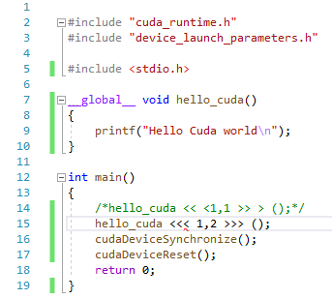
5.2 Elements of a Cuda Program
https://www.udemy.com/course/cuda-programming-masterclass/learn/lecture/11833384#overview
Elements of a Cuda Program
But here is in our kernel, cudaDeviceReset();
Now, we have our first Cuda program.

Slide 15
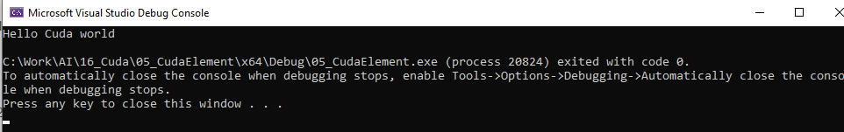
5.2 Elements of a Cuda Program
https://www.udemy.com/course/cuda-programming-masterclass/learn/lecture/11833384#overview
Elements of a Cuda Program
But here is in our kernel, cudaDeviceReset();
Now, we have our first Cuda program.

Slide 16

5.2 Elements of a Cuda Program
https://www.udemy.com/course/cuda-programming-masterclass/learn/lecture/11833384#overview
Elements of a Cuda Program
Change second parameter << <1, 2 >> >()
Launch kernel and print two times.

Slide 17
5.3 Grid and Block

Slide 18
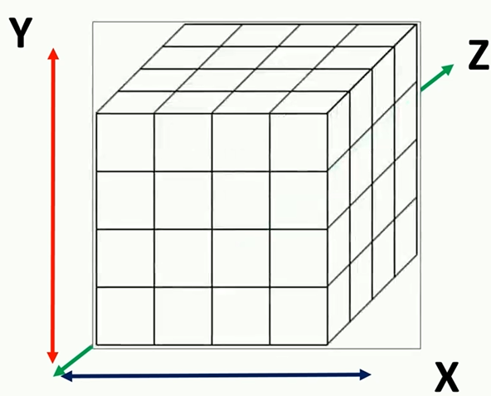
5.3 Grid and Block
https://www.udemy.com/course/cuda-programming-masterclass/learn/lecture/11833384#overview
Grid and Block
Cuda have the key concepts of grid and block.
Grid: Grid is a collection of all threads launch for a kernel.
For example, in the “Hello Cuda World”, kernel launch, if we specify <<<1, 20>>>, then we have 1 grid and 20 block to execute 20 (1 x 20) threads.
Block: Thread in a grid is organized into groups called thread blocks.
These thread blocks allow Cuda toolkit to synchronized and manage workload without heavy performance penalties.

Slide 19
5.3 Grid and Block
https://www.udemy.com/course/cuda-programming-masterclass/learn/lecture/11833384#overview
Grid and Block
Three dimensional view of the grid can be visualized using cartesian coordinates system.
Each smaller cube represent one thread.
There will be some number of threads in X, Y, and Z dimension. For example, here we visualize 64 threads, which arrange to have 4 threads in X dimension, 4 threads in dimension Y, and t threads in dimension Z.
4
4
4

Slide 20
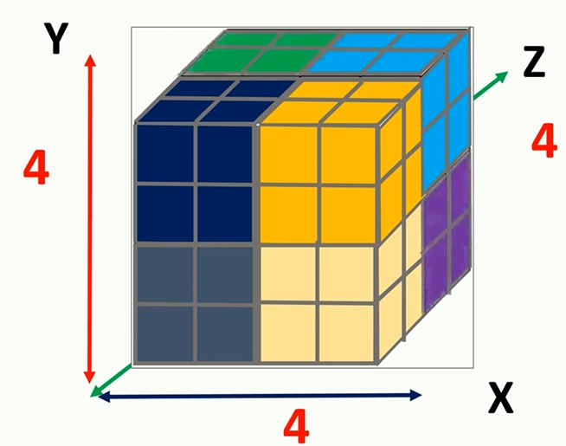
5.3 Grid and Block
https://www.udemy.com/course/cuda-programming-masterclass/learn/lecture/11833384#overview
Grid and Block
All together, we have 64 threads in this grid. Thread block in a grid is subset of a grid.
Hence, it can also arrange in three dimension in Cartesian coordinates system as well.
For example, if our 64 thread grid is arrange into 8 thread blocks, each have two threads in all three dimensions.

Slide 21
5.3 Grid and Block
https://www.udemy.com/course/cuda-programming-masterclass/learn/lecture/11833384#overview
Grid and Block
Kernel name <<< number_of_blocks, thread_per_block >>> (arguments)
The arrange of the thread block and grid in each dimension are specified by these two parameters.
The first parameter is how many blocks.
The second parameter is how many thread in each block.

Slide 22
5.3 Grid and Block
https://www.udemy.com/course/cuda-programming-masterclass/learn/lecture/11833384#overview
Grid and Block
We can specify multi-dimensional grid.
dim3 variable_name (X, Y, Z)
dim3 type variables in Cuda,
dim3 is a vector type or type which have X, Y, and Z values which are initialized to 1 by default.
You can access each dimension value dim3 type variable using .x, .y, and .x with variable name.
variable_name.x
variable_name.y
variable_name.z

Slide 23
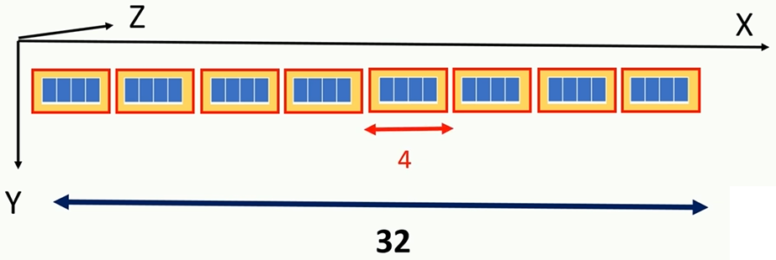
5.3 Grid and Block
https://www.udemy.com/course/cuda-programming-masterclass/learn/lecture/11833384#overview
Grid and Block
I need to launch “Hello World” Kernel with one dimensional grid with 32 thread arrange into 8 thread blocks, where each block having 4 threads in X dimension.
> dim3 block (4, 1, 1)
> dim3 grid (8, 1, 1)
> kernel_name <<< grid, block >>> ()

Slide 24
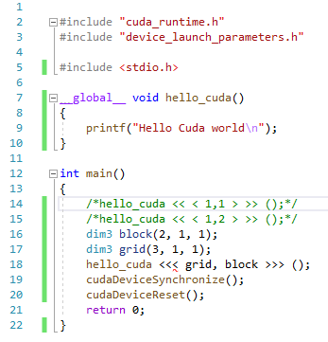
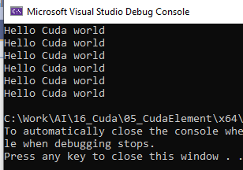
5.3 Grid and Block
https://www.udemy.com/course/cuda-programming-masterclass/learn/lecture/11833384#overview
Grid and Block
We have 3 blocks, each block has 2 grids: 2 grids/block x 3 blocks = 6 grids

Slide 25
5.4 Two Dimensional Grids

Slide 26
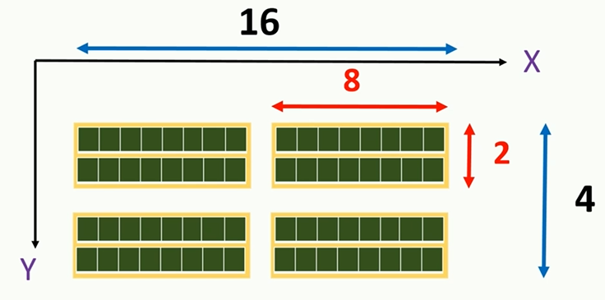
5.4 Two Dimensional Grids
https://www.udemy.com/course/cuda-programming-masterclass/learn/lecture/11833384#overview
Two Dimensional Grids
> dim3 block (8, 2, 1)
> dime3 grid (2, 2, 1)

Slide 27
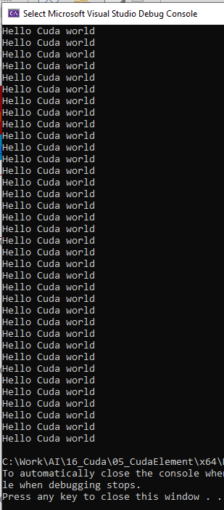
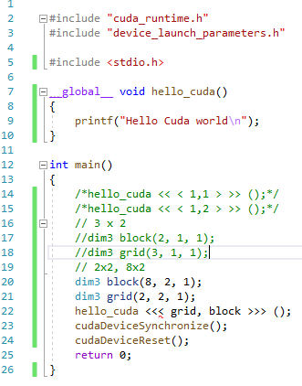
5.4 Two Dimensional Grids
https://www.udemy.com/course/cuda-programming-masterclass/learn/lecture/11833384#overview
Two Dimensional Grids
> dim3 block (8, 2, 1)
> dime3 grid (2, 2, 1)

Slide 28
5.5 Use variable.x and variable.y

Slide 29
5.5 Use variable.x and variable.y
https://www.udemy.com/course/cuda-programming-masterclass/learn/lecture/11833384#overview
Two Dimensional Grids
> dim3 block (8, 2, 1)
> dime3 grid (2, 2, 1)

Slide 30
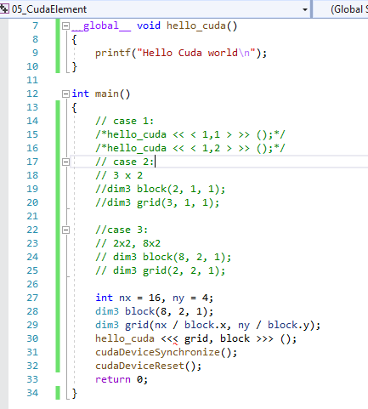
5.5 Use variable.x and variable.y
https://www.udemy.com/course/cuda-programming-masterclass/learn/lecture/11833384#overview
Two Dimensional Grids
Nx = 16, ny = 4
> dim3 block (8, 2, 1)
> dime3 grid (nx/block.x, ny/block.y, 1)

Slide 31
5.6 Limitation of Block Size

Slide 32
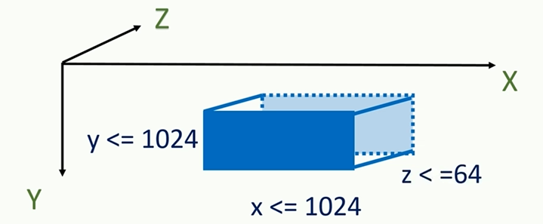
5.6 Limitation of Block
https://www.udemy.com/course/cuda-programming-masterclass/learn/lecture/11833384#overview
Limitation of Block
We have maximum value of (1024, 1024, 64) in the block.
Maximum number of x * y * z <= 1024.
x * y * z <= 1024

Slide 33
5.7 Limitation of Thread Block

Slide 34
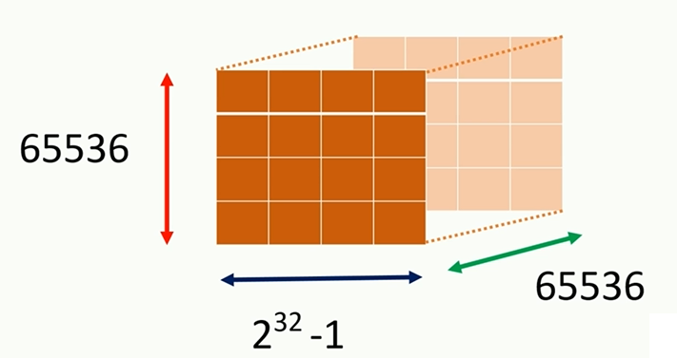
5.7 Limitation of Thread Block
https://www.udemy.com/course/cuda-programming-masterclass/learn/lecture/11833384#overview
Limitation for number of thread block in each dimension

Slide 35
End of Chapter

