Slide 1

6 ThreadIdx
Peter H. Chen

Slide 2
6 ThreadIdx
https://www.udemy.com/course/cuda-programming-masterclass/learn/lecture/11833388#overview
Cuda Thread: ThreadIdx
In Cuda, we have access to unique set of variables from device code.
These set of variables are implicitly initialized by Cuda runtime, based on where the accessing thread is located in the thread block.
All these variables are dim3 type variable with X, Y, and Z coordinates.

Slide 3
6.1 theradIdx

Slide 4
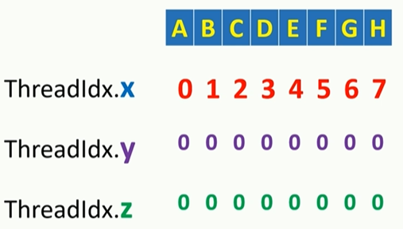
6.1 ThreadIdx
https://www.udemy.com/course/cuda-programming-masterclass/learn/lecture/11833388#overview
ThreadIdx
Cuda runtime uniquely initialized threadIdx variable for each thread depending on where that particular thread is located in the thread block.
ThreadIdx is dim3 type variable.
For example, consider a one dimensional grid with one thread block with eight threads. This diagram represent such as grid.
Here a thread is represented by each slot, and we named each of these thread using letter A to H.
This is a one dimensional grid, so X dimensional value of threadIdx variable or threadIdx.X values for each thread in this grid, will be initialized starting from 0 as shown here.

Slide 5
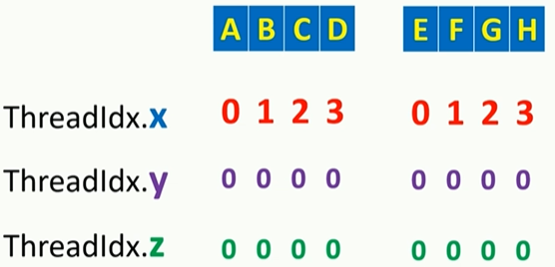
6.1 ThreadIdx
https://www.udemy.com/course/cuda-programming-masterclass/learn/lecture/11833388#overview
ThreadIdx
Two thread blocks.

Slide 6
6.2 2D-theradIdx

Slide 7
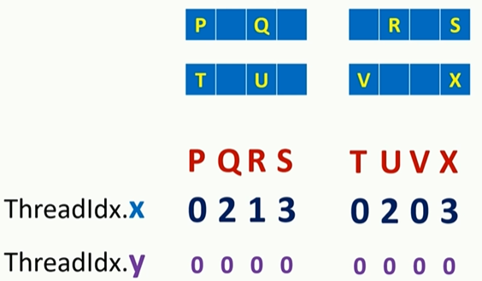
6.2 2D-theradIdx
https://www.udemy.com/course/cuda-programming-masterclass/learn/lecture/11833388#overview
2D ThreadIdx
Block filled into two dimensional threadIdx

Slide 8
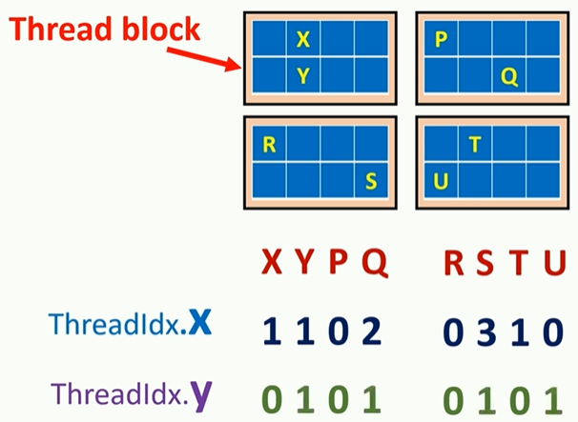
6.2 2D-theradIdx
https://www.udemy.com/course/cuda-programming-masterclass/learn/lecture/11833388#overview
In this diagram, we can see another wd grid,.

Slide 9
6.3 Grid with 256 threads

Slide 10
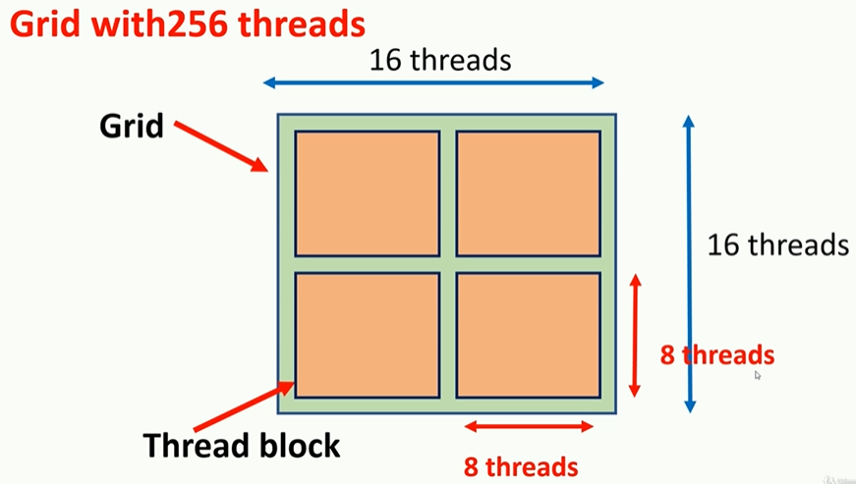
6.3 Grid with 256 threads
https://www.udemy.com/course/cuda-programming-masterclass/learn/lecture/11833388#overview
Grid with 256 threads
We will launch 2D with 256 threads with 4 blocks.
Each blocks has 64 threads.

Slide 11
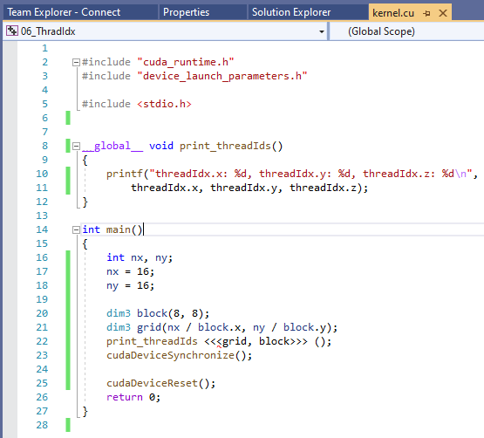
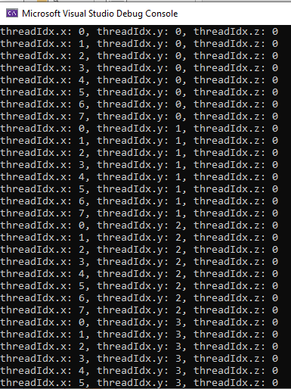
6.3 Grid with 256 threads
https://www.udemy.com/course/cuda-programming-masterclass/learn/lecture/11833388#overview
Grid with 256 threads
We will launch 2D with 256 threads with 4 blocks.
Each blocks has 64 threads.

Slide 12
End of Chapter

