Slide 1

2 Parallel Programming
Peter H. Chen

Slide 2
2 Parallel Programming
https://www.udemy.com/course/cuda-programming-masterclass/learn/lecture/11805184#overview
Parallel Programming
We can process multiple application at the same time.
Central Processing Unit
Control Unit
Input Device
Arithmetic/Logic Unit
Output Device
Memory Unit

Slide 3
2.1 Process

Slide 4
2.1 Process
https://www.udemy.com/course/cuda-programming-masterclass/learn/lecture/11805184#overview
Process
A process is an instance of a computer program that is being executed.
When you run the application, instruction for that application will be fetched to the processor.
Also the memory will be allocated in RAM to hold runtime resources.
The running instance refers to as a process.
Other than the memory and image of executable code or the instructions, there is an important thing called context is also associated with the process.
Hard drive
CPU
application
RAM

Slide 5
2.2 Context

Slide 6
2.2 Context
https://www.udemy.com/course/cuda-programming-masterclass/learn/lecture/11805184#overview
Context
Context is a collection of data about process which allows processor to suspend or hold the execution of a process and restart the execution later.
Memory address and program counter states are some of the data contained in the context.
When running a multiple applications or processes simultaneously, if we have only a single core process, that processor will execute instruction of these process in the round-robin fashion.
Time slot will be allocated for each process depending on the readiness of particular process memory and the priority of that process.
Process 1
Processor
Process 2
Process 3

Slide 7
2.2 Context
https://www.udemy.com/course/cuda-programming-masterclass/learn/lecture/11805184#overview
Context
If we arrange the execution of the instruction in a processor in timeline, one possible outcome would be like this.
Each time slot execute one process at the time.
This type of execution is possible due to the mechanism called context switching.
Process 1
Processor
Process 2
Process 3

Slide 8
2.2 Context
https://www.udemy.com/course/cuda-programming-masterclass/learn/lecture/11805184#overview
Context
With context switching mechanism, processor can load context of a process and execute it from the state it hold the execution previously and then it can suspend the execution that process and switch the context to another process and to start the execution of that particular process.
We call this type of execution as round-robin fashion execution of instructions.
Process 1
Processor
Process 2
Process 3

Slide 9
2.3 Thread

Slide 10
2.3 Thread
https://www.udemy.com/course/cuda-programming-masterclass/learn/lecture/11805184#overview
Thread
Another important concept which is very similar to process is a thread.
Thread or thread of execution.
Thread of execution is the smallest sequence of programmed instructions that can be managed independently by a scheduler.
Thread is component of a process.
Every process have at least on thread called main thread, which is the entry for the program.
One major distinction between threads and process is that within the same process, multiple threads can co-exists and shared the memory between them, which of course the memory allocated for that particular process.
But if we consider two processes, there will not be any sharing of resourses between them.

Slide 11
2.4 Parallel Processing

Slide 12
2.4 Parallel Processing
https://www.udemy.com/course/cuda-programming-masterclass/learn/lecture/11805184#overview
Parallel Processing
Cuda uses parallel programming. The modern CPU have multiple cores which means multiple threads or multiple processes can execute simultaneously without context switching.
This type of simultaneous processing of multiple threads is referred to as parallel processing.
Multiple threads
Multiple cores
Processor
Processor
Processor
Processor
Processor
Processor

Slide 13
2.5 Parallel Task

Slide 14

2.5 Parallel Task
https://www.udemy.com/course/cuda-programming-masterclass/learn/lecture/11805184#overview
Parallel Task
We can understand the parallel processing or parallel computing with a real world example.
When we build a bouse, we have a task to do

Slide 15
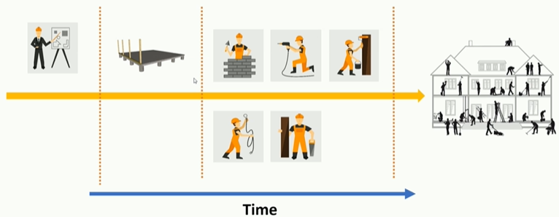
2.5 Parallel Task
https://www.udemy.com/course/cuda-programming-masterclass/learn/lecture/11805184#overview
Tasks in hand
Planning
Lay a foundation
Brick laying
Water and sewer pipe laying
Plumbing and roofing
House wiring
Painting
Carpet laying or marbling the floor
Furnishing
Gardening

Slide 16
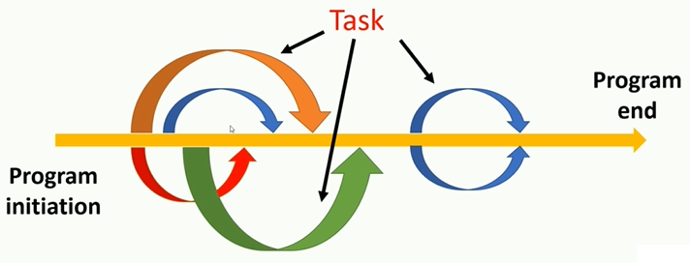
2.5 Parallel Task
https://www.udemy.com/course/cuda-programming-masterclass/learn/lecture/11805184#overview
We still can execute these instructions in sequential order with context switching.

Slide 17
2.6 Data Level Parallelism

Slide 18
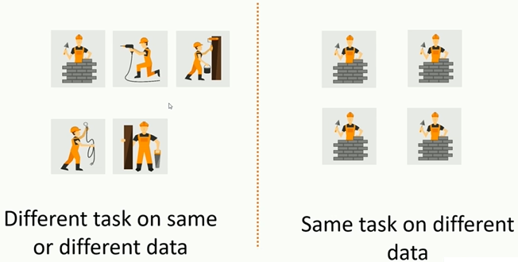
2.6 Data Level Parallelism
https://www.udemy.com/course/cuda-programming-masterclass/learn/lecture/11805184#overview
If we have multiple cores, we can execute the program parallelly.
Task level and data level parallelism.
This type of parallelism is referred to as data level parallelism.

Slide 19
2.7 Parallelism vs. Concurrency

Slide 20
2.7 Parallelism vs. Concurrency
https://www.udemy.com/course/cuda-programming-masterclass/learn/lecture/11805184#overview
Parallelism vs. Concurrency
There are slightly difference in parallelism and concurrency.
If we have single co-processor, this processor will accommodate this execution with context switching.
This type of simultaneously execution is referred to as concurrency.
This is actually an illusion of parallel execution but actually in hardware level, we execute instruction sequentially.
Process 1
Processor
Process 2
Process 3

Slide 21
2.7 Parallelism vs. Concurrency
https://www.udemy.com/course/cuda-programming-masterclass/learn/lecture/11805184#overview
Concurrency
Process 1
Processor
Process 2
Process 3
Parallelism
Multiple threads
Multiple cores
Process 1
Processor
Process 2
Processor
Process 3
Processor

Slide 22
2.7 Parallelism vs. Concurrency
https://www.udemy.com/course/cuda-programming-masterclass/learn/lecture/11805184#overview
Parallelism vs. Concurrency
When we have multiple cores to execute multiple processes. The Parallelism is true parallelism. We have enough cores in our processor ti run each of these process in different cores.
All processes or threads will run in parallel in all the cores.
Multiple threads
Multiple cores
Process 1
Processor
Process 2
Processor
Process 3
Processor

Slide 23
End of Chapter

