Slide 1

7 BlockIdx
Peter H. Chen

Slide 2
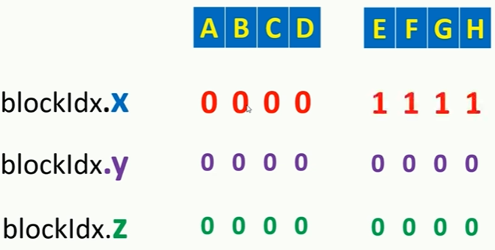
7 BlockIdx
https://www.udemy.com/course/cuda-programming-masterclass/learn/lecture/11833394#overview
Cuda BlockIdx
Cuda runtime uniquely initialized blockIdx variable for each thread depending on the coordinates of the belonging thread block in the grid.
blockIdx is dim3 type variable.

Slide 3
7.1 BlockIdx Example 1
Peter H. Chen

Slide 4
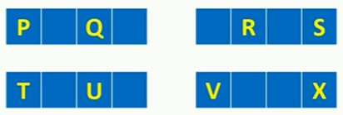
7.1 BlockIdx Example 1
https://www.udemy.com/course/cuda-programming-masterclass/learn/lecture/11833394#overview
2 dimensional grid with 2 thread blocks in each dimension
Each thread block have 4 threads in X dimension.
Here, we have named for some of these threads with letters.
So assign blockIdx values for each of those.

Slide 5
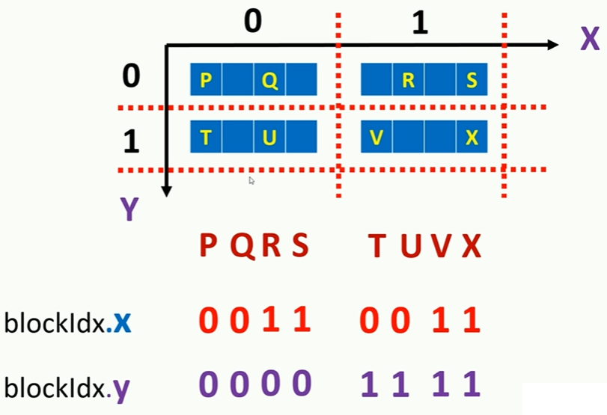
7.1 BlockIdx Example 1
https://www.udemy.com/course/cuda-programming-masterclass/learn/lecture/11833394#overview
Assign block id for each threads.

Slide 6
7.2 BlockIdx Example 2
Peter H. Chen

Slide 7
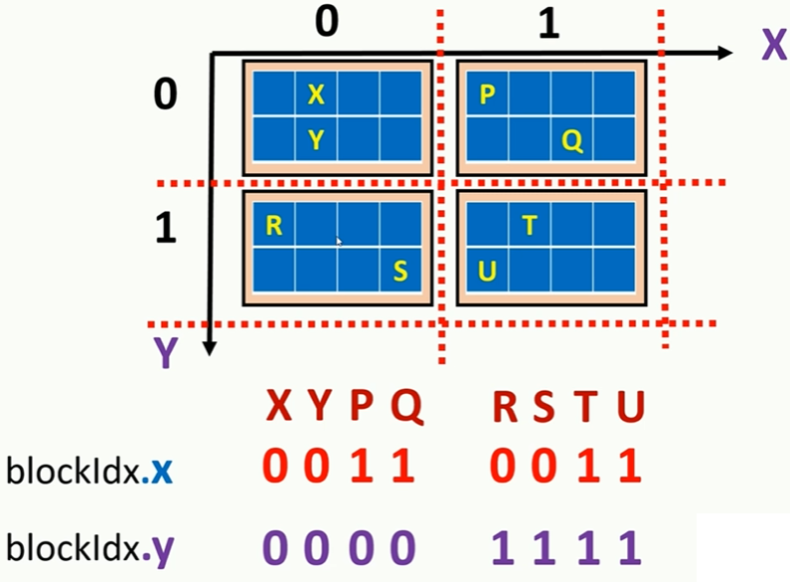
7.2 BlockIdx Example 2
https://www.udemy.com/course/cuda-programming-masterclass/learn/lecture/11833394#overview
Assign block id for each threads.

Slide 8
7.3 blockDim

Slide 9
7.3 blockDim
https://www.udemy.com/course/cuda-programming-masterclass/learn/lecture/11833394#overview
blockDim
blockDim variable consist number of threads in each dimension of a thread block.
Notice all the thread block in a grid have same block size, so this variable value is same for all threads in a grid.
blockDim is dim2 type variable.

Slide 10
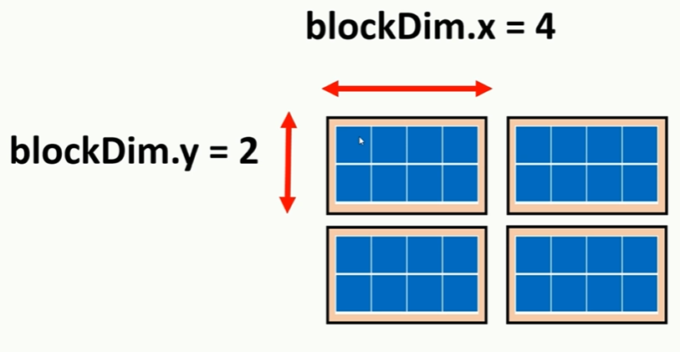
7.3 blockDim Example
https://www.udemy.com/course/cuda-programming-masterclass/learn/lecture/11833394#overview
blockDim Example

Slide 11
7.4 gridDim

Slide 12
7.4 gridDim
https://www.udemy.com/course/cuda-programming-masterclass/learn/lecture/11833394#overview
gridDim
gridDim variable consists number of thread blocks in each dimension of a grid.
gridDim is dim3 type variable.

Slide 13
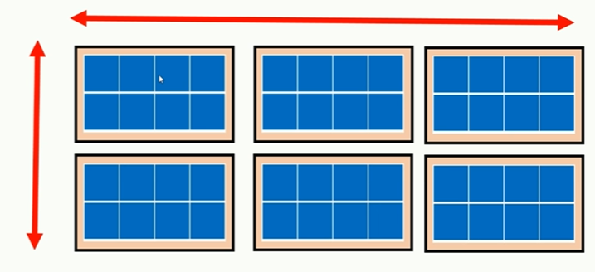
7.4 gridDim Example
https://www.udemy.com/course/cuda-programming-masterclass/learn/lecture/11833394#overview
gridDim Example
gridDim.x = 3
gridDim.y = 3

Slide 14
7.5 blockDim and gridDim Example

Slide 15
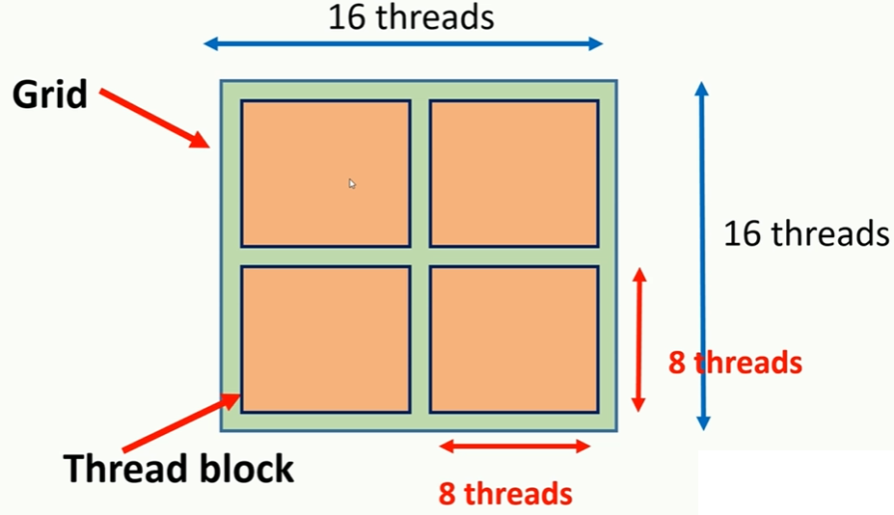
7.5 blockDim and gridDim Example
https://www.udemy.com/course/cuda-programming-masterclass/learn/lecture/11833394#overview
blockDim and gridDim Example
Gird with 256 threads

Slide 16
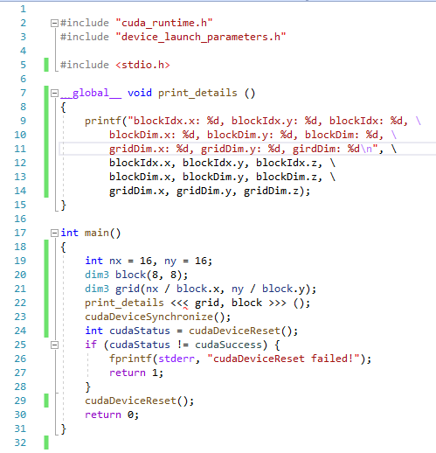
7.5 blockDim and gridDim Example
https://www.udemy.com/course/cuda-programming-masterclass/learn/lecture/11833394#overview
blockDim and gridDim Example
Code

Slide 17
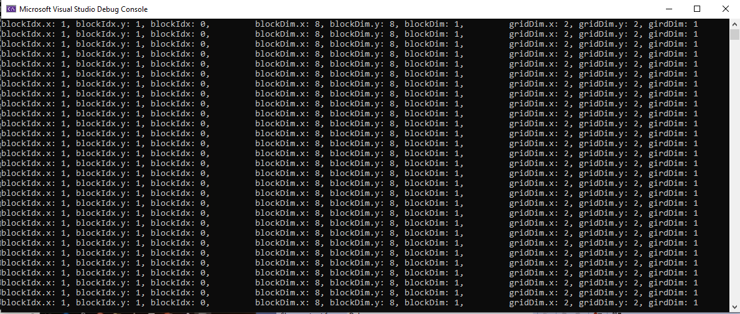
7.5 blockDim and gridDim Example
https://www.udemy.com/course/cuda-programming-masterclass/learn/lecture/11833394#overview
blockDim and gridDim Example
Result

Slide 18
End of Chapter

