Slide 1

9 Index Calculation by Idx
Peter H. Chen

Slide 2
9 Index Calculation by Idx
https://www.udemy.com/course/cuda-programming-masterclass/learn/lecture/11833398#overview
Unique Index Calculation for thread in a grid: ThreadIdx, blockIdx, and blockDim
In a Cuda program, it is very common to use threadIdx, blockIdx, blockDim, and gridDim variable values to calculate the array indices.
This is used these variables to access the element of an array transferred to a kernel.

Slide 3
9.1 Single Block

Slide 4
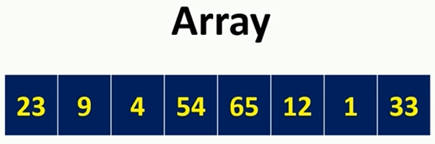
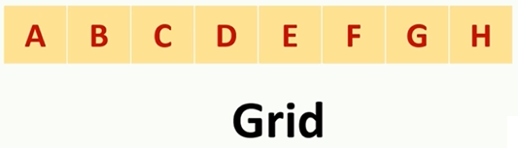
9.1 Single Block
https://www.udemy.com/course/cuda-programming-masterclass/learn/lecture/11833398#overview
Unique Index Calculation for thread in a grid: ThreadIdx, blockIdx, and blockDim
For example, we have an array of 8 elements with values as below:
We are going to launch to one dimensional grid with single thread block. We named these threads in this grid using letters:

Slide 5
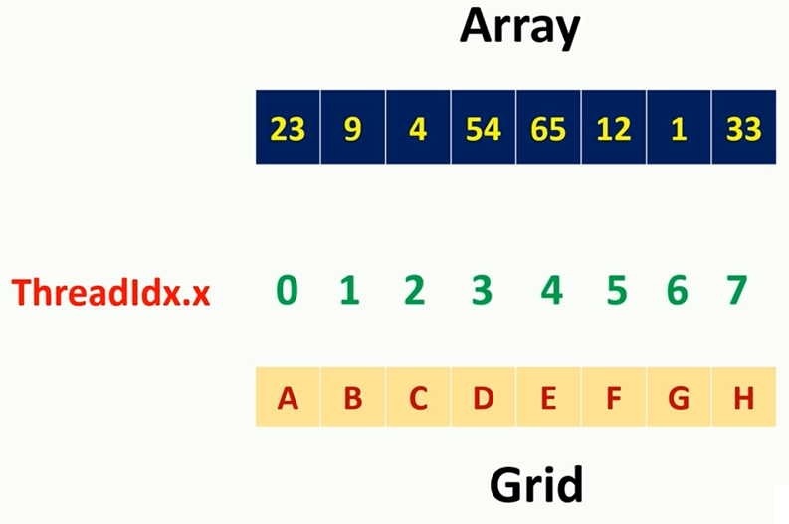
9 Index Calculation by Idx
https://www.udemy.com/course/cuda-programming-masterclass/learn/lecture/11833398#overview
Unique Index Calculation for thread in a grid: ThreadIdx, blockIdx, and blockDim
The threadIdx.x value of each thread in this gird is above the corresponding threads.

Slide 6
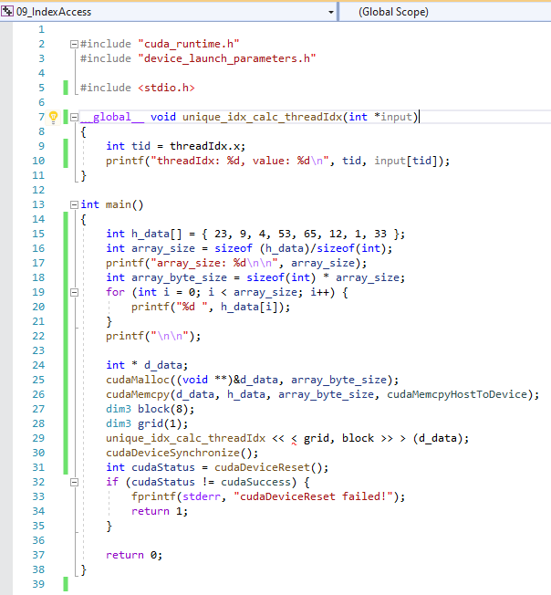
9.1 Code
https://www.udemy.com/course/cuda-programming-masterclass/learn/lecture/11833398#overview
Code:

Slide 7
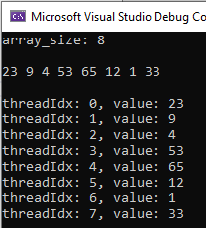
9.1 Verify
https://www.udemy.com/course/cuda-programming-masterclass/learn/lecture/11833398#overview
Verify:

Slide 8
9.2 Two Blocks

Slide 9
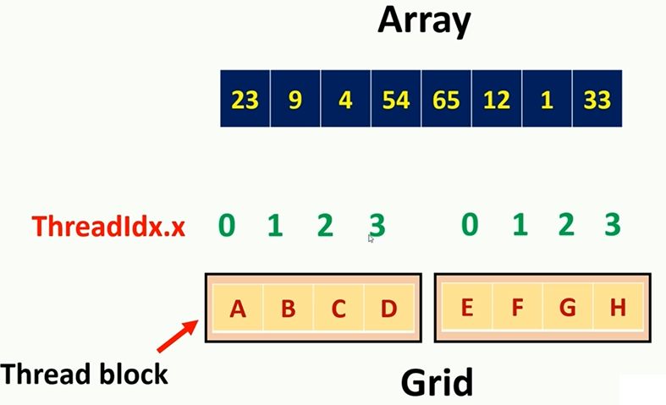
9.2 Two Blocks
https://www.udemy.com/course/cuda-programming-masterclass/learn/lecture/11833398#overview
Two Blocks: How to access the elements with two blocks?

Slide 10
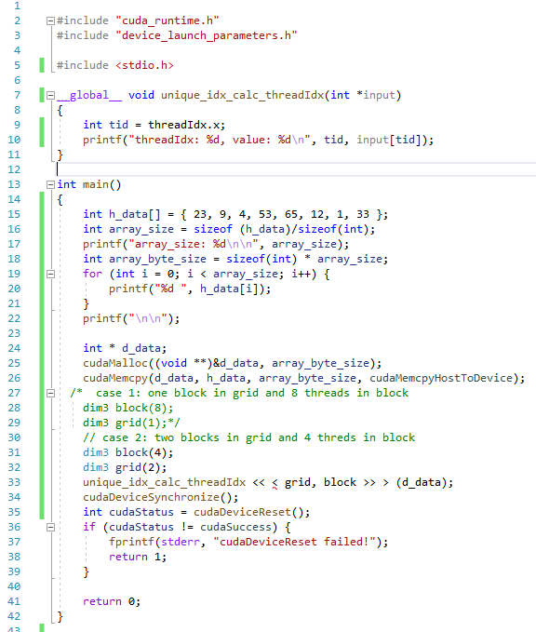
9.2 Two Blocks
https://www.udemy.com/course/cuda-programming-masterclass/learn/lecture/11833398#overview
Code:

Slide 11
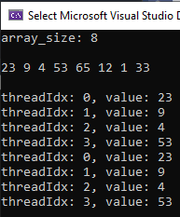
9.2 Two Blocks
https://www.udemy.com/course/cuda-programming-masterclass/learn/lecture/11833398#overview
Verify:

Slide 12
9.3 Four Blocks

Slide 13
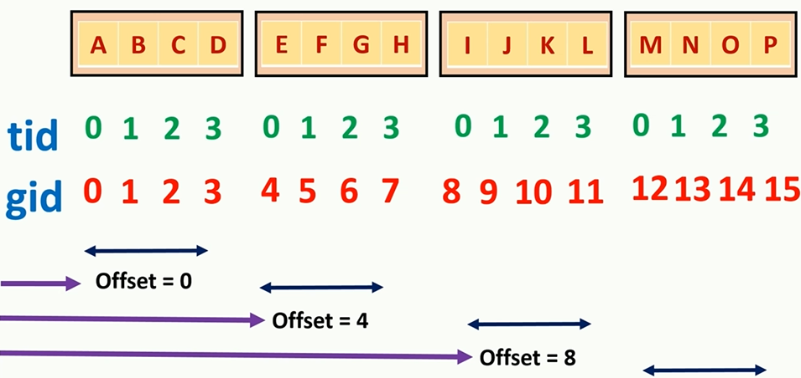
9.3 Four Blocks
https://www.udemy.com/course/cuda-programming-masterclass/learn/lecture/11833398#overview
Four Blocks: How to access the elements with two blocks?
Offset = 12

Slide 14

9.3 Four Blocks
https://www.udemy.com/course/cuda-programming-masterclass/learn/lecture/11833398#overview
Four Blocks: How to access the elements with two blocks?

Slide 15
9.3 Four Blocks
https://www.udemy.com/course/cuda-programming-masterclass/learn/lecture/11833398#overview
For thread in second thread block:
blockIndx.x = 1
blockDim.x = 4
The second block offset:
Offset = blockIndx.x * blocDim.x = 1 * 4 = 4

Slide 16
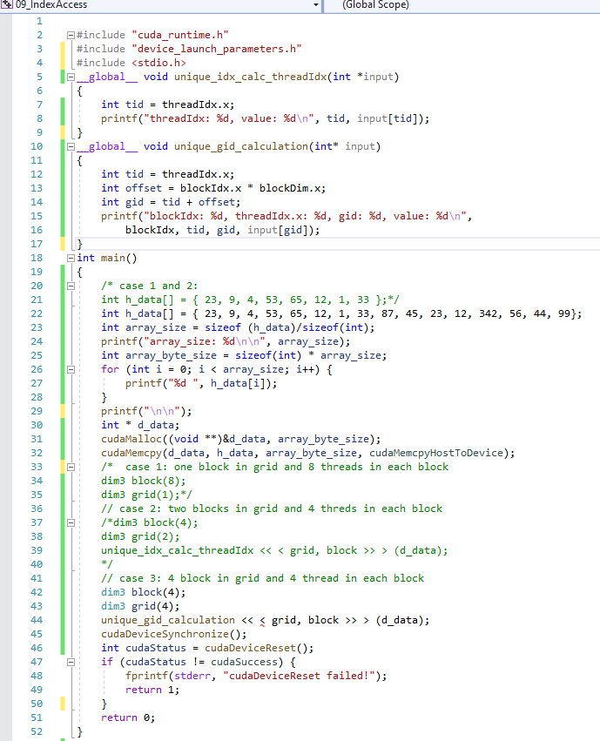
9.3 Four Blocks
https://www.udemy.com/course/cuda-programming-masterclass/learn/lecture/11833398#overview
Code:

Slide 17
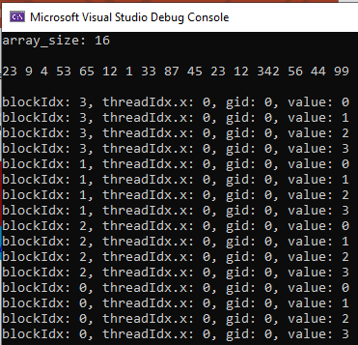
9.3 Four Blocks
https://www.udemy.com/course/cuda-programming-masterclass/learn/lecture/11833398#overview
Verify:

Slide 18
End of Chapter

