Slide 1

10 Index Access 2D Grid 1
Peter H. Chen

Slide 2
10 Index Access 2D Grid 1
https://www.udemy.com/course/cuda-programming-masterclass/learn/lecture/11833400#overview
Index Access 2D Grid 01:
We discuss 2 dimensional Grids.

Slide 3
10.1 Two Dimensional Grid

Slide 4
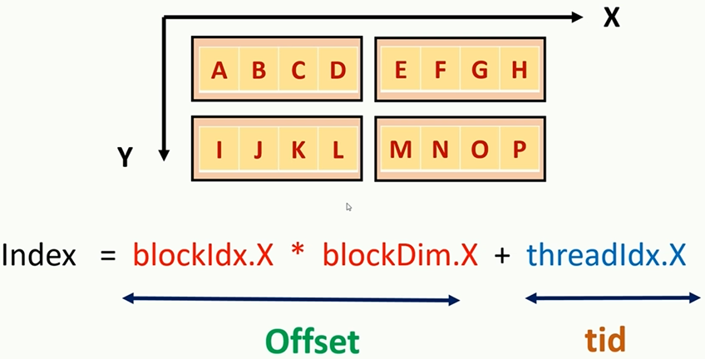
10.1 Two Dimensional Grid
https://www.udemy.com/course/cuda-programming-masterclass/learn/lecture/11833400#overview
Index Access 2D Grid 01:
We have two dimensional Grid. Each dimension contain 2 blocks.

Slide 5
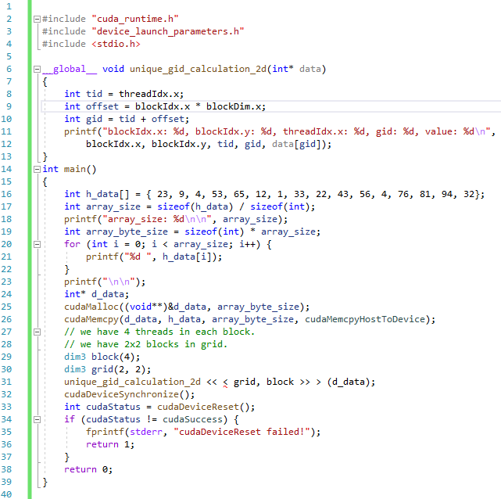
10.1 Two Dimensional Grid
https://www.udemy.com/course/cuda-programming-masterclass/learn/lecture/11833400#overview
Code

Slide 6
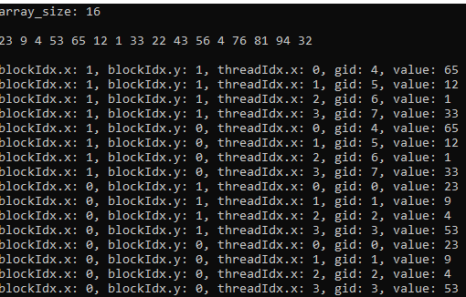
10.1 Two Dimensional Grid
https://www.udemy.com/course/cuda-programming-masterclass/learn/lecture/11833400#overview
Result:

Slide 7
10.2 2D Index

Slide 8
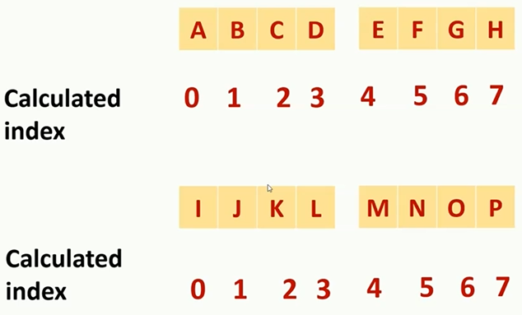
10.2 2D Index
https://www.udemy.com/course/cuda-programming-masterclass/learn/lecture/11833400#overview
These are the index from the previous calculation.

Slide 9
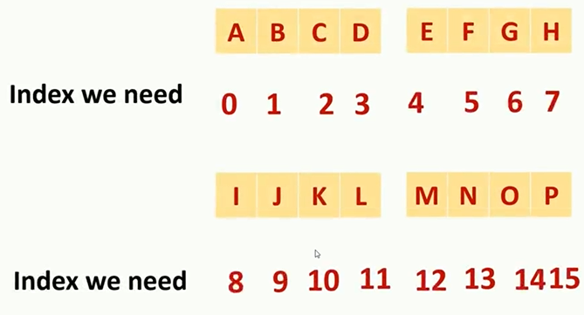
10.2 2D Index
https://www.udemy.com/course/cuda-programming-masterclass/learn/lecture/11833400#overview
These are the Global Index.
We must have the unique index for all the 16 elements.

Slide 10
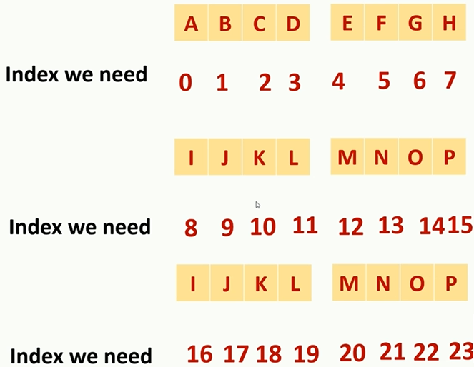
10.2 2D Index
https://www.udemy.com/course/cuda-programming-masterclass/learn/lecture/11833400#overview
These are the Global Index.
We add the third row.

Slide 11
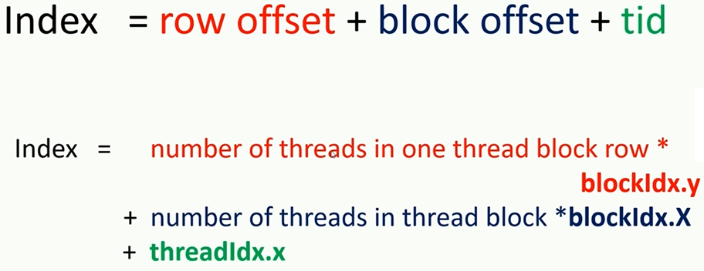
10.2 2D Index
https://www.udemy.com/course/cuda-programming-masterclass/learn/lecture/11833400#overview
These are the Global Index.
Write down the general equation

Slide 12
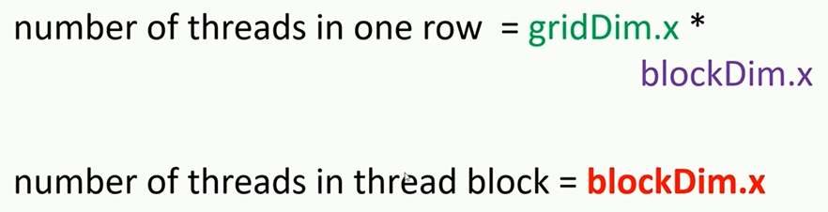
10.2 2D Index
https://www.udemy.com/course/cuda-programming-masterclass/learn/lecture/11833400#overview
These are the Global Index.
Write down the general equation

Slide 13
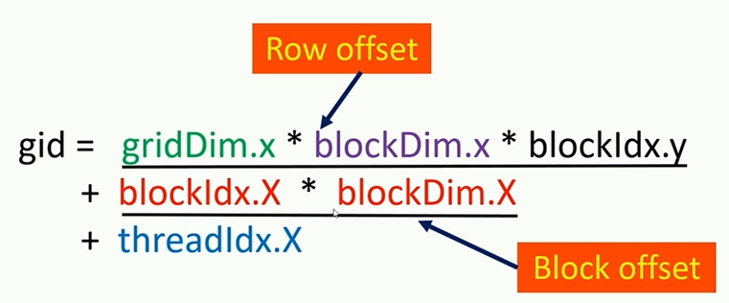
10.2 2D Index
https://www.udemy.com/course/cuda-programming-masterclass/learn/lecture/11833400#overview
These are the Global Index.
Write down the general equation

Slide 14
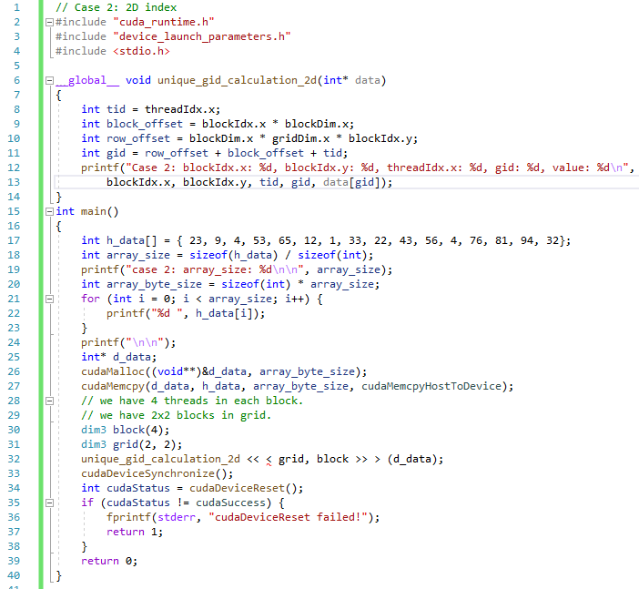
10.2 2D Index
https://www.udemy.com/course/cuda-programming-masterclass/learn/lecture/11833400#overview
Code

Slide 15
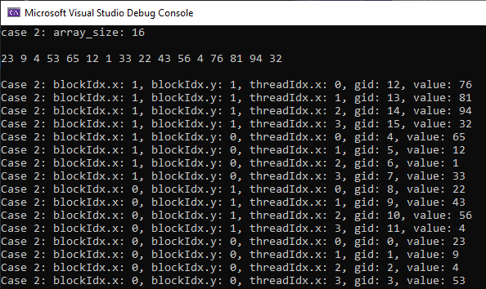
10.2 2D Index
https://www.udemy.com/course/cuda-programming-masterclass/learn/lecture/11833400#overview
Result

Slide 16
End of Chapter

