Slide 1

1 ASP.NET Core and Angular
Peter H. Chen

Slide 2
1 ASP.NET Core and Angular
https://www.youtube.com/watch?v=TA5ty7pEo5k&list=PL3_YUnRN3Uhh5vywsT75JbQsB8eBpwm1y
ASP.NET Core and Angular
ASP (Active Server Pages) is a development framework for building web pages.
We build Business Intelligence Dashboard application by ASP.NET Core 2.0 MVC with PostgreSQL and Angular.
We have three components in our SPA.
We use chart.js to display the chart. We have bar chart, donut (pie) chart, and line chart.
We have page for displaying the row/columns.
We have page for system health for different types of mock servers at your organization. We have web server, analysis server, and mail server. These server objects are just represented in our database. This gives the front end users for particular server is online or offline. You send message to each server to see it is online or off line.
The backend API is actually running on another port here locally. Request and response with JSON format. The backend is .NET 2.0 and Postgres. You can run SQL database server.

Slide 3
1.1 Install NodeJS

Slide 4
1.1 Install NodeJS
https://www.youtube.com/watch?v=TA5ty7pEo5k&list=PL3_YUnRN3Uhh5vywsT75JbQsB8eBpwm1y
Install Node JS
We use Windows in this discussion.
This node JS is for Angular. The node JS come with NPM (Node Package Manager).
The type script is also come with npm.

Slide 5
1.2 Install Angular CLI

Slide 6
1.2 Install Angular CLI
https://www.youtube.com/watch?v=TA5ty7pEo5k&list=PL3_YUnRN3Uhh5vywsT75JbQsB8eBpwm1y
Install Angular CLI
> npm install –g @angular/cli
> ng new app
> cd app
> ng serve --open

Slide 7
1.3 Install VS Code

Slide 8
1.3 Install VS Code
https://www.youtube.com/watch?v=TA5ty7pEo5k&list=PL3_YUnRN3Uhh5vywsT75JbQsB8eBpwm1y
VS Code for IDE

Slide 9
1.4 Install ASP.NET Core

Slide 10
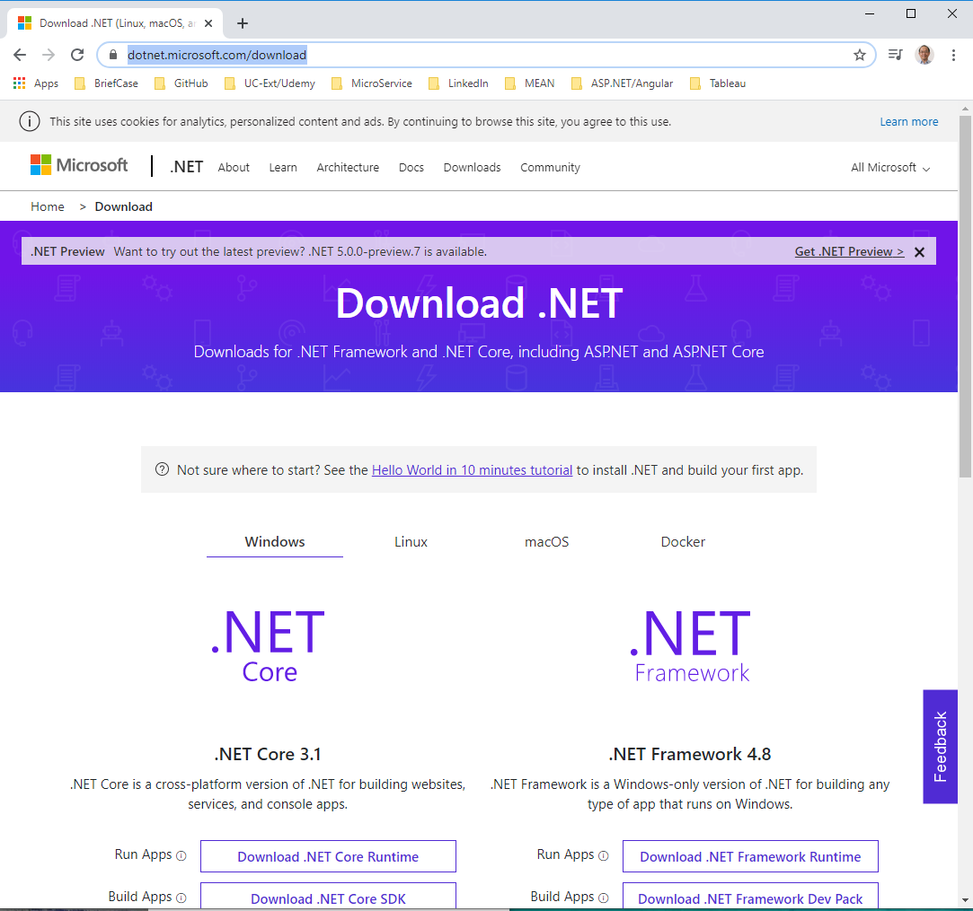
1.4 Install ASP.NET Core
https://www.youtube.com/watch?v=TA5ty7pEo5k&list=PL3_YUnRN3Uhh5vywsT75JbQsB8eBpwm1y
Install .NET Core
https://www.youtube.com/watch?v=MBdyxWyKBKI

Slide 11
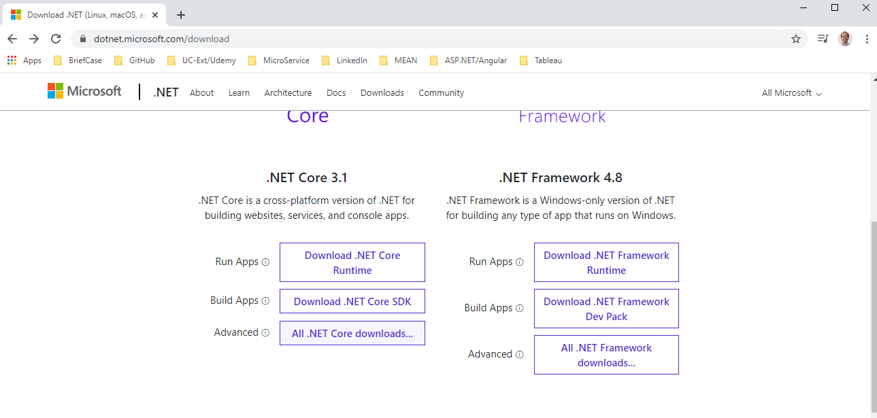
1.4 Install ASP.NET Core
https://www.youtube.com/watch?v=TA5ty7pEo5k&list=PL3_YUnRN3Uhh5vywsT75JbQsB8eBpwm1y
Install .NET Core
https://www.youtube.com/watch?v=MBdyxWyKBKI
Select Advanced .NET Core 3.1.

Slide 12
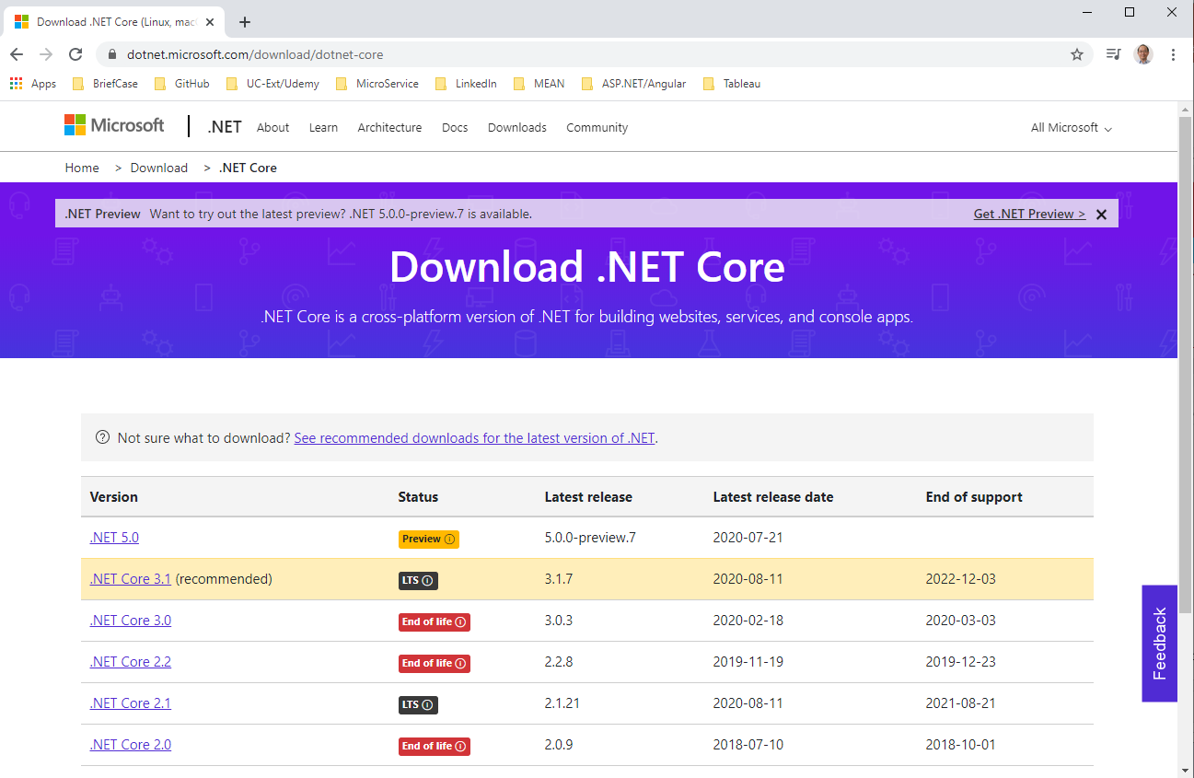
1.4 Install ASP.NET Core
https://www.youtube.com/watch?v=TA5ty7pEo5k&list=PL3_YUnRN3Uhh5vywsT75JbQsB8eBpwm1y
Install .NET Core
https://www.youtube.com/watch?v=MBdyxWyKBKI
Select .NET Core 3.1 (Recommended).

Slide 13
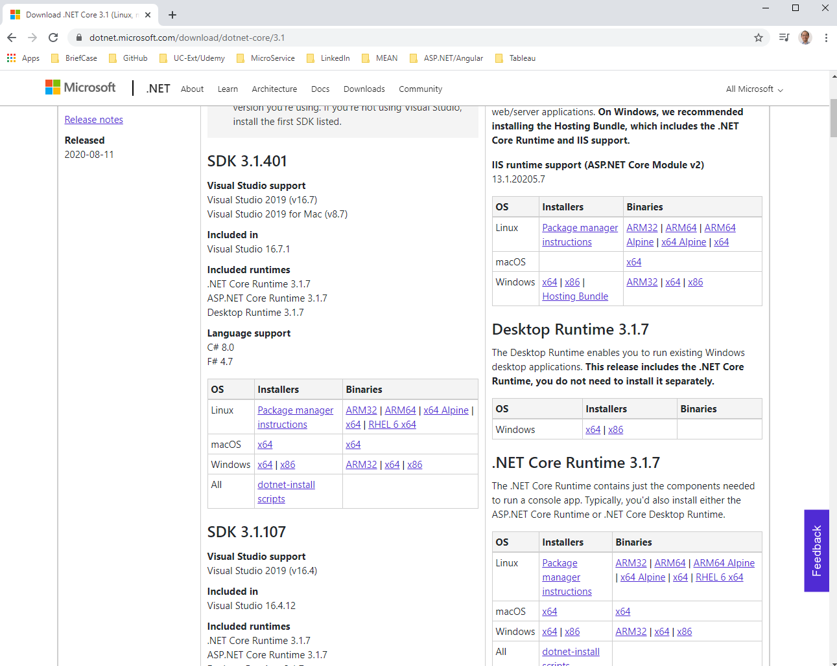
1.4 Install ASP.NET Core
https://www.youtube.com/watch?v=TA5ty7pEo5k&list=PL3_YUnRN3Uhh5vywsT75JbQsB8eBpwm1y
Install .NET Core
https://www.youtube.com/watch?v=MBdyxWyKBKI
Select Windows (64 bits).

Slide 14
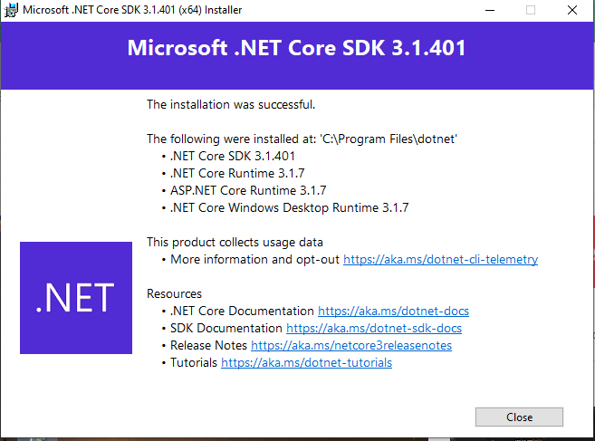
1.4 Install ASP.NET Core
https://www.youtube.com/watch?v=TA5ty7pEo5k&list=PL3_YUnRN3Uhh5vywsT75JbQsB8eBpwm1y
Install .NET Core
https://www.youtube.com/watch?v=MBdyxWyKBKI
SDK development environment on Windows.

Slide 15
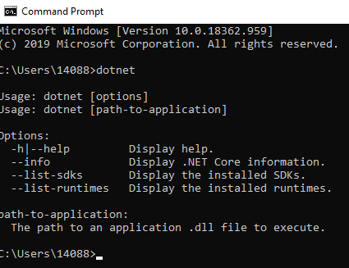
1.4 Install ASP.NET Core
https://www.youtube.com/watch?v=TA5ty7pEo5k&list=PL3_YUnRN3Uhh5vywsT75JbQsB8eBpwm1y
Install .NET Core
https://www.youtube.com/watch?v=MBdyxWyKBKI
Open Command Prompt
> dotnet

Slide 16
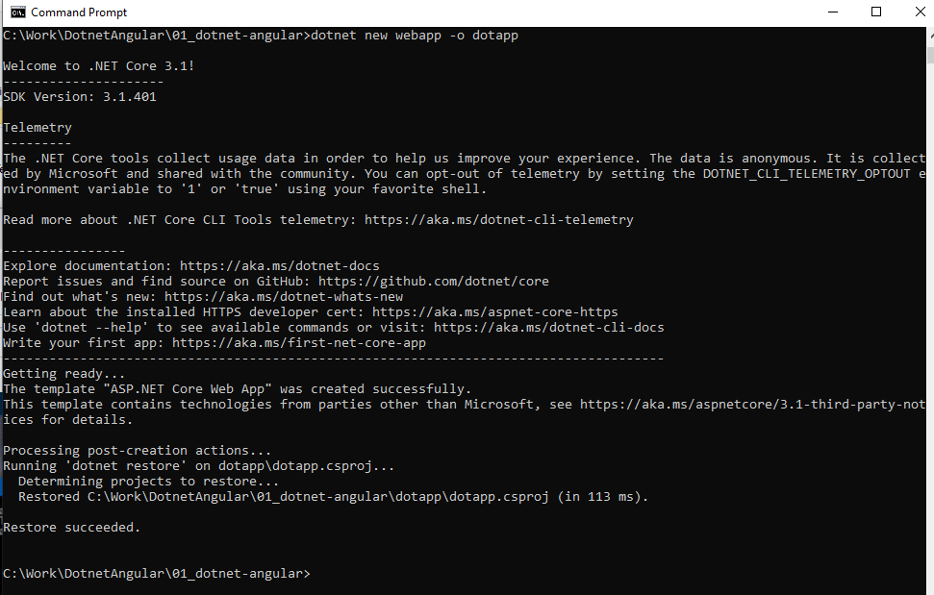
1.4 Install ASP.NET Core
https://www.youtube.com/watch?v=TA5ty7pEo5k&list=PL3_YUnRN3Uhh5vywsT75JbQsB8eBpwm1y
Install .NET Core
https://www.youtube.com/watch?v=MBdyxWyKBKI
Open Command Prompt
> cd dir
> donet new webapp -o dotapp

Slide 17
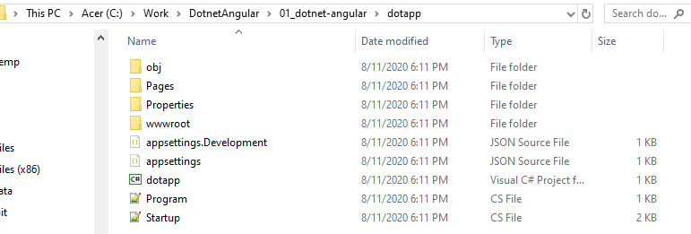
1.4 Install ASP.NET Core
https://www.youtube.com/watch?v=TA5ty7pEo5k&list=PL3_YUnRN3Uhh5vywsT75JbQsB8eBpwm1y
Install .NET Core
https://www.youtube.com/watch?v=MBdyxWyKBKI
Explore dotapp

Slide 18
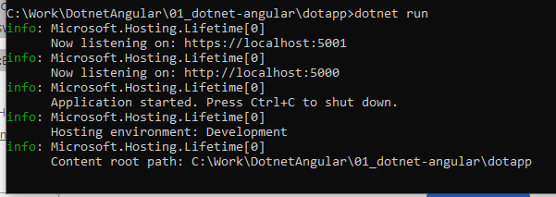
1.4 Install ASP.NET Core
https://www.youtube.com/watch?v=TA5ty7pEo5k&list=PL3_YUnRN3Uhh5vywsT75JbQsB8eBpwm1y
Install .NET Core
> cd dotapp
> donet run
> http for portnumber 5000

Slide 19
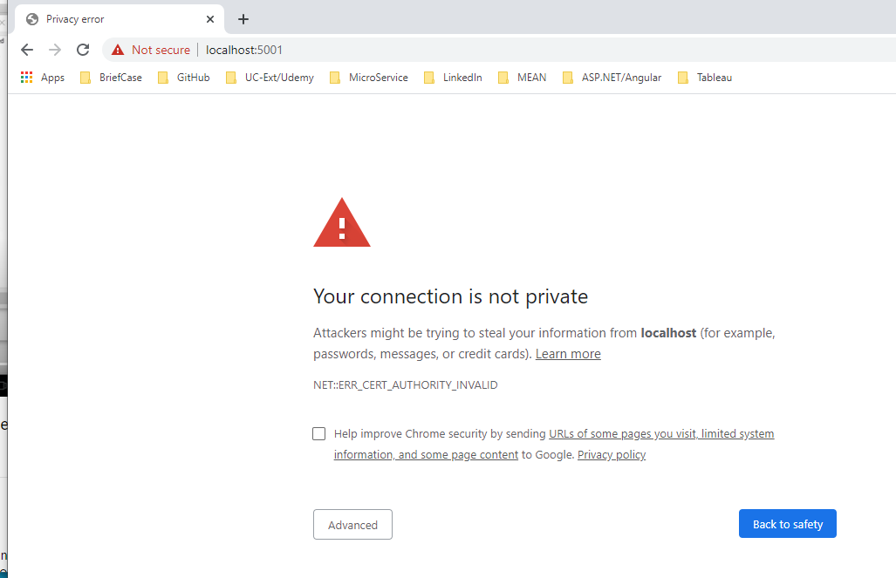
1.4 Install ASP.NET Core
https://www.youtube.com/watch?v=TA5ty7pEo5k&list=PL3_YUnRN3Uhh5vywsT75JbQsB8eBpwm1y
Install .NET Core
Open the chrome or Firefox
> localhost:5000
Note: There is Error: NET:ERR_CERT_AUTHORITY_INVALID
Click “Advanced” and then “Click Unsafe” mode. The error goes away.

Slide 20
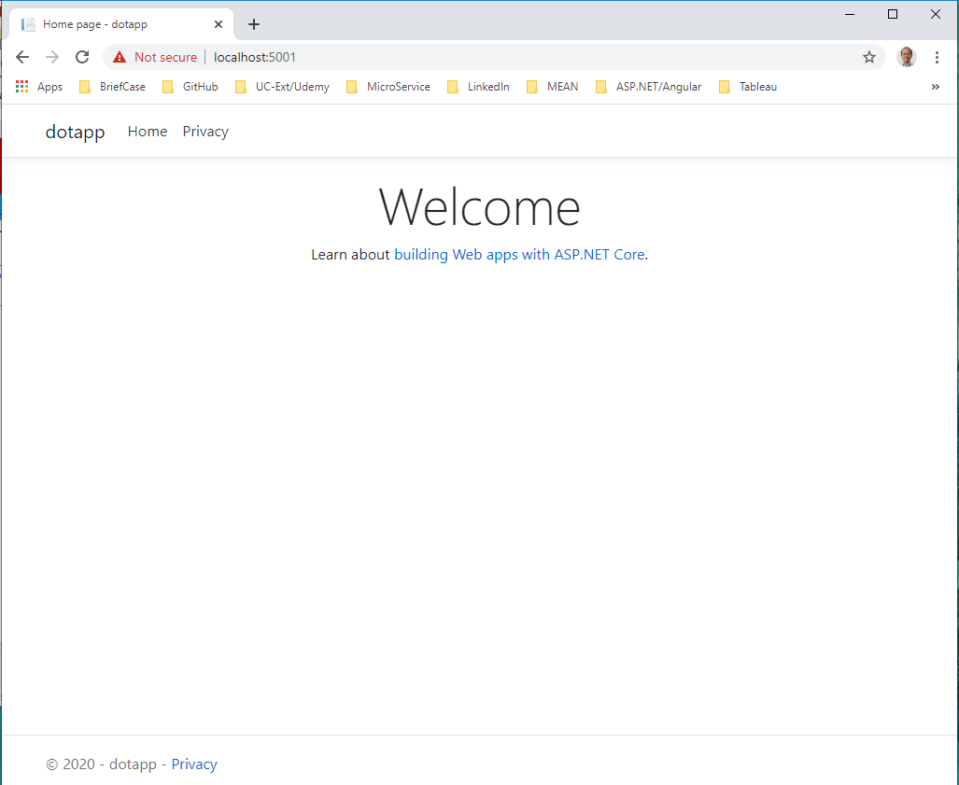
1.4 Install ASP.NET Core
https://www.youtube.com/watch?v=TA5ty7pEo5k&list=PL3_YUnRN3Uhh5vywsT75JbQsB8eBpwm1y
Install .NET Core
https://www.youtube.com/watch?v=MBdyxWyKBKI
Click “Advanced” and then click “Unsafe” (Firefox and Chrome works the same way).

Slide 21
1.5 Install Postgre

Slide 22
1.5 Install Postgre
https://www.youtube.com/watch?v=TA5ty7pEo5k&list=PL3_YUnRN3Uhh5vywsT75JbQsB8eBpwm1y
PostgreSQL
https://www.postgresql.org/download/
Postgre also give you PG admin for front end application. That give you setup users and query our tables.

Slide 23
End of Chapter

