Slide 1

1 What is GraphQL?
Peter H. Chen

Slide 2
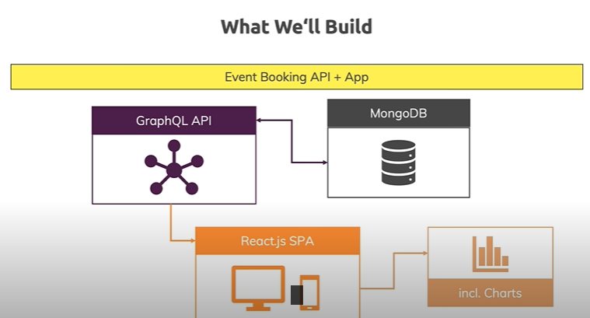
1 What is GraphQL?
https://www.youtube.com/watch?v=7giZGFDGnkc&list=PL55RiY5tL51rG1x02Yyj93iypUuHYXcB_
What is GraphQL?

Slide 3
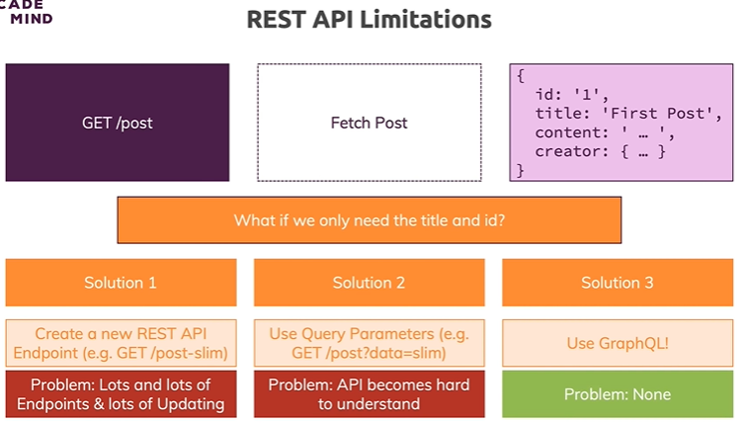
1 What is GraphQL?
https://www.youtube.com/watch?v=7giZGFDGnkc&list=PL55RiY5tL51rG1x02Yyj93iypUuHYXcB_
What is GraphQL?

Slide 4
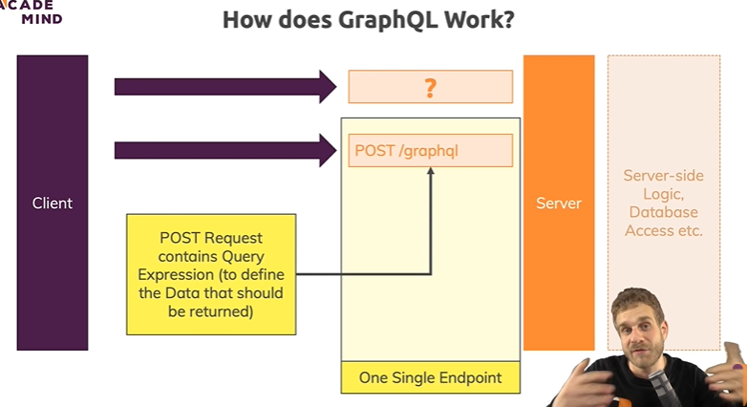
1 What is GraphQL?
https://www.youtube.com/watch?v=7giZGFDGnkc&list=PL55RiY5tL51rG1x02Yyj93iypUuHYXcB_
What is GraphQL?

Slide 5
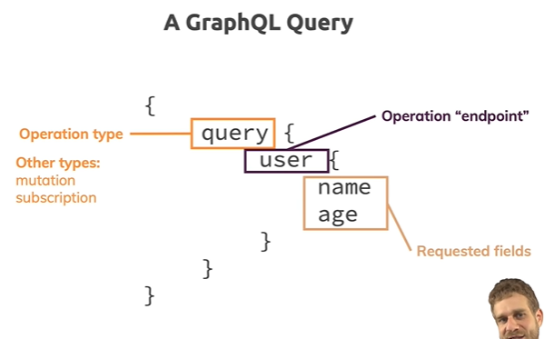
1 What is GraphQL?
https://www.youtube.com/watch?v=7giZGFDGnkc&list=PL55RiY5tL51rG1x02Yyj93iypUuHYXcB_
What is GraphQL?

Slide 6
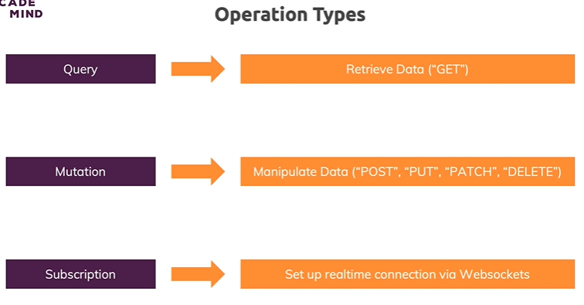
1 What is GraphQL?
https://www.youtube.com/watch?v=7giZGFDGnkc&list=PL55RiY5tL51rG1x02Yyj93iypUuHYXcB_
What is GraphQL?

Slide 7
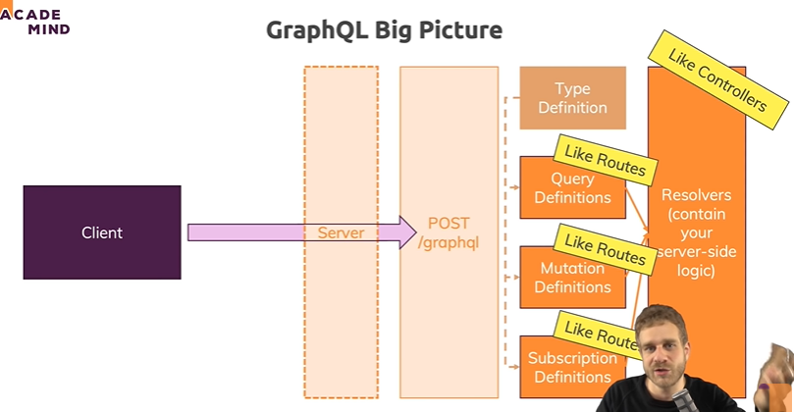
1 What is GraphQL?
https://www.youtube.com/watch?v=7giZGFDGnkc&list=PL55RiY5tL51rG1x02Yyj93iypUuHYXcB_
What is GraphQL?

Slide 8
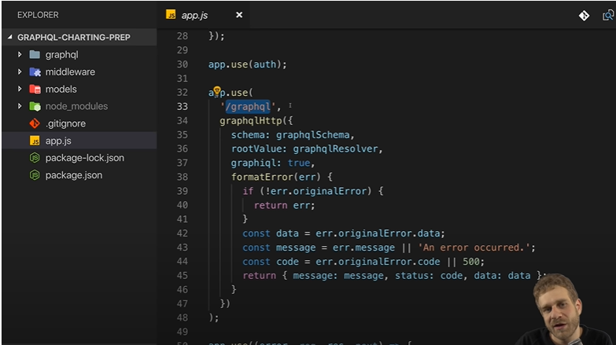
1 What is GraphQL?
https://www.youtube.com/watch?v=7giZGFDGnkc&list=PL55RiY5tL51rG1x02Yyj93iypUuHYXcB_
‘/graphql’: endpoint

Slide 9
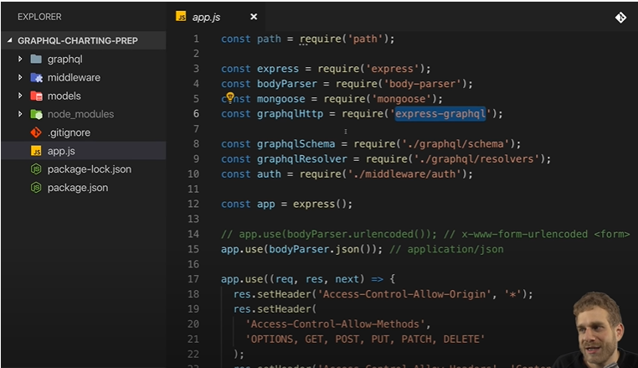
1 What is GraphQL?
https://www.youtube.com/watch?v=7giZGFDGnkc&list=PL55RiY5tL51rG1x02Yyj93iypUuHYXcB_
‘/express-graphql’: package

Slide 10
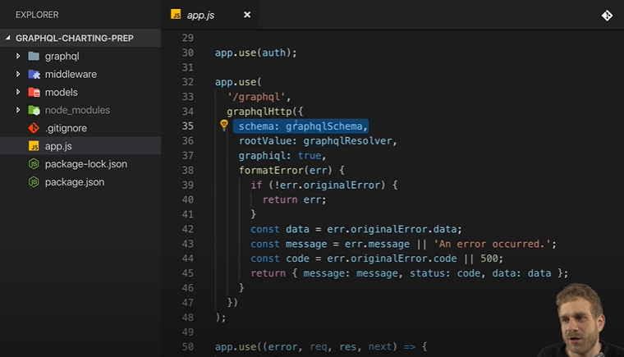
1 What is GraphQL?
https://www.youtube.com/watch?v=7giZGFDGnkc&list=PL55RiY5tL51rG1x02Yyj93iypUuHYXcB_
Schema, resolver (combine all the definition of data type and routes)

Slide 11
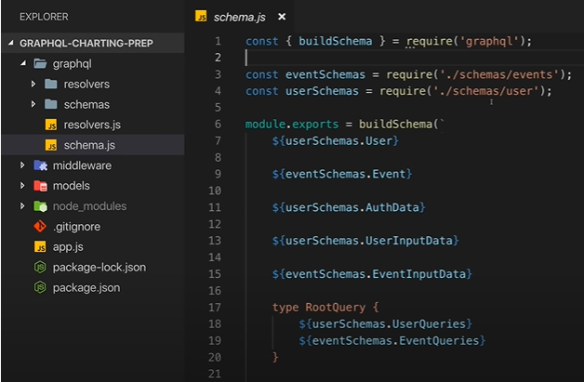
1 What is GraphQL?
https://www.youtube.com/watch?v=7giZGFDGnkc&list=PL55RiY5tL51rG1x02Yyj93iypUuHYXcB_
Schema definition

Slide 12
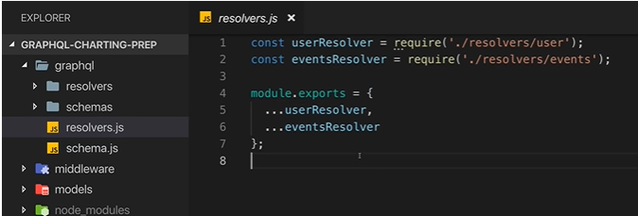
1 What is GraphQL?
https://www.youtube.com/watch?v=7giZGFDGnkc&list=PL55RiY5tL51rG1x02Yyj93iypUuHYXcB_
Resolver: Combine all the other objects.

Slide 13
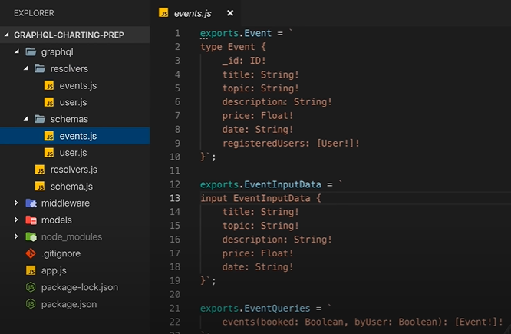
1 What is GraphQL?
https://www.youtube.com/watch?v=7giZGFDGnkc&list=PL55RiY5tL51rG1x02Yyj93iypUuHYXcB_
Schema/events.js

Slide 14
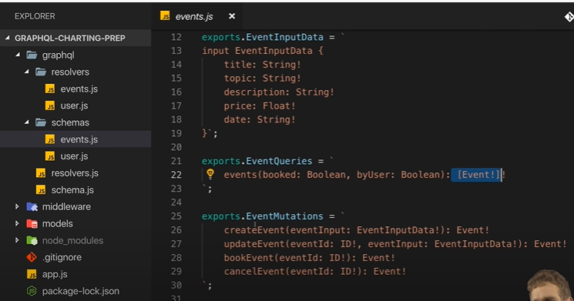
1 What is GraphQL?
https://www.youtube.com/watch?v=7giZGFDGnkc&list=PL55RiY5tL51rG1x02Yyj93iypUuHYXcB_
Schema/events.js

Slide 15
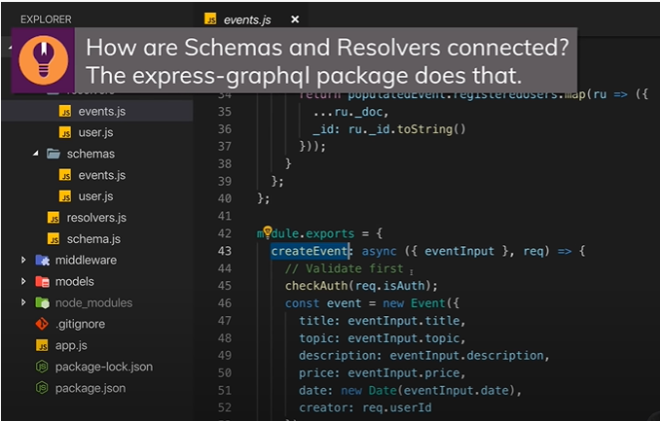
1 What is GraphQL?
https://www.youtube.com/watch?v=7giZGFDGnkc&list=PL55RiY5tL51rG1x02Yyj93iypUuHYXcB_
Resolver/events.js

Slide 16
End of Chapter

