Slide 1

2 Setup
Peter H. Chen

Slide 2
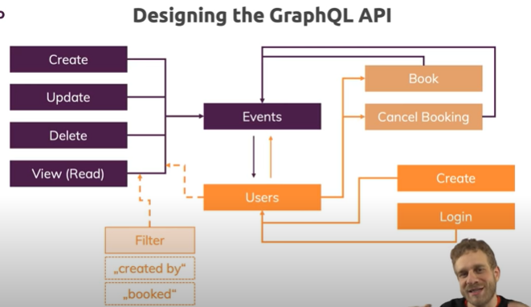
2 Setup
https://www.youtube.com/watch?v=yvEEeKMuxn0&list=PL55RiY5tL51rG1x02Yyj93iypUuHYXcB_&index=2
Setup

Slide 3
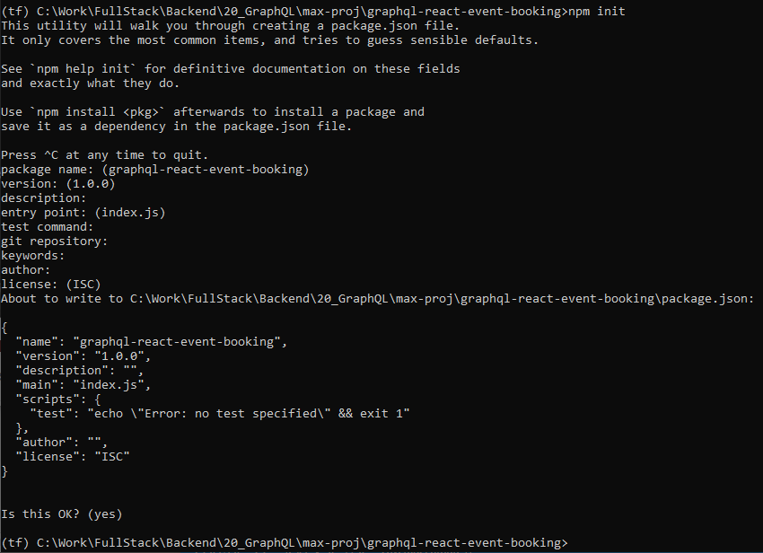
2 Setup
https://www.youtube.com/watch?v=yvEEeKMuxn0&list=PL55RiY5tL51rG1x02Yyj93iypUuHYXcB_&index=2
Setup:
> mkdir graphql-react-event-booking
> cd graphql-react-event-booking
> npm init

Slide 4
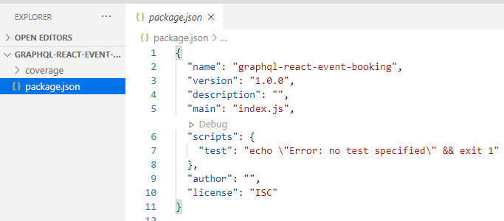
2 Setup
https://www.youtube.com/watch?v=yvEEeKMuxn0&list=PL55RiY5tL51rG1x02Yyj93iypUuHYXcB_&index=2
Setup:
> package.json

Slide 5
2.1 Install

Slide 6
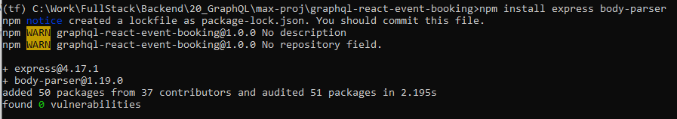
2.1 Install
https://www.youtube.com/watch?v=yvEEeKMuxn0&list=PL55RiY5tL51rG1x02Yyj93iypUuHYXcB_&index=2
Setup: install express and Json content parser
> npm install --save express body-parser

Slide 7
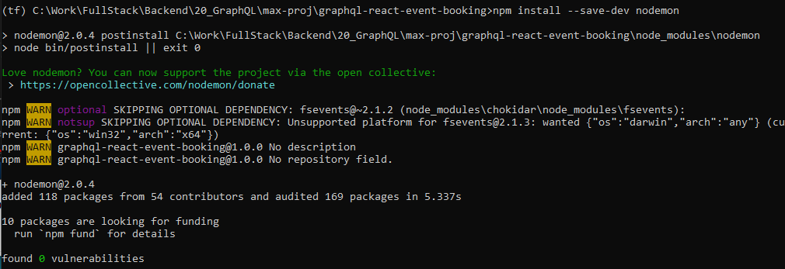
2.1 Install
https://www.youtube.com/watch?v=yvEEeKMuxn0&list=PL55RiY5tL51rG1x02Yyj93iypUuHYXcB_&index=2
Setup: nodeMon for development only
> npm install –save-dev nodemon

Slide 8
2.2 Create app.js

Slide 9
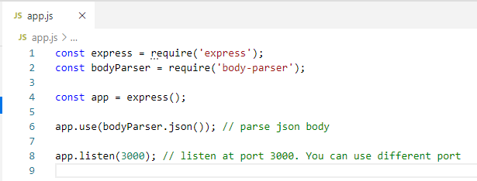
2.2 Create app.js
https://www.youtube.com/watch?v=yvEEeKMuxn0&list=PL55RiY5tL51rG1x02Yyj93iypUuHYXcB_&index=2
Create app.js

Slide 10
2.2 Create app.js
https://www.youtube.com/watch?v=yvEEeKMuxn0&list=PL55RiY5tL51rG1x02Yyj93iypUuHYXcB_&index=2
Run app.js
> node app.js

Slide 11
2.3 Modify package.json

Slide 12
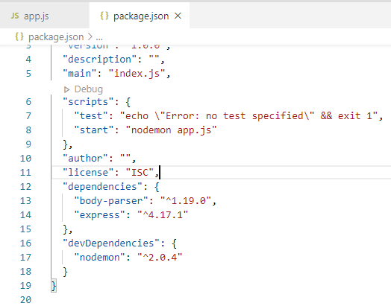
2.3 Modify package.json
https://www.youtube.com/watch?v=yvEEeKMuxn0&list=PL55RiY5tL51rG1x02Yyj93iypUuHYXcB_&index=2
Add:
“start”: “nodemon app.js”

Slide 13
2.3 Modify package.json
https://www.youtube.com/watch?v=yvEEeKMuxn0&list=PL55RiY5tL51rG1x02Yyj93iypUuHYXcB_&index=2
Now, all the node environment are all setup.
We modify the app.js to display the message.

Slide 14
2.4 Request and Response

Slide 15
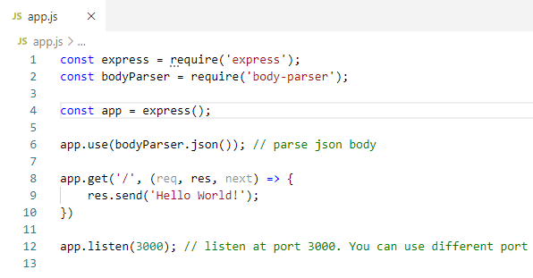
2.4 Request and Response
https://www.youtube.com/watch?v=yvEEeKMuxn0&list=PL55RiY5tL51rG1x02Yyj93iypUuHYXcB_&index=2
Request and Response

Slide 16
2.5 Verify

Slide 17
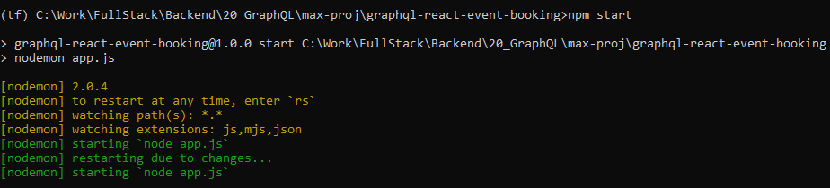
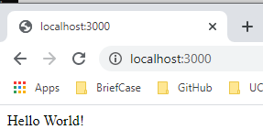
2.5 Verify
https://www.youtube.com/watch?v=yvEEeKMuxn0&list=PL55RiY5tL51rG1x02Yyj93iypUuHYXcB_&index=2
> npm start
Open Chrome
> localhost:3000

Slide 18
End of Chapter

