Slide 1

3 Schema and Resolver
Peter H. Chen

Slide 2
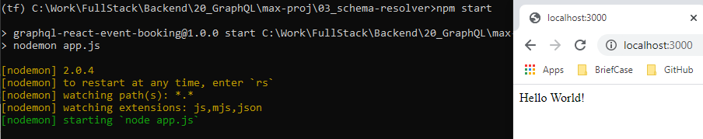
3 Schema and Resolver
https://www.youtube.com/watch?v=LXTyzk2uud0&list=PL55RiY5tL51rG1x02Yyj93iypUuHYXcB_&index=3
Schema and Resolver
We have node server created and verified in the last discussion.
We will create and Schema and Resolver in this discussion.
Make sure we have everything up and running before we go.

Slide 3
3.1 Install

Slide 4
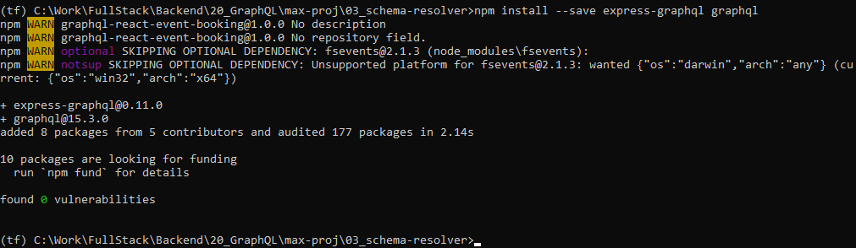
3.1 Install
https://www.youtube.com/watch?v=yvEEeKMuxn0&list=PL55RiY5tL51rG1x03Yyj93iypUuHYXcB_&index=3
Setup: install express-graphql and graphql
express-graphql: middleware Package for parse the query of Schema from schema to resolver.
Graphql: Package for allowing us to define schema of API and convert into JavaScript code.
> npm install --save express-graphql graphql

Slide 5
3.2 Import Packages Schema/Resolver

Slide 6
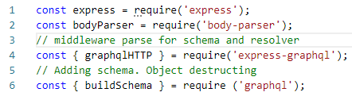
3.2 Import Packages Schema/Resolver
https://www.youtube.com/watch?v=yvEEeKMuxn0&list=PL55RiY5tL51rG1x03Yyj93iypUuHYXcB_&index=3
Add import package for Schema and Resolver

Slide 7
3.3 Add Schema

Slide 8
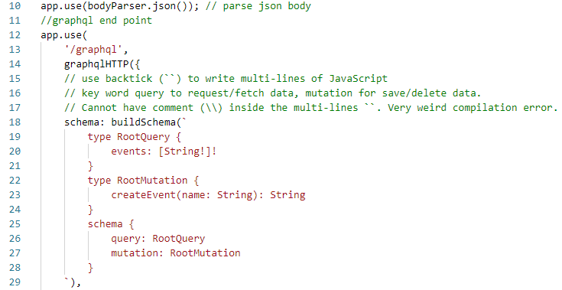
3.3 Add Schema
https://www.youtube.com/watch?v=yvEEeKMuxn0&list=PL55RiY5tL51rG1x03Yyj93iypUuHYXcB_&index=3
Add Schema

Slide 9
3.4 Add Resolver

Slide 10
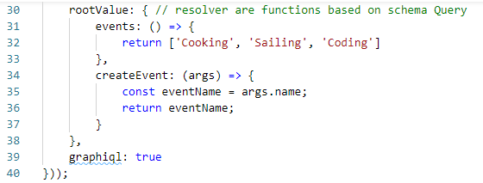
3.4 Add Resolver
https://www.youtube.com/watch?v=yvEEeKMuxn0&list=PL55RiY5tL51rG1x03Yyj93iypUuHYXcB_&index=3
Add Resolver

Slide 11
3.5 Add Debugger

Slide 12
3.5 Add Debugger
https://www.youtube.com/watch?v=yvEEeKMuxn0&list=PL55RiY5tL51rG1x03Yyj93iypUuHYXcB_&index=3
Add Debugger (graphiql: true)

Slide 13
3.6 Verify

Slide 14
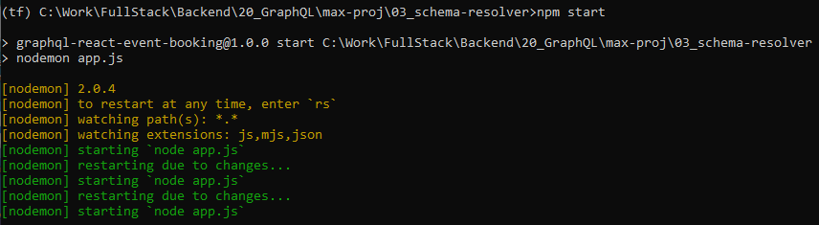
3.6 Verify
https://www.youtube.com/watch?v=yvEEeKMuxn0&list=PL55RiY5tL51rG1x03Yyj93iypUuHYXcB_&index=3
Start Server
> npm start

Slide 15
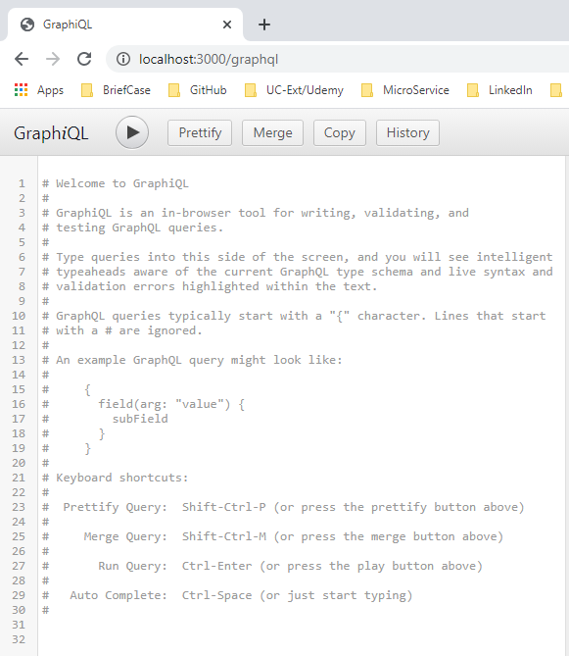
3.6 Verify
https://www.youtube.com/watch?v=yvEEeKMuxn0&list=PL55RiY5tL51rG1x03Yyj93iypUuHYXcB_&index=3
Open Chrome
> localhost:3000/graphql

Slide 16
3.7 Test Query Events

Slide 17
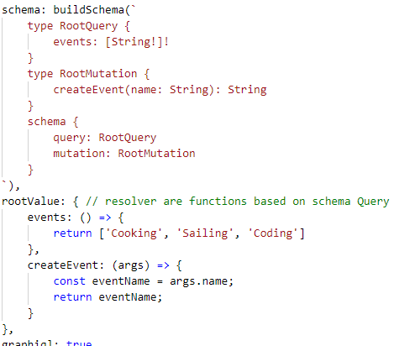
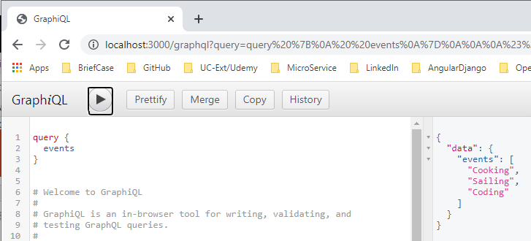
3.7 Test Query Events
https://www.youtube.com/watch?v=yvEEeKMuxn0&list=PL55RiY5tL51rG1x03Yyj93iypUuHYXcB_&index=3
Check
Query {
events
}

Slide 18
3.8 Test Mutation

Slide 19
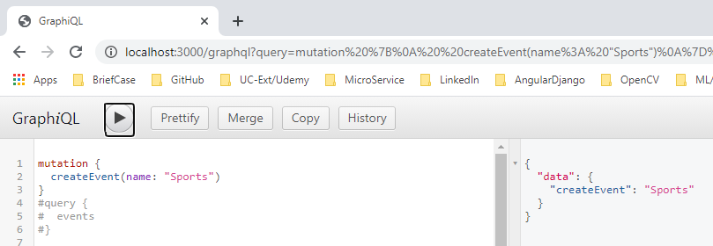
3.8 Test Mutation
https://www.youtube.com/watch?v=yvEEeKMuxn0&list=PL55RiY5tL51rG1x03Yyj93iypUuHYXcB_&index=3
Check
Mutation {
createEvent (name: “Sports”)
}

Slide 20
End of Chapter

