Slide 1

4 Type and Data
Peter H. Chen

Slide 2
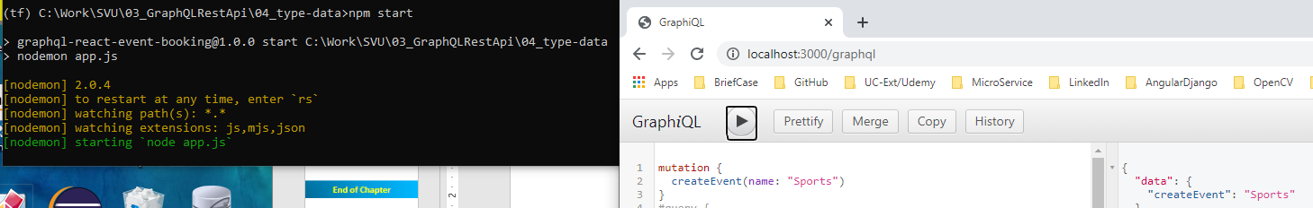
4 Type and Data
https://www.youtube.com/watch?v=LXTyzk2uud0&list=PL55RiY5tL51rG1x02Yyj94iypUuHYXcB_&index=4
Type and Data
We have Schema and resolver worked.
Check it before move forward to next.
We will add type and data in this section. Type is the most powerful and complex in graphql API.

Slide 3
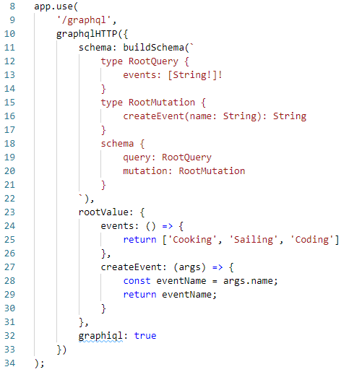
4 Type and Data
https://www.youtube.com/watch?v=LXTyzk2uud0&list=PL55RiY5tL51rG1x02Yyj94iypUuHYXcB_&index=4
Type and Data
We define type RootQuery and type RootMutation.
We have the events and createEvent inside the defined type.
The schema uses the defined type.
We can query events with dummy string.
We also can query createEvent with given string.
They will be very complex at the end.
Before we store to the database, we simply store in the memory here.

Slide 4
4.1 Add Custom Type

Slide 5
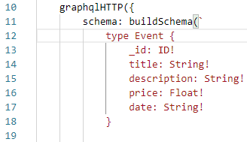
4.1 Add Custom Type
https://www.youtube.com/watch?v=yvEEeKMuxn0&list=PL55RiY5tL51rG1x04Yyj94iypUuHYXcB_&index=4
Add Custom Type
We define a new Event Type with following:
_id is reserved for MongoDB. ID is special type
Date: String!. There is no DATE in GraphQL.
How to use the Event type?

Slide 6
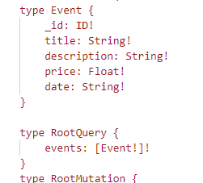
4.1 Add Custom Type
https://www.youtube.com/watch?v=yvEEeKMuxn0&list=PL55RiY5tL51rG1x04Yyj94iypUuHYXcB_&index=4
Add Custom Type
When we fetch the events: [String!]!
We can change the String into custom Event.
Here [Event!]! means we cannot have an empty array []! And cannot be an emty type Event!.

Slide 7
4.1 Add Custom Type
https://www.youtube.com/watch?v=yvEEeKMuxn0&list=PL55RiY5tL51rG1x04Yyj94iypUuHYXcB_&index=4
Add Custom Type
When we createEvent(), we also change the String into Event type.

Slide 8
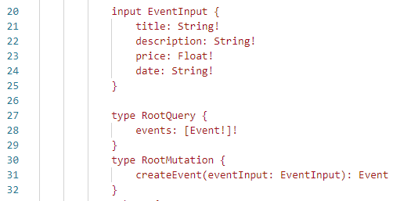
4.1 Add Custom Type
https://www.youtube.com/watch?v=yvEEeKMuxn0&list=PL55RiY5tL51rG1x04Yyj94iypUuHYXcB_&index=4
Add Custom Type
The createEvent is too long. We have better way to represent the long argument.
GraphQL provides the special type of input EventInput { .. }

Slide 9

4.1 Add Custom Type
https://www.youtube.com/watch?v=yvEEeKMuxn0&list=PL55RiY5tL51rG1x04Yyj94iypUuHYXcB_&index=4
Add Custom Type
Create temporary events = []
Later, we replace events with the database when we are in production.

Slide 10
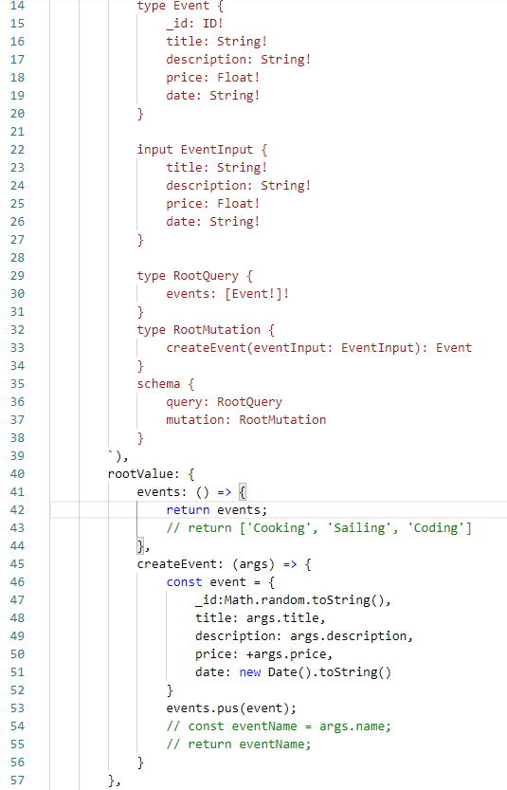
4.1 Add Custom Type
https://www.youtube.com/watch?v=yvEEeKMuxn0&list=PL55RiY5tL51rG1x04Yyj94iypUuHYXcB_&index=4
Add Custom Type
The code is modified on the right.
For the float, we add “+” to make sure it is a number, not a string. Number have sign “+” and string does not have.

Slide 11
4.2 Verify

Slide 12

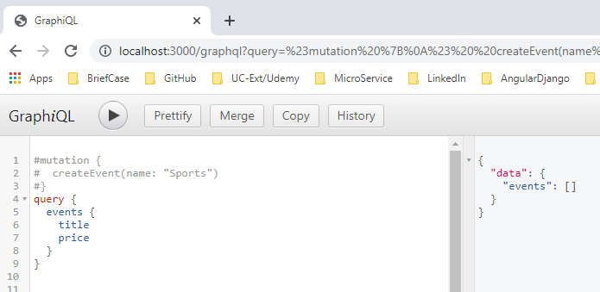
4.2 Verify
https://www.youtube.com/watch?v=yvEEeKMuxn0&list=PL55RiY5tL51rG1x04Yyj94iypUuHYXcB_&index=4
> npm start
Open Chrome
> localhost:3000/graphql
Check the code and type the following:
> query {
> events {
> title
> price
> }
> }

Slide 13
4.3 Verify Mutation

Slide 14
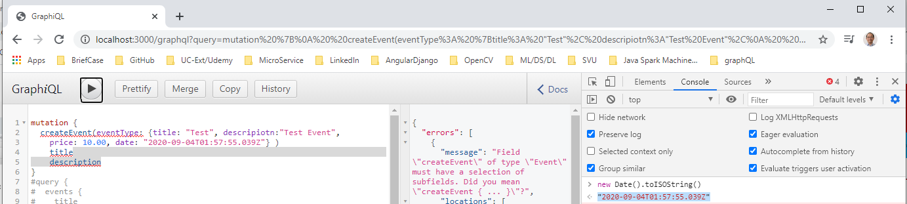
4.2 Verify
https://www.youtube.com/watch?v=yvEEeKMuxn0&list=PL55RiY5tL51rG1x04Yyj94iypUuHYXcB_&index=4
Verify the mutation
Fn + Console
> new Date().toString()
>> "2020-09-04T01:57:55.039Z"

Slide 15
4.4 Modify Mutation Code

Slide 16
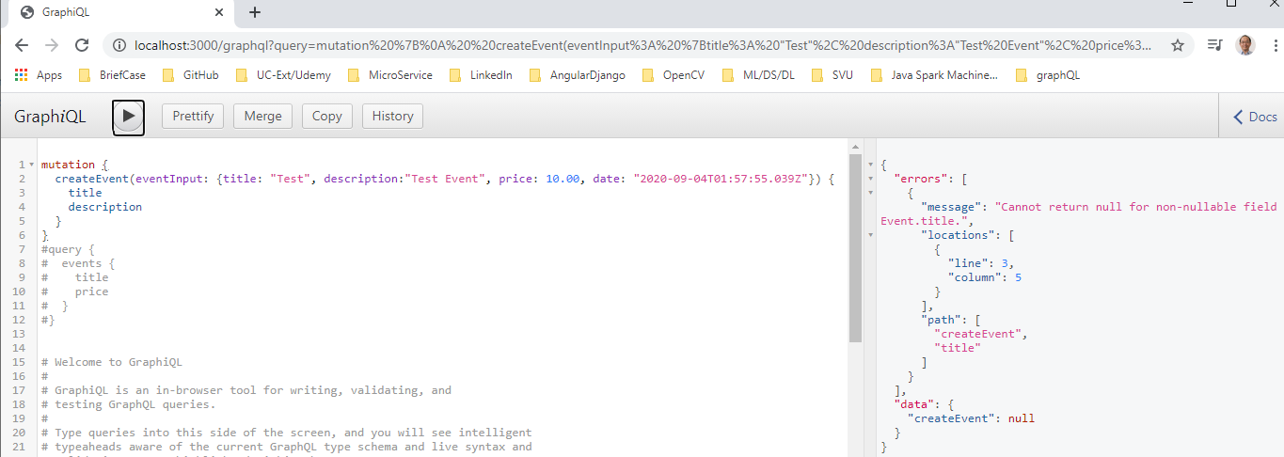
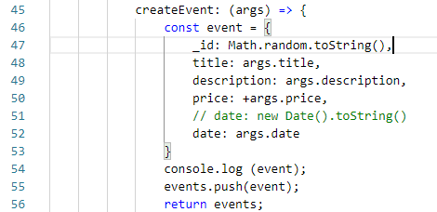
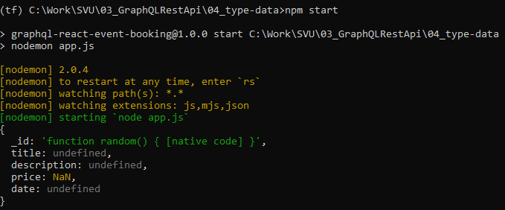
4.4 Modify Mutation Code
https://www.youtube.com/watch?v=yvEEeKMuxn0&list=PL55RiY5tL51rG1x04Yyj94iypUuHYXcB_&index=4
Modify Mutation Code
It has error messages
Add console.log to see the data. Data is null.

Slide 17
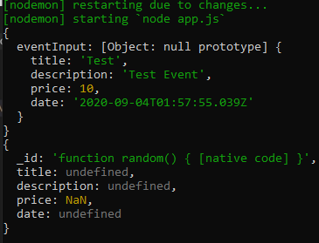

4.4 Modify Mutation Code
https://www.youtube.com/watch?v=yvEEeKMuxn0&list=PL55RiY5tL51rG1x04Yyj94iypUuHYXcB_&index=4
Modify Mutation Code
It has error messages
Add console.log to see the data. Data is null.
Print the args. We have the args data.

Slide 18
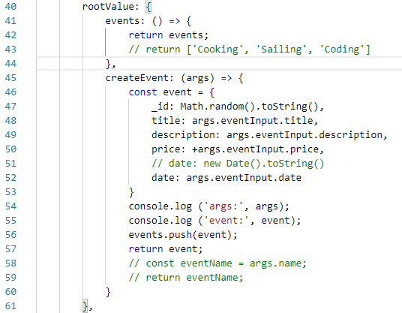
4.4 Modify Mutation Code
https://www.youtube.com/watch?v=yvEEeKMuxn0&list=PL55RiY5tL51rG1x04Yyj94iypUuHYXcB_&index=4
Modify Mutation Code

Slide 19
4.5 Verify Mutation

Slide 20
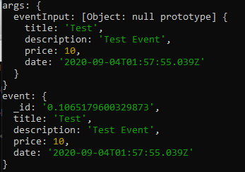
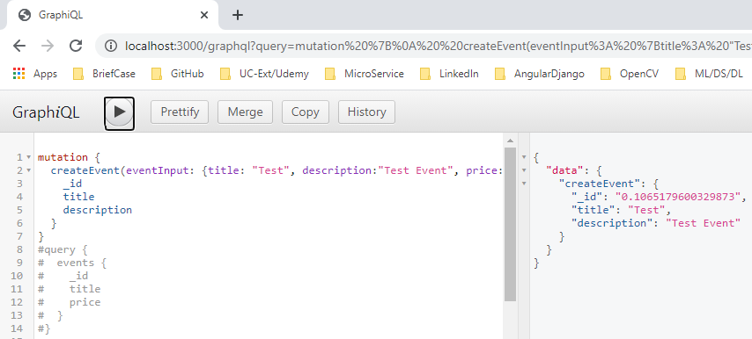
4.5 Verify Mutation
https://www.youtube.com/watch?v=yvEEeKMuxn0&list=PL55RiY5tL51rG1x04Yyj94iypUuHYXcB_&index=4
Verify the mutation
Now, results looks good.

Slide 21
4.6 Verify Query Again

Slide 22
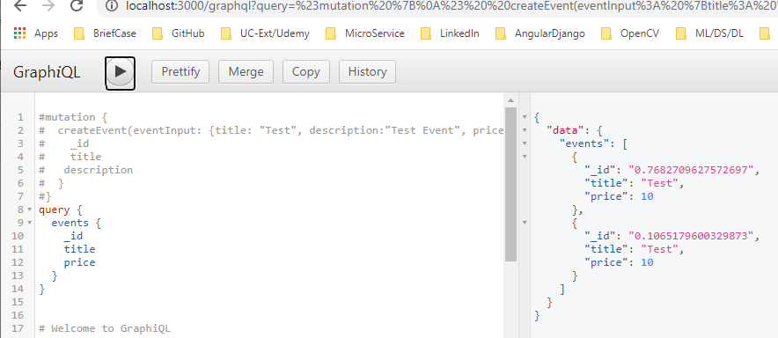
4.6 Verify Query Again
https://www.youtube.com/watch?v=yvEEeKMuxn0&list=PL55RiY5tL51rG1x04Yyj94iypUuHYXcB_&index=4
Verify the query again

Slide 23
4.7 Summary

Slide 24
4.7 Summary
https://www.youtube.com/watch?v=yvEEeKMuxn0&list=PL55RiY5tL51rG1x04Yyj94iypUuHYXcB_&index=4
Summary
We change the data type and data.
It is very useful and efficiency for data transformation.

Slide 25
End of Chapter

