Slide 1
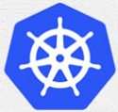
1 Introduction to Kubernetes
Peter H. Chen

Slide 2
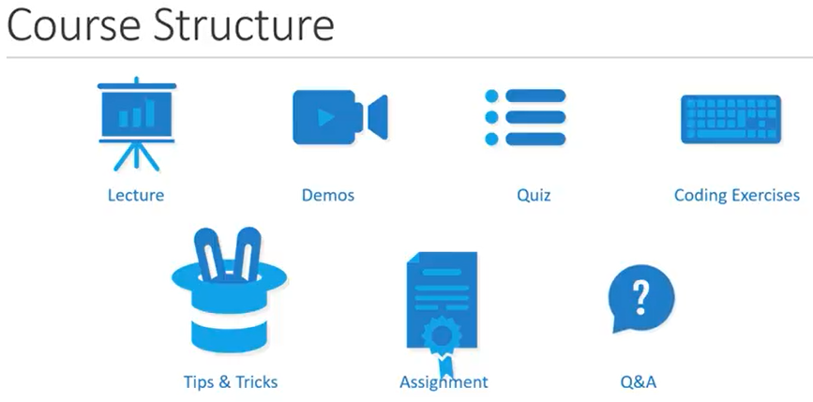
1 Introduction to Kubernetes
https://www.youtube.com/watch?v=r0uRLhrzbtU&list=PL2We04F3Y_43dAehLMT5GxJhtk3mJtkl5&index=1
Kubernetes:
Kubernetes is for microservices and Container orchestration
Requires Basic concept of Container concept.
You can be a developer, system admin, or project manager.
YAML files coding will help you understand the Kubernetes configuration file.

Slide 3
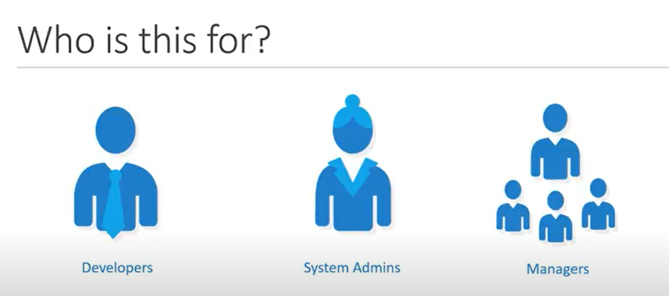
1 Introduction to Kubernetes
https://www.youtube.com/watch?v=r0uRLhrzbtU&list=PL2We04F3Y_43dAehLMT5GxJhtk3mJtkl5&index=1
Kubernetes:
Kubernetes is for microservices and Container orchestration
Requires Basic concept of Container concept.
You can be a developer, system admin, or project manager.
YAML files coding will help you understand the Kubernetes configuration file.

Slide 4
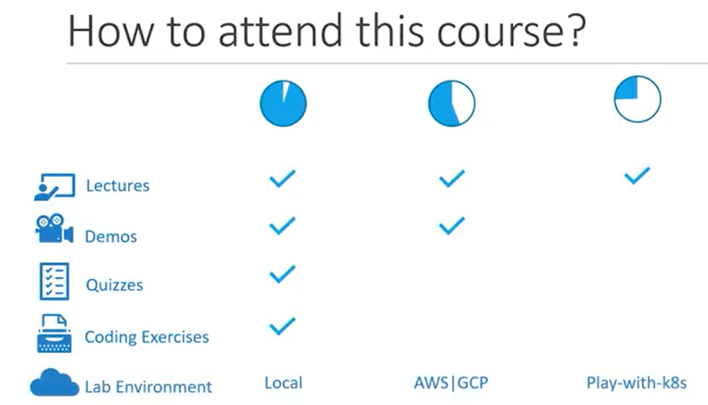
1 Introduction to Kubernetes
https://www.youtube.com/watch?v=r0uRLhrzbtU&list=PL2We04F3Y_43dAehLMT5GxJhtk3mJtkl5&index=1
Kubernetes:
Kubernetes is for microservices and Container orchestration
Requires Basic concept of Container concept.
You can be a developer, system admin, or project manager.
YAML files coding will help you understand the Kubernetes configuration file.

Slide 5
1.1 Objectives

Slide 6
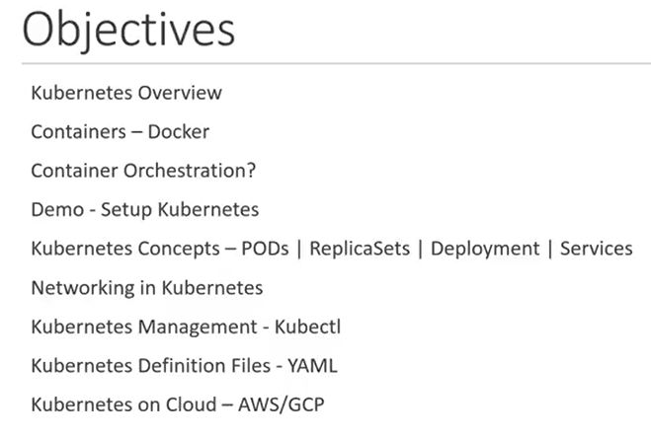
1.1 Objectives
https://www.youtube.com/watch?v=r0uRLhrzbtU&list=PL2We04F3Y_43dAehLMT5GxJhtk3mJtkl5&index=1
Objectives:
Docker Containers
Container Orchestration
Setup Kubernetes
Kubernetes Concepts: PODs, ReplicaSets, Deployment, Services
Networking in Kubernetes
Kubernetes Management: Kubectl
Kubernetes Definition File: YAML
Kubernetes on Cloud for application deployment: AWS/GCP

Slide 7
End

