Slide 1
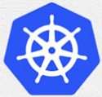
2 Docker Introduction
Peter H. Chen

Slide 2
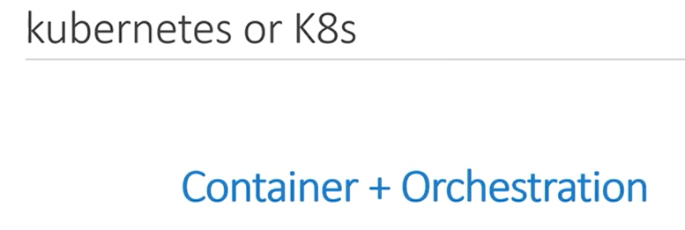
2 Docker Introduction
https://www.youtube.com/watch?v=rmf04ylI2K0&list=PL2We04F3Y_43dAehLMT5GxJhtk3mJtkl5&index=2
Docker Introduction
Kubernetes of K8s
Kubernetes is also known as K8s. It was built by Google on their experience running containers in production.
It is an open-source project.
One of the most popular container orchestration technologies.

Slide 3
2.1 Container and Orchestration

Slide 4
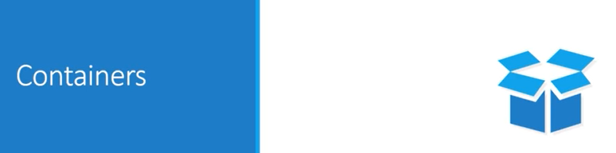
2.1 Container and Orchestration
https://www.youtube.com/watch?v=rmf04ylI2K0&list=PL2We04F3Y_43dAehLMT5GxJhtk3mJtkl5&index=2
Container and Orchestration
We discuss what is container.
We discussed most popular container that is docker.

Slide 5
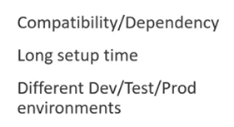
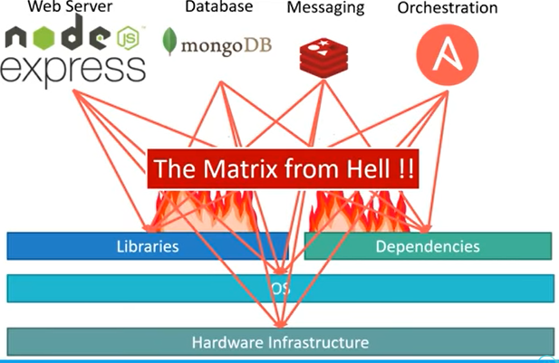
2.1 Container and Orchestration
https://www.youtube.com/watch?v=rmf04ylI2K0&list=PL2We04F3Y_43dAehLMT5GxJhtk3mJtkl5&index=2
Container and Orchestration
Most popular container technology is Docker.
Why do you need docker container?
If we have web server using nodeJS, a database, such as, MongoDB, a messaging system like Radis, and Orchestration tool, like Ansible.

Slide 6
2.1 Container and Orchestration
https://www.youtube.com/watch?v=rmf04ylI2K0&list=PL2We04F3Y_43dAehLMT5GxJhtk3mJtkl5&index=2
Container and Orchestration
We have a lot of applications with all these different component.
We have a lot of issues developing this application with all these different components.
First, there are compatibility with the underlying Operating System. We have to ensure that all these different services are compatible with the version of the Operating system.

Slide 7
2.1 Container and Orchestration
https://www.youtube.com/watch?v=rmf04ylI2K0&list=PL2We04F3Y_43dAehLMT5GxJhtk3mJtkl5&index=2
Container and Orchestration
Second, we must ensure the services of libraries and dependencies on the Operating system. One service depends on one version and another service depends on another version.
The architecture of application changed over the time. We must upgrade to newer version. Every time, somethings changed, we must go through the same process of checking combability between these various components.

Slide 8
2.1 Container and Orchestration
https://www.youtube.com/watch?v=rmf04ylI2K0&list=PL2We04F3Y_43dAehLMT5GxJhtk3mJtkl5&index=2
Container and Orchestration
This issue is usually referred as Matrix from the Hell.
Node JS
Express
MongoDB
Messaging
Orchestration
Matrix from the Hell!!
Libraries
Dependencies
Operating System
Hardware Infrastructure

Slide 9
2.1 Container and Orchestration
https://www.youtube.com/watch?v=rmf04ylI2K0&list=PL2We04F3Y_43dAehLMT5GxJhtk3mJtkl5&index=2
Container and Orchestration
Docker is the solution to solve “Matrix from the Hell”.
Containerize Application and run each service with its own dependencies in separate containers.
Container
Container
Container
Container
Web Server
Node JS
Express
MongoDB
Messaging
Orchestration
Libs
Deps
Libs
Deps
Libs
Deps
Libs
Deps
Docker
Operating System
Hardware Infrastructure

Slide 10
2.1 Container and Orchestration
https://www.youtube.com/watch?v=rmf04ylI2K0&list=PL2We04F3Y_43dAehLMT5GxJhtk3mJtkl5&index=2
Virtual Machine vs. Container:
VM size is GB and take minutes to boot.
Container is MB and take second to boot.
App 1
App 2
App 3
App 1
App 2
App 3
Bons/Libs
Bons/Libs
Bons/Libs
Bons/Libs
Bons/Libs
Bons/Libs
Guest OS
Guest OS
Guest OS
Docker Engine
Operating System
Hypervisor
Hardware, Infrastructure, cloud
Host Operating System
Containers
Hardware, Infrastructure, cloud
Containers include the application, all of its dependencies, the share the kernel with other containers, running as isolated processes in user space on the host operating system.
Docker containers are not tied to any infrastructures. They run on any processors, computers, or any clouds.
Virtual Machines
Virtual machine include the application, the necessary binaries and libraries, and an entire guest operating system, all of which can be tens of GBs

Slide 11
2.2 What is Container?

Slide 12
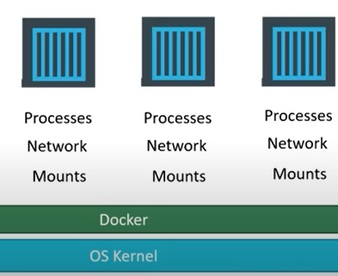
2.2 What is Container?
https://www.youtube.com/watch?v=rmf04ylI2K0&list=PL2We04F3Y_43dAehLMT5GxJhtk3mJtkl5&index=2
What is container?

Slide 13
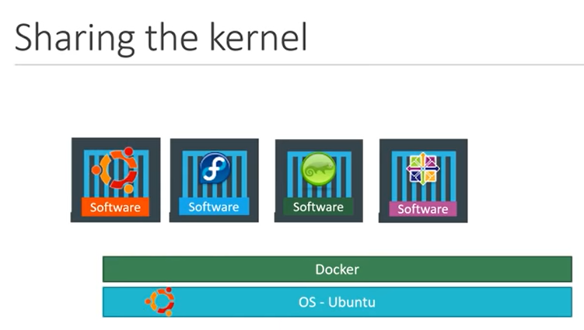
2.2 What is Container?
https://www.youtube.com/watch?v=rmf04ylI2K0&list=PL2We04F3Y_43dAehLMT5GxJhtk3mJtkl5&index=2
What is container?
Docker on window.
Docker on Linux.

Slide 14
2.2 What is Container?
https://www.youtube.com/watch?v=rmf04ylI2K0&list=PL2We04F3Y_43dAehLMT5GxJhtk3mJtkl5&index=2
Docker command:
> docker run ansible
> docker run mongodb
> docker run redis
> docker urn nodejs
> docker urn nodejs
> docker urn nodejs

Slide 15
2.2 What is Container?
https://www.youtube.com/watch?v=rmf04ylI2K0&list=PL2We04F3Y_43dAehLMT5GxJhtk3mJtkl5&index=2
Container vs Image
Image can run as many as they want. Each time instantiate an instance.
Docker Container 1
Docker Image
Docker Container 2
Docker Container 3

Slide 16
2.2 What is Container?
https://www.youtube.com/watch?v=rmf04ylI2K0&list=PL2We04F3Y_43dAehLMT5GxJhtk3mJtkl5&index=2
Container vs Image
Developer generates the image.
The operation team can take the image and test and deploy anywhere.
Developer
Team
Operation Team
Docker Image
Docker Image

Slide 17
2.3 Container vs. Virtual Machine

Slide 18
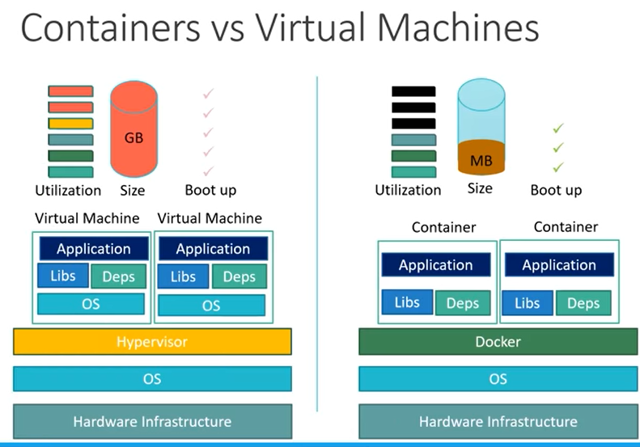
2.3 Container vs. Virtual Machine
https://www.youtube.com/watch?v=rmf04ylI2K0&list=PL2We04F3Y_43dAehLMT5GxJhtk3mJtkl5&index=2
Container vs. Virtual Machine
Container on the right: Less isolation.
Virtual Machine on the left: Take long time to run.

Slide 19
2.4 How is it Done?

Slide 20
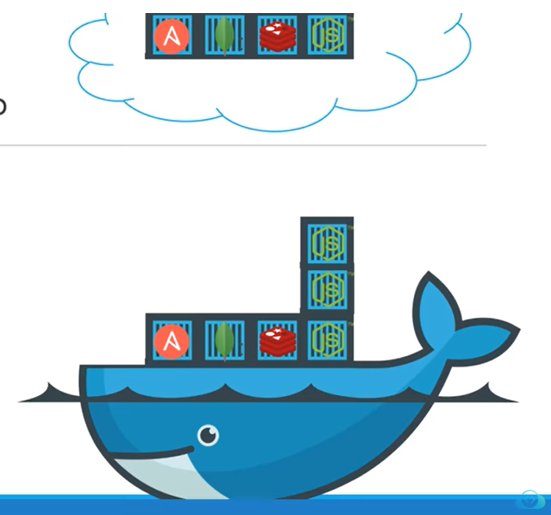
2.4 How is it Done?
https://www.youtube.com/watch?v=rmf04ylI2K0&list=PL2We04F3Y_43dAehLMT5GxJhtk3mJtkl5&index=2
How is it Done?
> docker run ansible
> docker run mongodb
> docker run redis
> docker run nodejs
> docker run nodejs
> docker run nodejs

Slide 21
2.5 Container vs Image

Slide 22
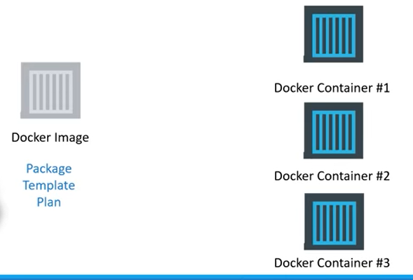
2.5 Container vs Image
https://www.youtube.com/watch?v=rmf04ylI2K0&list=PL2We04F3Y_43dAehLMT5GxJhtk3mJtkl5&index=2
Container vs Image
Image is template
Container is an instance.

Slide 23
2.6 Container Advantage

Slide 24
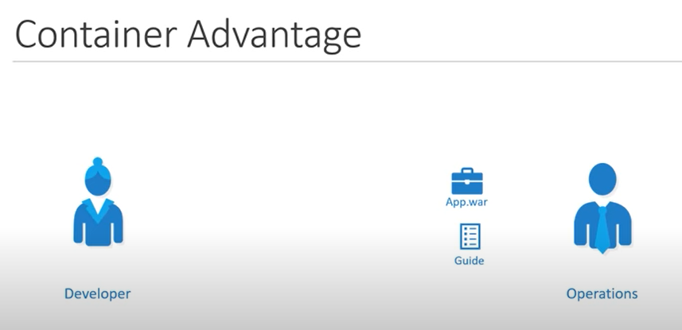
2.6 Container Advantage
https://www.youtube.com/watch?v=rmf04ylI2K0&list=PL2We04F3Y_43dAehLMT5GxJhtk3mJtkl5&index=2
Container Advantage
The old way: developer give and app.war (Web Archive) and guide to the operators (users).
The operations struggle to install and to solve all the issues.

Slide 25
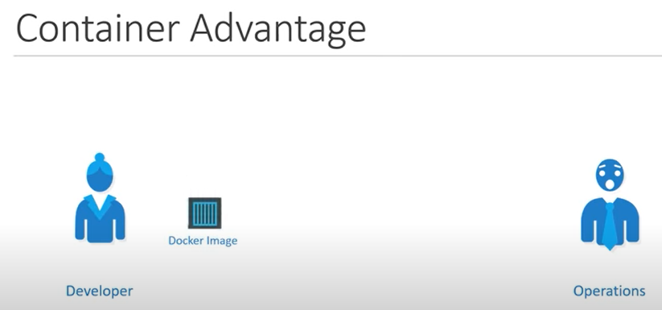
2.6 Container Advantage
https://www.youtube.com/watch?v=rmf04ylI2K0&list=PL2We04F3Y_43dAehLMT5GxJhtk3mJtkl5&index=2
Container Advantage
The new way: developer create app.war (Web Archive) and Dockerfile.
App.war and Dockerfile are combined into an image file for the application.

Slide 26
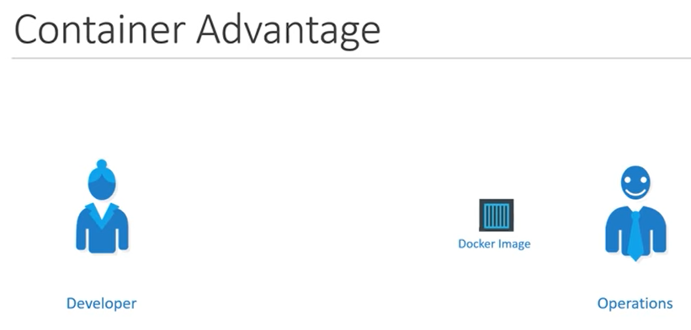
2.6 Container Advantage
https://www.youtube.com/watch?v=rmf04ylI2K0&list=PL2We04F3Y_43dAehLMT5GxJhtk3mJtkl5&index=2
Container Advantage
Any operator (user) can take the image and run without modifying or install anything.

Slide 27
End

