Slide 1
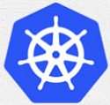
3 Kubernetes Concept
Peter H. Chen

Slide 2
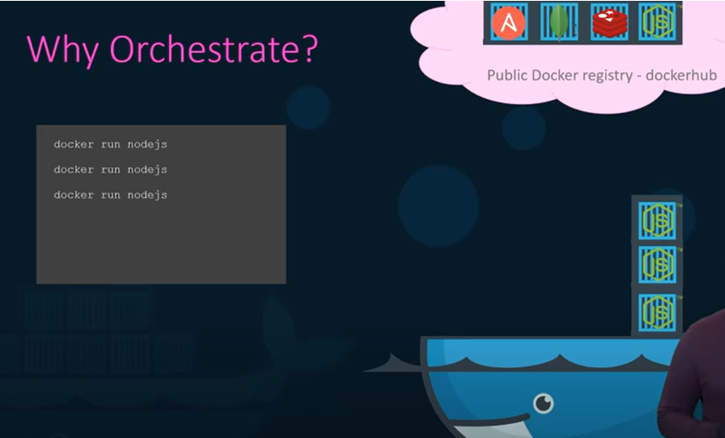
3 Kubernetes Concept
https://www.youtube.com/watch?v=QJ4fODH6DXI&list=PL2We04F3Y_43dAehLMT5GxJhtk3mJtkl5&index=3
Kubernetes Concept
You can run a single instance of application with a simple docker command
> docker run nodejs
When number of users increase and that instance is no loner to handle to load?
You deploy additional instance of your application by running the multiple docker run
> docker run nodejs
> …
> docker run nodejs

Slide 3
3 Kubernetes Concept
https://www.youtube.com/watch?v=QJ4fODH6DXI&list=PL2We04F3Y_43dAehLMT5GxJhtk3mJtkl5&index=3
Kubernetes Concept
You must close watch on the load and performance of your application and deploy additional instances.
Not only that. We must watch the health of these applications.
If the container is failed, we should be able to detect that and run the docker run command again to deploy another instance of that application.

Slide 4
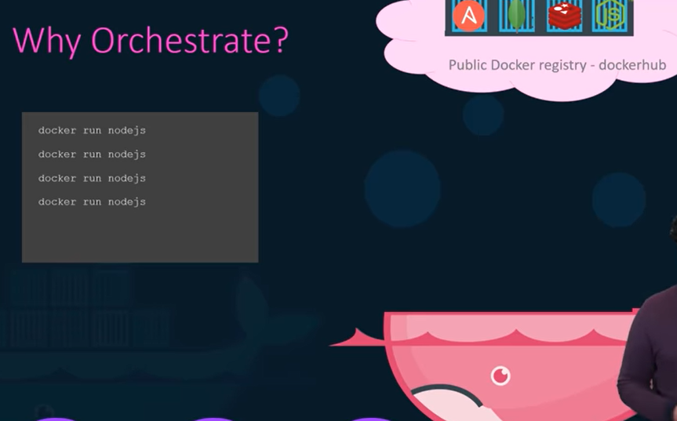
3 Kubernetes Concept
https://www.youtube.com/watch?v=QJ4fODH6DXI&list=PL2We04F3Y_43dAehLMT5GxJhtk3mJtkl5&index=3
Kubernetes Concept
How about the health of the docker host itself?
What if the host crashes and is inaccessible?
The container hosted on that host become inaccessible too.
What do you do in order to solve these issues?
You need a dedicated engineer who can sit and monitor the state performance and health of the containers and take necessary action to remediate the situation.

Slide 5
3 Kubernetes Concept
https://www.youtube.com/watch?v=QJ4fODH6DXI&list=PL2We04F3Y_43dAehLMT5GxJhtk3mJtkl5&index=3
Kubernetes Concept
When you have large applications deployed with tens of thousands of containers.
To have one dedicated engineer to watch the health of each docker run is not a practical approach.
Even you build your own script and that will help you to tackle these issues to some extent.

Slide 6
3.1 Container Orchestration

Slide 7
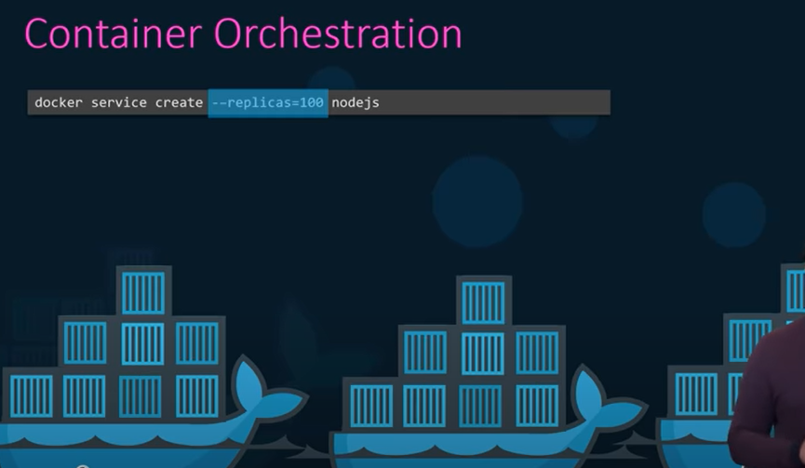
3 3.1 Container Orchestration
https://www.youtube.com/watch?v=QJ4fODH6DXI&list=PL2We04F3Y_43dAehLMT5GxJhtk3mJtkl5&index=3
Container Orchestration
Container orchestration is just a solution for the health of containers host.
It consists a set of tools and scripts that can help host containers in a production environment.
Typically, the container orchestration solution consists of multiple docker hosts that can host containers.
> docker service create --replicas=100 nodejs

Slide 8
3.1 Container Orchestration
https://www.youtube.com/watch?v=QJ4fODH6DXI&list=PL2We04F3Y_43dAehLMT5GxJhtk3mJtkl5&index=3
Container Orchestration
That way, if one fails, the application is still accessible though the others.
Container orchestration solution easily allows you to deploy hundreds of thousands of instances of your application with single commands.
> docker service create --replicas=100 nodejs
This command is for docker swarm.

Slide 9
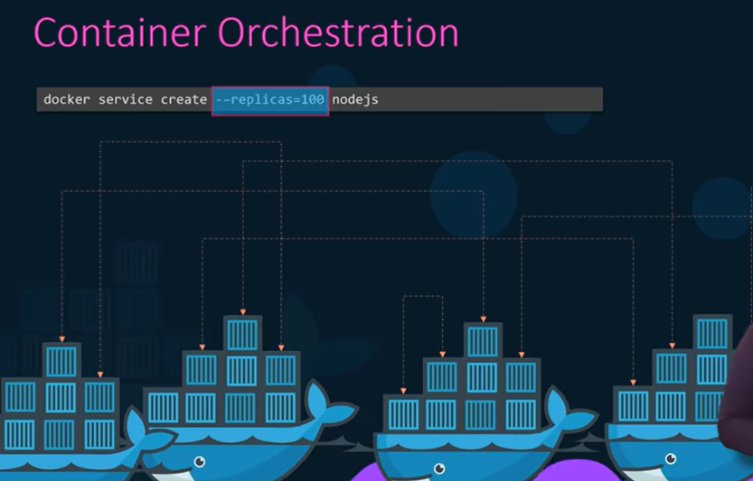
3.1 Container Orchestration
https://www.youtube.com/watch?v=QJ4fODH6DXI&list=PL2We04F3Y_43dAehLMT5GxJhtk3mJtkl5&index=3
Container Orchestration
Some orchestration solutions can help you automatically scale up the number of instances when users increase and scale down the number of instances when the demand decreases.
Some solution can even help you in automatically adding additional hosts to support the user load and not just clustering and scaling.

Slide 10
3.1 Container Orchestration
https://www.youtube.com/watch?v=QJ4fODH6DXI&list=PL2We04F3Y_43dAehLMT5GxJhtk3mJtkl5&index=3
Container Orchestration
The container orchestration solutions also provide for advanced networking between these containers across different hosts as well as load balancing user requests across different host.
They also provide support for sharing storage between host as well as support for configuration management and security within the cluster.

Slide 11
3.2 Container Monitor Solution

Slide 12
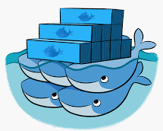

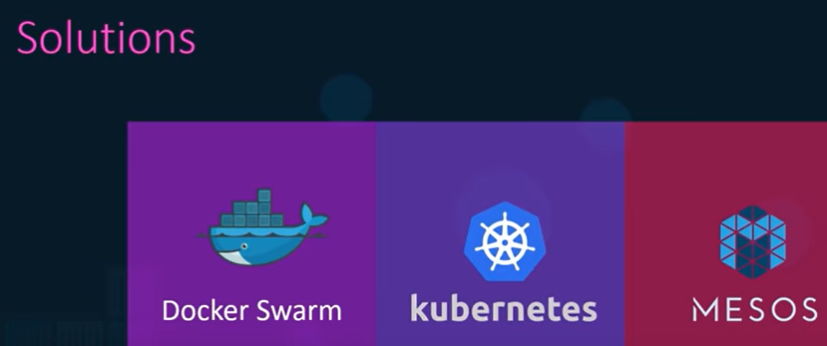
3.2 Container Monitor Solution
https://www.youtube.com/watch?v=QJ4fODH6DXI&list=PL2We04F3Y_43dAehLMT5GxJhtk3mJtkl5&index=3
Container Monitor Solution
There are multiple container orchestration available today.
Docker Swarm
Kubernetes
Apache MESOS

Slide 13
3.2 Container Monitor Solution
https://www.youtube.com/watch?v=QJ4fODH6DXI&list=PL2We04F3Y_43dAehLMT5GxJhtk3mJtkl5&index=3
Container Monitor Solution
Docker has Docker Swarm, Google has Kubernetes, and Apache has MESOS.
Docker Swarm is easy to setup and get started it.
Docker Swarm lacks some of advanced auto scaling features required for complex production grade application.
MESOS, on the other hand, is quite difficult to setup and get started but support many advanced features.
Kubernetes is among the most popular of all, a little bit difficult to set up and get started up but provides a lot of options to customize deployment and support for many different vendors.

Slide 14
3.3 Docker vs. Kubernetes

Slide 15
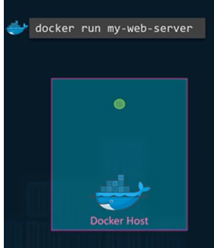
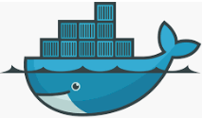
3.3 Docker vs. Kubernetes
https://www.youtube.com/watch?v=QJ4fODH6DXI&list=PL2We04F3Y_43dAehLMT5GxJhtk3mJtkl5&index=3
Docker vs. Kubernetes
Kubernetes is now support on all public cloud service providers, like GCP (Google Cloud Platform), Azure, and AWS.
The Kubernetes project is one of the top ranked projects on GitHub.
With Docker, you can run a single instance of application using docker CLI. By running docker run command:
> docker run my-web-server
Which is great.
Running an application has never been so easy before.
Docker Host

Slide 16
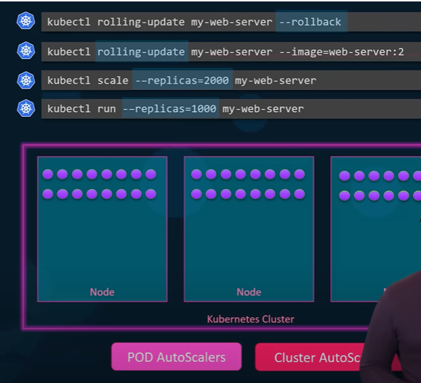
3.3 Docker vs. Kubernetes
https://www.youtube.com/watch?v=QJ4fODH6DXI&list=PL2We04F3Y_43dAehLMT5GxJhtk3mJtkl5&index=3
Docker vs. Kubernetes
With Kubernetes, using the Kubernetes CLI, known as kubeCtl (kube-Control), you can run a 1,000 instances of the same application with a single command.
> kubectl run --replica=1000 my-web-server
…
…
…
Docker Host
Node
Kubernetes Cluster

Slide 17
3.3 Docker vs. Kubernetes
https://www.youtube.com/watch?v=QJ4fODH6DXI&list=PL2We04F3Y_43dAehLMT5GxJhtk3mJtkl5&index=3
Docker vs. Kubernetes
Kubernetes can scale it up to 2,000.
With another command,
> kubectl run --replica=2000 my-web-server

Slide 18
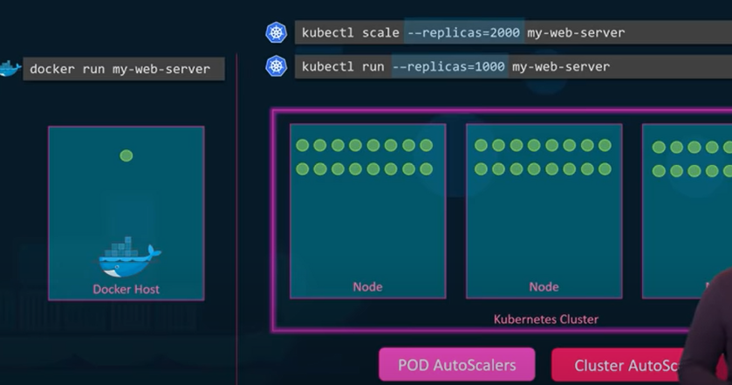
3.3 Docker vs. Kubernetes
https://www.youtube.com/watch?v=QJ4fODH6DXI&list=PL2We04F3Y_43dAehLMT5GxJhtk3mJtkl5&index=3
Docker vs. Kubernetes
Kubernetes can scale it up to 2,000.
With another command,
> kubectl run --replica=2000 my-web-server
…
…
…
…
…
…
…
…
…
Docker Host
Node
Node
Node
Kubernetes Cluster

Slide 19
3.3 Docker vs. Kubernetes
https://www.youtube.com/watch?v=QJ4fODH6DXI&list=PL2We04F3Y_43dAehLMT5GxJhtk3mJtkl5&index=3
Docker vs. Kubernetes
Kubernetes can be even configured to do this automatically so that instances and the infrastructure itself can scale up and down the user load.
Kubernetes can upgrade these 2,000 instances of the application in a rolling upgrade fashion one at time with a single command.
> kubectl rolling-update my-web-server –image-web-server:2

Slide 20
3.3 Docker vs. Kubernetes
https://www.youtube.com/watch?v=QJ4fODH6DXI&list=PL2We04F3Y_43dAehLMT5GxJhtk3mJtkl5&index=3
Docker vs. Kubernetes
We can roll back with
> kubectl rolling-update --rollback

Slide 21
3.3 Docker vs. Kubernetes
https://www.youtube.com/watch?v=QJ4fODH6DXI&list=PL2We04F3Y_43dAehLMT5GxJhtk3mJtkl5&index=3
Docker vs. Kubernetes
> kubectl run --replica=1000 my-web-server
> kubectl run --replica=2000 my-web-server
> docker run my-web-server
…
…
…
…
…
…
…
…
…
Docker Host
Node
Node
Node
Kubernetes Cluster
POD AutoScalers
Cluster AutoScalers

Slide 22
3.3 Docker vs. Kubernetes
https://www.youtube.com/watch?v=QJ4fODH6DXI&list=PL2We04F3Y_43dAehLMT5GxJhtk3mJtkl5&index=3
Docker vs. Kubernetes
If something goes wrong, if can help you to roll back these images with single command
> docker run my-web-server
> kubectl rolling-update my-web-server –image-web-server:2
…
…
…
…
…
…
…
…
…
Docker Host
Node
Node
Node
Kubernetes Cluster
POD AutoScalers
Cluster AutoScalers

Slide 23
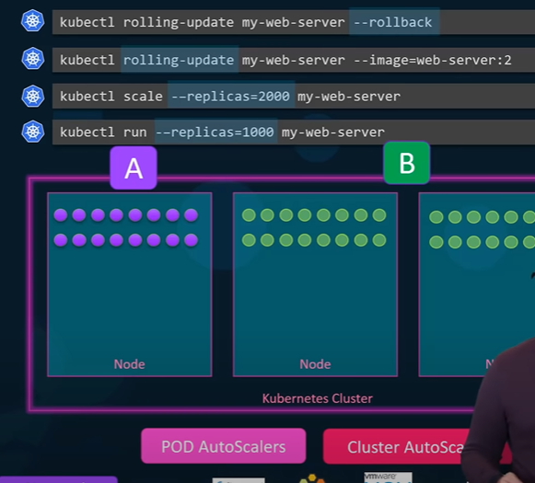
3.3 Docker vs. Kubernetes
https://www.youtube.com/watch?v=QJ4fODH6DXI&list=PL2We04F3Y_43dAehLMT5GxJhtk3mJtkl5&index=3
Docker vs. Kubernetes
Kubernetes can hep you test new features of your application by only upgrading a percentage of these instances through A, B testing methods.
The Kubernetes open architecture provides for many different networks and storage vendors. You can think of a plugin for Kubernetes
> docker run my-web-server
> kubectl rolling-update my-web-server --rollback
…
…
…
…
…
…
…
…
…
A
B
Docker Host
Node
Node
Node
Kubernetes Cluster
POD AutoScalers
Cluster AutoScalers

Slide 24
3.3 Docker vs. Kubernetes
https://www.youtube.com/watch?v=QJ4fODH6DXI&list=PL2We04F3Y_43dAehLMT5GxJhtk3mJtkl5&index=3
Docker vs. Kubernetes
Kubernetes supports a variety of authentication and authorization mechanisms.
All major cloud service providers have native support for Kubernetes.
> docker run my-web-server
> kubectl rolling-update my-web-server --rollback
…
…
…
…
…
…
…
…
…
A
B
Docker Host
Node
Node
Node
Kubernetes Cluster
POD AutoScalers
Cluster AutoScalers

Slide 25
3.4 Relation between Docker and Kubernetes

Slide 26
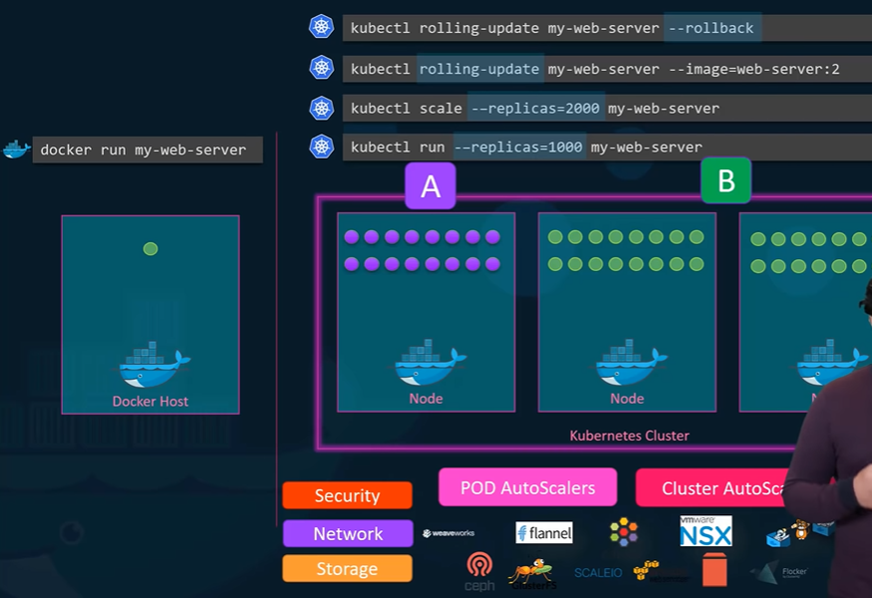
3.4 Relation between Docker and Kubernetes
https://www.youtube.com/watch?v=QJ4fODH6DXI&list=PL2We04F3Y_43dAehLMT5GxJhtk3mJtkl5&index=3
What is Relation between Docker and Kubernetes
Kubernetes use Docker host to host the applications in the form of Docker containers.
> docker run my-web-server
> kubectl rolling-update my-web-server --rollback
…
…
…
…
…
…
…
…
…
A
B
Docker Host
Node
Node
Node
Kubernetes Cluster
Storage
Security
Network
POD AutoScalers
Cluster AutoScalers

Slide 27
3.4 Relation between Docker and Kubernetes
https://www.youtube.com/watch?v=QJ4fODH6DXI&list=PL2We04F3Y_43dAehLMT5GxJhtk3mJtkl5&index=3
What is Relation between Docker and Kubernetes
Kubernetes supports a variety of authentication and authorization mechanism.
All major cloud service provider have native support for Kubernetes.
> docker run my-web-server
> kubectl rolling-update my-web-server --rollback
…
…
…
…
…
…
…
…
…
A
B
Docker Host
Node
Node
Node
Kubernetes Cluster
Storage
Security
Network
POD AutoScalers
Cluster AutoScalers

Slide 28
3.5 Kubernetes Architecture

Slide 29
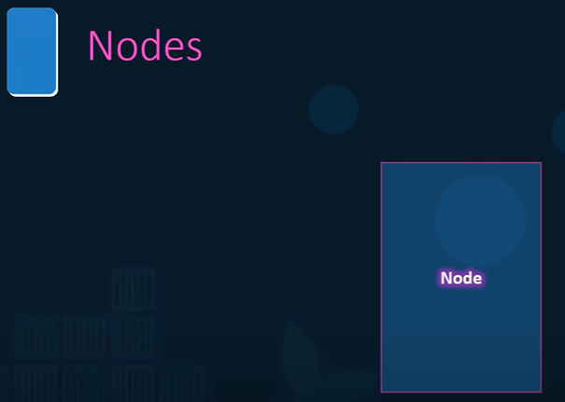

3.5 Kubernetes Architecture
https://www.youtube.com/watch?v=QJ4fODH6DXI&list=PL2We04F3Y_43dAehLMT5GxJhtk3mJtkl5&index=3
Kubernetes Architecture
Let’s quick look at Kubernetes Architecture.
A Kubernetes Cluster consists of a s et of nodes.
Let start with nodes.
Node

Slide 30
3.6 Node

Slide 31
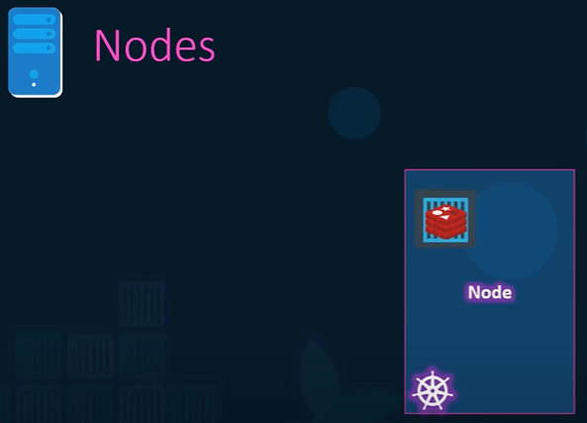
3.6 Node
https://www.youtube.com/watch?v=QJ4fODH6DXI&list=PL2We04F3Y_43dAehLMT5GxJhtk3mJtkl5&index=3
Node
A node is a machine physical or virtual.
On which a Kubernetes software, a set of tools are installed.
A node is a worker machine and that is where the containers will be launched by Kubernetes.
Node

Slide 32
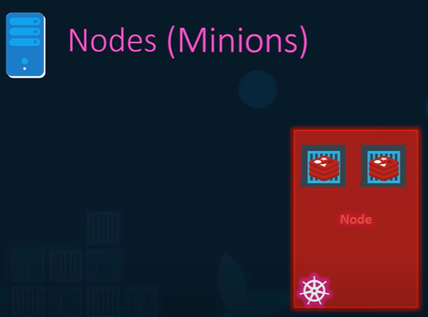
3.6 Node
https://www.youtube.com/watch?v=QJ4fODH6DXI&list=PL2We04F3Y_43dAehLMT5GxJhtk3mJtkl5&index=3
Node
What if the node on which at the application is running fails, i.e., our application goes down.
Node

Slide 33
3.7 Cluster

Slide 34
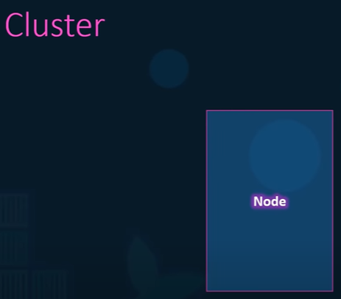
3.7 Cluster
https://www.youtube.com/watch?v=QJ4fODH6DXI&list=PL2We04F3Y_43dAehLMT5GxJhtk3mJtkl5&index=3
Cluster
We need more than one node.
Node
Node
Node

Slide 35
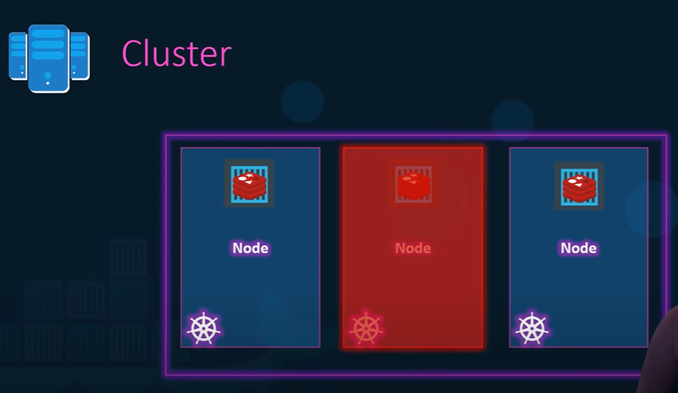
3.7 Cluster
https://www.youtube.com/watch?v=QJ4fODH6DXI&list=PL2We04F3Y_43dAehLMT5GxJhtk3mJtkl5&index=3
Cluster
A cluster is a set of nodes grouped together even if one node fails, you have your application still accessible from the other nodes.
Node
Node
Node

Slide 36
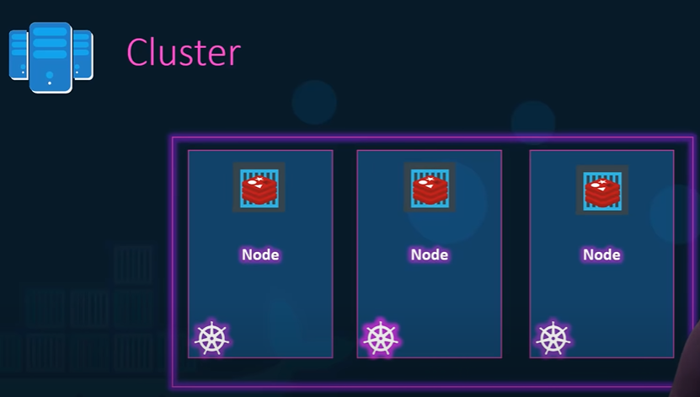
3.7 Cluster
https://www.youtube.com/watch?v=QJ4fODH6DXI&list=PL2We04F3Y_43dAehLMT5GxJhtk3mJtkl5&index=3
Cluster
We have a cluster but who is responsible for managing this cluster.
Where is the information about the members of the cluster stored.
Node
Node
Node

Slide 37
3.7 Cluster
https://www.youtube.com/watch?v=QJ4fODH6DXI&list=PL2We04F3Y_43dAehLMT5GxJhtk3mJtkl5&index=3
Cluster
How are the nodes monitored?
When a node fails, how do you move the workload of the failed nodes to anther worker node?
Node
Node
Node

Slide 38
3.8 Master

Slide 39
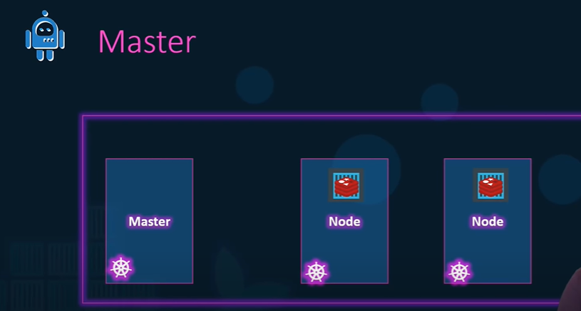
3.8 Master
https://www.youtube.com/watch?v=QJ4fODH6DXI&list=PL2We04F3Y_43dAehLMT5GxJhtk3mJtkl5&index=3
Master
That is the master comes in.
The master is a node with Kubernetes control plain components installed.
Master
Node
Node
Node

Slide 40
3.8 Master
https://www.youtube.com/watch?v=QJ4fODH6DXI&list=PL2We04F3Y_43dAehLMT5GxJhtk3mJtkl5&index=3
Master
The master watches over the nodes in the cluster and is responsible for the actual orchestration of containers on the worker nodes.
Master
Node
Node
Node

Slide 41
3.9 Component

Slide 42
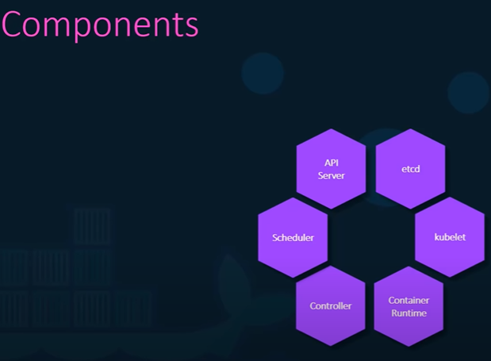
3.9 Component
https://www.youtube.com/watch?v=QJ4fODH6DXI&list=PL2We04F3Y_43dAehLMT5GxJhtk3mJtkl5&index=3
Components
When the install the Kubernetes on the system, you are installing the following components:
An API Server, an etcd server, a kubelet, container runtime engine like docker, a bunch of controller, and the scheduler.
API Server
Scheduler
Container Runtime
etcd
Controller
kubelet

Slide 43
3.10 API Server

Slide 44
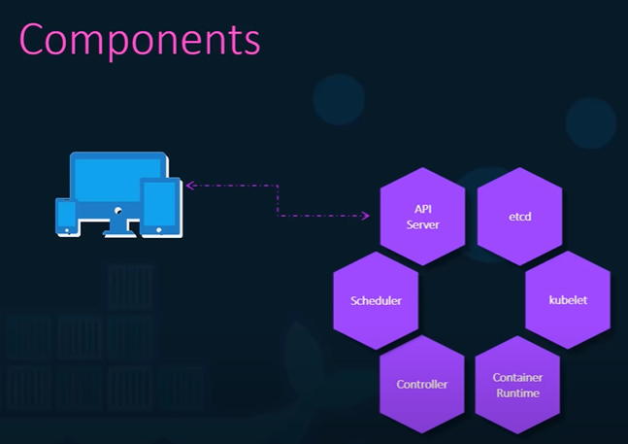
3.10 API Server
https://www.youtube.com/watch?v=QJ4fODH6DXI&list=PL2We04F3Y_43dAehLMT5GxJhtk3mJtkl5&index=3
API Server
The API server acts as the front end for Kubernetes, the user management devices command line interfaces all talk to API server, interact with the Kubernetes cluster.
API Server
Scheduler
Container Runtime
etcd
Controller
kubelet

Slide 45
3.11 etcd

Slide 46
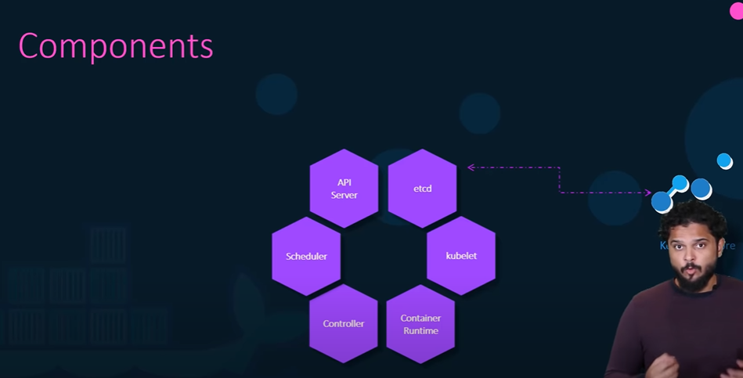
3.11 etcd
https://www.youtube.com/watch?v=QJ4fODH6DXI&list=PL2We04F3Y_43dAehLMT5GxJhtk3mJtkl5&index=3
etcd
Next is etcd key value store.
The etcd is a distributed reliable key value stored by Kubernetes to store all data used to manage the cluster.
Think this way, when you have multiple nodes and multiple masters in your cluster, the etcd stores all that information on all the nodes in the cluster in a distributed manner.
The etcd is responsible for implementing logs within the cluster to ensure there is no conflict between the masters.
API Server
Scheduler
Container Runtime
etcd
Controller
kubelet

Slide 47
3.12 Scheduler

Slide 48
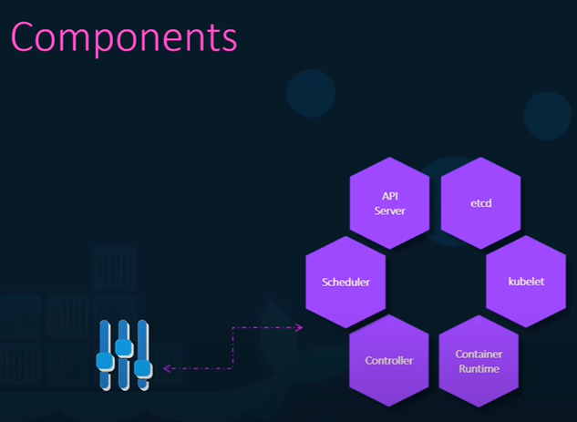
3.12 Scheduler
https://www.youtube.com/watch?v=QJ4fODH6DXI&list=PL2We04F3Y_43dAehLMT5GxJhtk3mJtkl5&index=3
Scheduler
The scheduler is responsible for distributing work or containers across multiple nodes.
The scheduler looks for newly created containers assigns them to nodes.
API Server
Scheduler
Container Runtime
etcd
Controller
kubelet

Slide 49
3.13 Controller

Slide 50
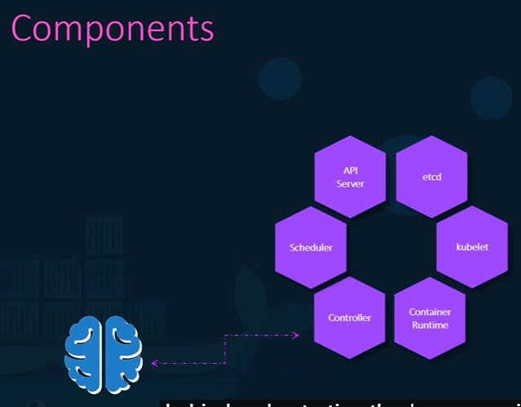
3.13 Controller
https://www.youtube.com/watch?v=QJ4fODH6DXI&list=PL2We04F3Y_43dAehLMT5GxJhtk3mJtkl5&index=3
Controller
The controller are the brain behind orchestration.
The controller are responsible for noticing and responding when nodes containers or endpoint goes down.
The controller makes decisions to bring up new containers in such cases.
API Server
Scheduler
Container Runtime
etcd
Controller
kubelet

Slide 51
3.14 Container Runtime

Slide 52
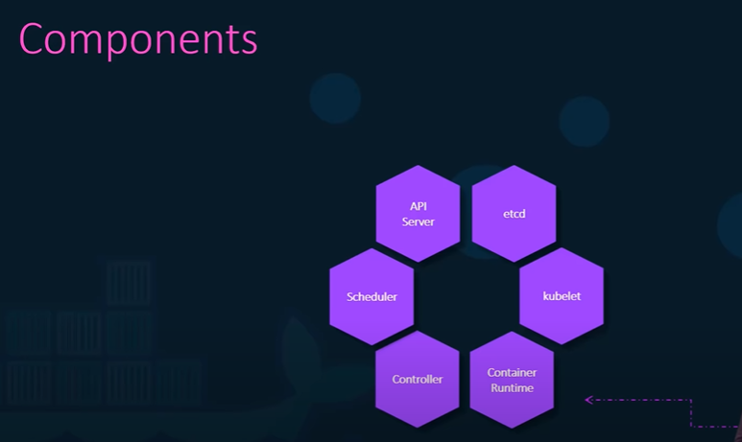
3.14 Container Runtime
https://www.youtube.com/watch?v=QJ4fODH6DXI&list=PL2We04F3Y_43dAehLMT5GxJhtk3mJtkl5&index=3
Container Runtime
The container runtime is underlying software that we used to run containers.
In our case, the container runtime happens to be docker.
API Server
Scheduler
Container Runtime
etcd
Controller
kubelet

Slide 53
3.15 Kubelet

Slide 54
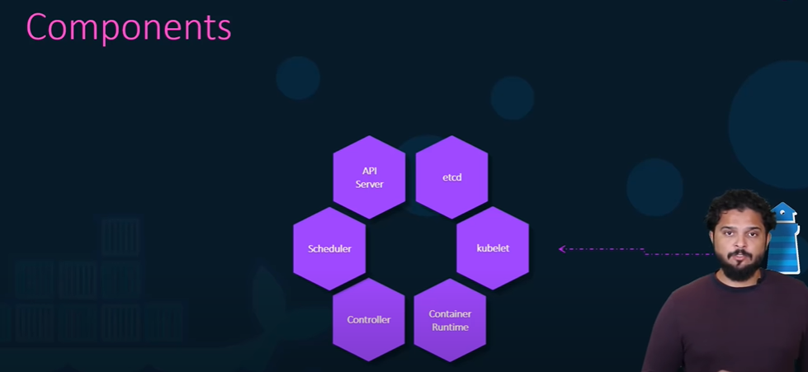
3.15 Kubelet
https://www.youtube.com/watch?v=QJ4fODH6DXI&list=PL2We04F3Y_43dAehLMT5GxJhtk3mJtkl5&index=3
Kubelet
Finally, the kubelet is the agent that runs on each node in the cluster.
The agent is responsible for making sure that a containers are running on the nodes as expected.
API Server
Scheduler
Container Runtime
etcd
Controller
kubelet

Slide 55
3.16 Kubectl

Slide 56
3.16 Kubectl
https://www.youtube.com/watch?v=QJ4fODH6DXI&list=PL2We04F3Y_43dAehLMT5GxJhtk3mJtkl5&index=3
Kubectl
We want to know about one of the command-line utilities known as kubectl or kube-control tool.
The kubectl tool is the Kubernetes CLI which is used to deploy and manage application on a Kubernetes cluster to get cluster related information, the statis with the node in the cluster and many other things.

Slide 57
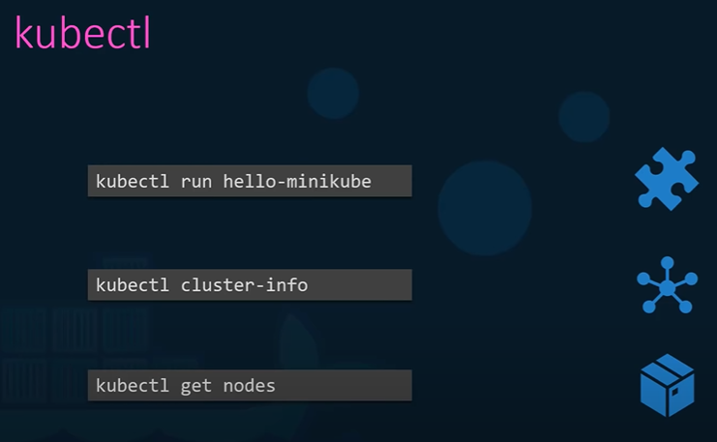
3.16 Kubectl
https://www.youtube.com/watch?v=QJ4fODH6DXI&list=PL2We04F3Y_43dAehLMT5GxJhtk3mJtkl5&index=3
Kubectl
The kubectl command:
> kubctl run hello-minikube
Is used to deploy an application on the cluster.
The kubectl command:
> kubectl cluster-info
Is used to view information about the cluster.
The kubectl command:
> kubectl get nodes
Is used to list all the nodes in the cluster.

Slide 58
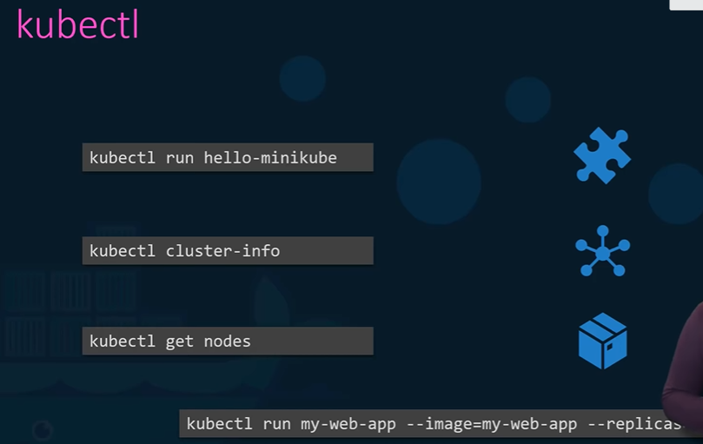
3.5 Kubernetes Architecture
https://www.youtube.com/watch?v=QJ4fODH6DXI&list=PL2We04F3Y_43dAehLMT5GxJhtk3mJtkl5&index=3
Kubectl
To run hundreds of instances of your application across hundreds of node, all we need a single Kubernetes command:
> kubectl run my-web-app --image=my-web-app --replicas=100

Slide 59
End of Chapter

