Slide 1
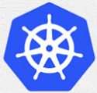
5 Kubeadm Introduction
Peter H. Chen

Slide 2
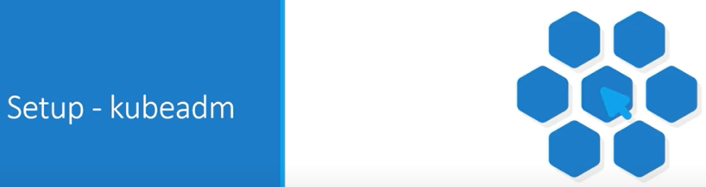
5 Kubeadm Introduction
https://www.youtube.com/watch?v=Aw01Wtx104U&list=PL2We04F3Y_43dAehLMT5GxJhtk3mJtkl5&index=5
Kubeadm Introduction
We discuss kubeadm tool which can be used to bootstrap a Kubernetes cluster.

Slide 3
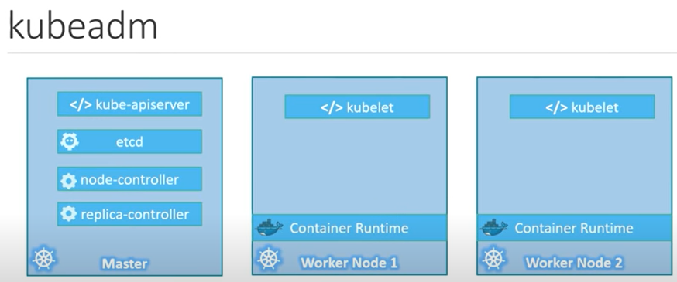
5 Kubeadm Introduction
https://www.youtube.com/watch?v=Aw01Wtx104U&list=PL2We04F3Y_43dAehLMT5GxJhtk3mJtkl5&index=5
Kubeadm Introduction
With the minikube utility, we can only setup a single node Kubernetes cluster.
The kubeadm tool helps us setup a multi-node cluster with master and workers on separate machines.
Installing all these various components individually on different nodes and modifying the configuration files to make it works is a tedious tasks.

Slide 4
5 Kubeadm Introduction
https://www.youtube.com/watch?v=Aw01Wtx104U&list=PL2We04F3Y_43dAehLMT5GxJhtk3mJtkl5&index=5
Kubeadm Introduction
Kubeadm tool helps us in doing all of that very easily in an automated fashion.

Slide 5
5 Steps
https://www.youtube.com/watch?v=Aw01Wtx104U&list=PL2We04F3Y_43dAehLMT5GxJhtk3mJtkl5&index=5
Steps
Before we head into the detailed discussion, it is good to understand how the whole process works.
Let’s go through the 5 steps for Kubernetes installation.
We go through the steps one by one.

Slide 6
5.1 Step 1

Slide 7
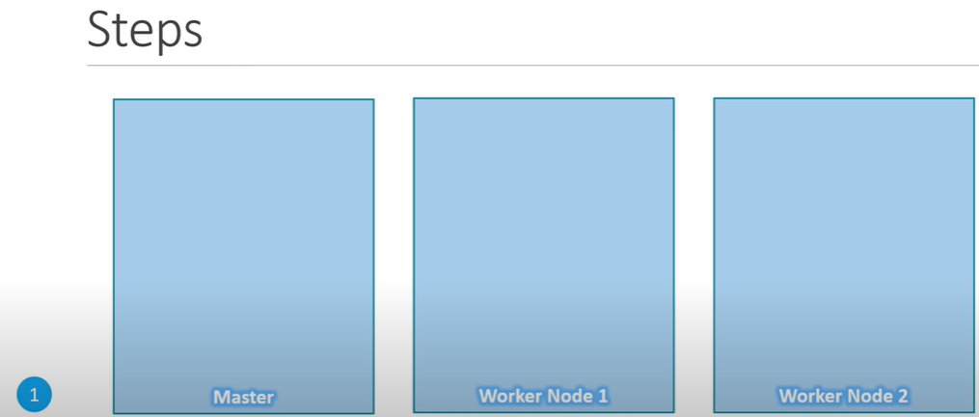
5.1 Step 1
https://www.youtube.com/watch?v=Aw01Wtx104U&list=PL2We04F3Y_43dAehLMT5GxJhtk3mJtkl5&index=5
Steps 1
First step: we must have multiple systems or virtual machines created for configuring a cluster.
We will see how to setup the laptops.
The systems are created designate one as master and others are workers nodes.

Slide 8
5.2 Step 2

Slide 9
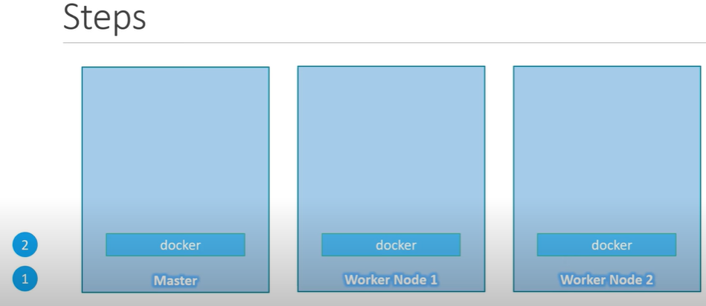
5.2 Step 2
https://www.youtube.com/watch?v=Aw01Wtx104U&list=PL2We04F3Y_43dAehLMT5GxJhtk3mJtkl5&index=5
Step 2
Second step: Install a container runtime on the host so that we can run containers on these hosts.
We will be using docker. So, we must install docker.

Slide 10
5.3 Step 3

Slide 11
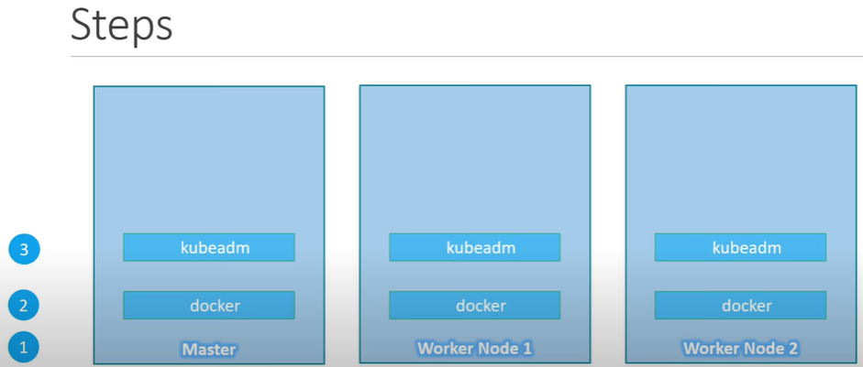
5.3 Step 3
https://www.youtube.com/watch?v=Aw01Wtx104U&list=PL2We04F3Y_43dAehLMT5GxJhtk3mJtkl5&index=5
Step 3
Third step: Install kubeadm tool on all the nodes.
The kubeadm tool helps us bootstrap the Kubernetes solution by installing and configuring all the required components in the right nodes.

Slide 12
5.4 Step 4

Slide 13
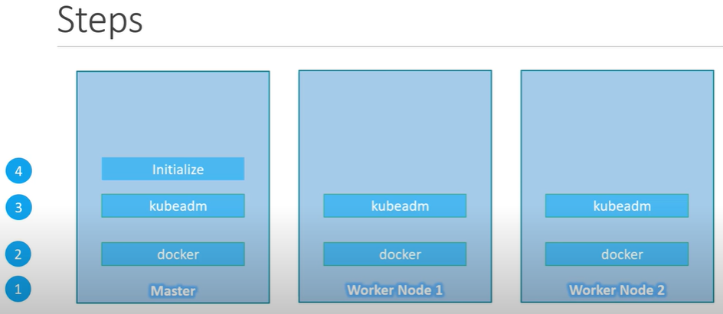
5.4 Step 4
https://www.youtube.com/watch?v=Aw01Wtx104U&list=PL2We04F3Y_43dAehLMT5GxJhtk3mJtkl5&index=5
Step 4
Fourth Step: Initialize the master server during the process.
All the required components are installed and configured on the master server.
That way, we can start the cluster level configurations from the master server.
Once the master server is initialized and

Slide 14
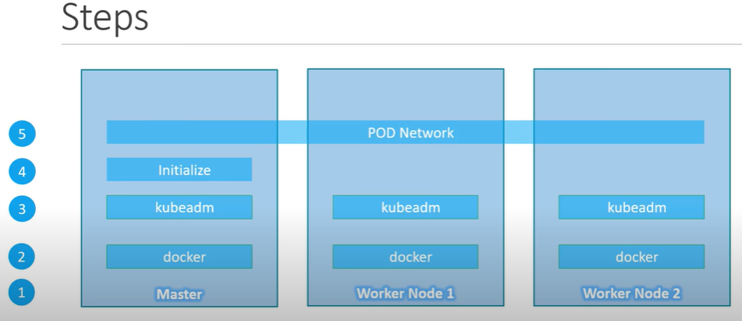
5.4 Step 4
https://www.youtube.com/watch?v=Aw01Wtx104U&list=PL2We04F3Y_43dAehLMT5GxJhtk3mJtkl5&index=5
Step 4
Kubernetes requires a special network between a master and worker nodes which is called as a pod network or a cluster network.
We will be discussing in the networking section later.
For now, we will follow the instructions available to get his installed and set up in our environment.

Slide 15
5.5 Step 5

Slide 16
5.5 Step 5
https://www.youtube.com/watch?v=Aw01Wtx104U&list=PL2We04F3Y_43dAehLMT5GxJhtk3mJtkl5&index=5
Step 5 (2:41/4:13)
Fifth step: Join the worker nodes to the mast node.
We are all set to launch out application in Kubernetes.

Slide 17
5.6 Kubeadm

Slide 18

5.6 Kubeadm
https://www.youtube.com/watch?v=Aw01Wtx104U&list=PL2We04F3Y_43dAehLMT5GxJhtk3mJtkl5&index=5
Kubeadm (2:51/4:13)
Now, we Kubeadm Introduction using the kubeadm tool in our local environment.
This installation is divided into multiple parts.
In the first section, we will setup the basic Kubernetes in our laptop using a virtualization technology.

Slide 19
5.6 Kubeadm
https://www.youtube.com/watch?v=Aw01Wtx104U&list=PL2We04F3Y_43dAehLMT5GxJhtk3mJtkl5&index=5
Kubeadm Introduction with Kubeadm (3:00/4:13)
In our example, we are going to use VirtualBox. We need three virtual machines running Ubuntu.
The three virtual machines need to have their own IP addresses, have their unique host names, and they are port of the same network so that they can communicate with each other.
We have three sections of setup demos.
The first section is to setup a basic lab environments.
The first section is for beginner.

Slide 20
Kubeadm
https://www.youtube.com/watch?v=Aw01Wtx104U&list=PL2We04F3Y_43dAehLMT5GxJhtk3mJtkl5&index=5
Kubeadm (4:04/4:13)
Once we finished the first section, we will use Kubeadm tool to setup and configure Kubernetes on that.

Slide 21
End

